Slide 1
Yilin Wang Dec.12nd 2025
Group Meeting
Notes and Thoughts

Slide 2
Agenda
202607

Slide 3
Agenda
202607

Slide 4
Neural Orientated Problem
LR4

Slide 5


Yilin Wang: wang4517@purdue.edu Yiheng Feng*: feng333@purdue.edu
Acknowledgement
Thanks for Listening!
Q & A

Slide 6

Case Study
Toy Network
Network Configuration
CTM evaluation
Result & Analysis
Conclusion
Toy network analysis
25
$c\left(i,t\right)=\left(i+t+2\right)\%4+1$
1
2
3
Veh_1: 25-26, t=0 |route: 25-1-2-3-22-23-24-26. Time: 0-4-8-9-12-13-16-19
Veh_2: 25-26, t=1 |route: 25-1-2-19-20-9-24-26. Time: 1-2-4-5-8-11-14-15
Veh_3: 25-26, t=2 |route: 25-1-2-3-22-23-24-26. Time: 2-4-8-9-12-13-16-19
Veh_4: 25-26, t=3 |route: 25-13-4-5-20-9-24-26. Time: 3-6-8-11-14-15-18-19
13
16
19
22
4
5
6
14
17
20
23
7
8
9
15
18
21
24
10
11
12
26
Figure 2: A 3x3 toy network

Slide 7
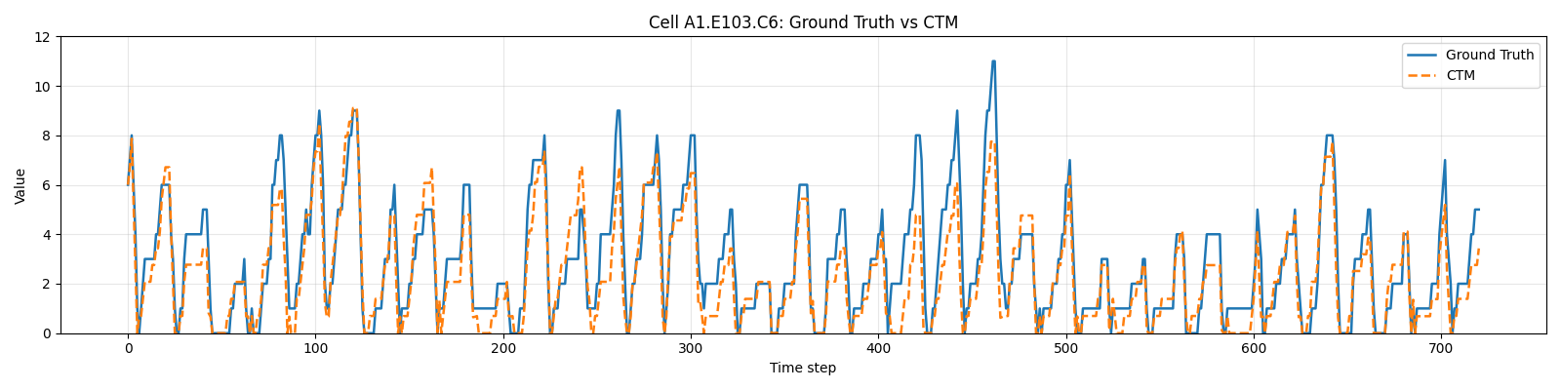
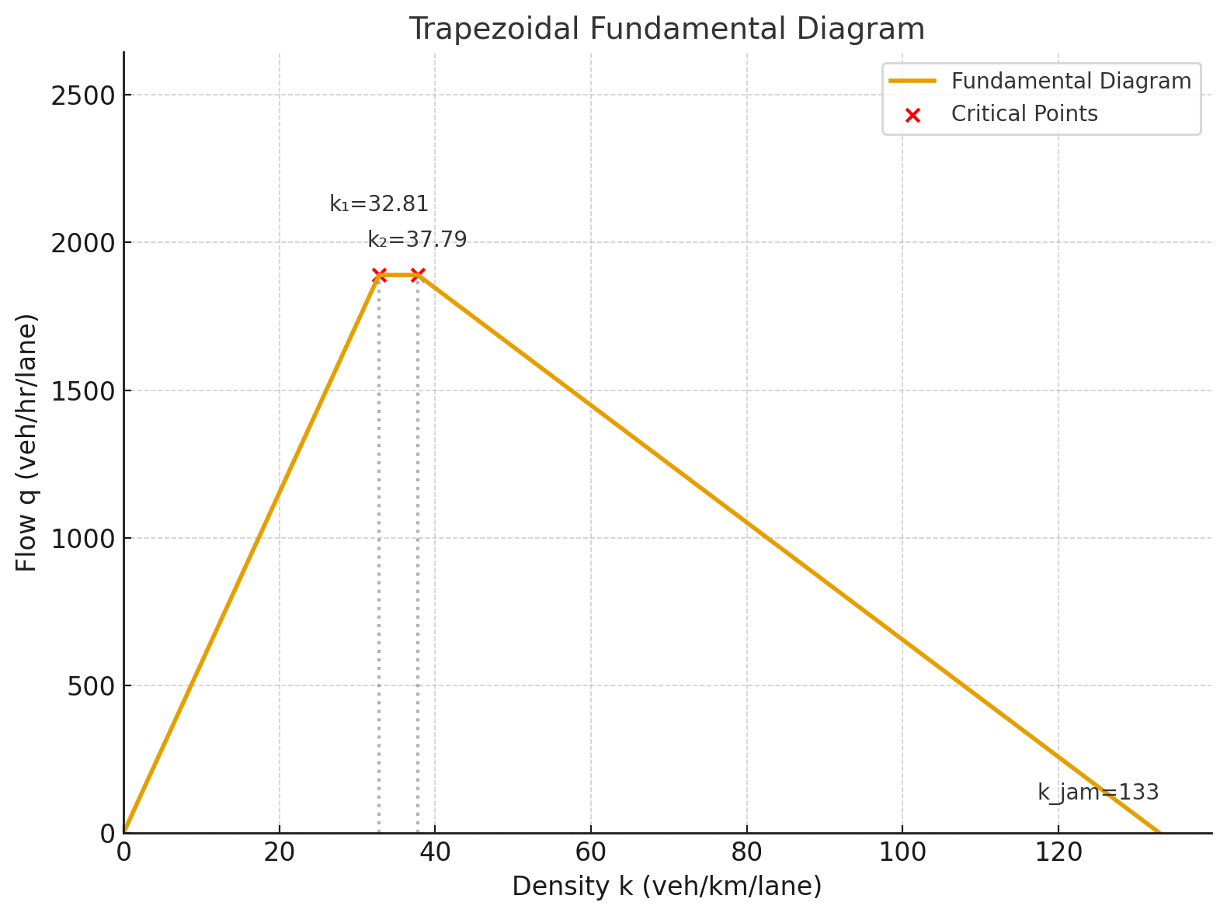
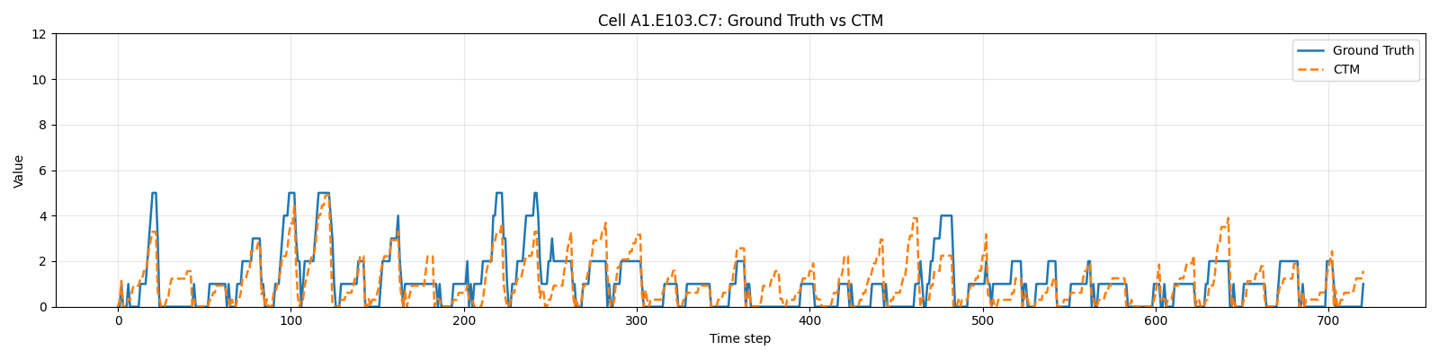
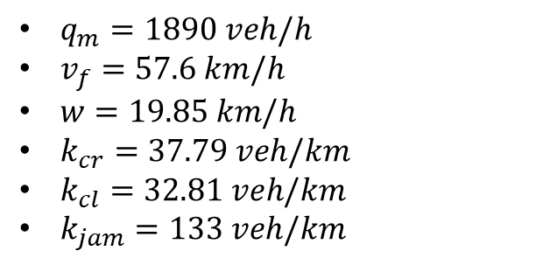
Case Study
Toy Network
Network Configuration
CTM evaluation
Result & Analysis
Conclusion
CTM Calibration
$q_{m}=1890 veh/h$
$v_{f}=57.6 km/h$
$w=19.85 km/h$
$k_{cr}=37.79 veh/km$
$k_{cl}=32.81 veh/km$
$k_{jam}=133 veh/km$
MAE 0.61 veh/cell/step

Slide 8











Methodology
Overview
Cell Transmission Model
Travel Cost Prediction
D-VRP & Coverage Optimization
Normal cells
$$Q_{i−1}(t), N_{i−1}(t)$$
$$Q_{i}(t), N_{i}(t)$$
$$Q_{i+1}(t), N_{i+1}(t)$$
$$n_{i−1}(t)$$
$$y_{i−1, i}(t)$$
$$n_{i}(t)$$
$$n_{i+1}(t)$$
$$y_{i, i+1}(t)$$
For normal cell
$n_{i}(t+1)$= $n_{i}\left(t\right)+y_{i−1, i}\left(t\right)−y_{i, i+1}\left(t\right)$
For sink cell
$n_{i}(t+1)$= $n_{i}\left(t\right)+y_{i−1, i}\left(t\right)$
For source cell
$n_{i}(t+1)$= $n_{i}\left(t\right)+d_{i}\left(t\right)−y_{i,i+1}\left(t\right)$
[1] Daganzo, Carlos F. "The cell transmission model, part II: network traffic." Transportation Research Part B: Methodological 29.2 (1995): 79-93.

Slide 9
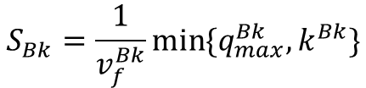


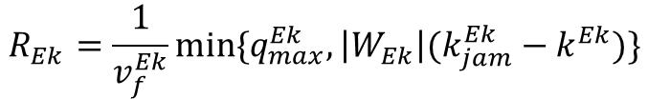


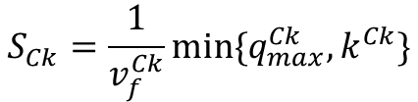






Methodology
Overview
Cell Transmission Model
Travel Cost Prediction
D-VRP & Coverage Optimization
Merging cells
$$R_{Ek}=\frac{1}{v_{f}^{Ek}}min⁡\{q_{max}^{Ek},\left|W_{Ek}\right|(k_{jam}^{Ek}−k^{Ek})\}$$
$$Bk$$
$$y_{bk}$$
$$Ek$$
$$S_{Bk}=\frac{1}{v_{f}^{Bk}}min⁡\{q_{max}^{Bk},k^{Bk}\}$$
$$Ck$$
$$y_{ck}$$
$$S_{Ck}=\frac{1}{v_{f}^{Ck}}min⁡\{q_{max}^{Ck},k^{Ck}\}$$
I: if $R_{Ek}≥S_{Bk}$+ $S_{Ck}$ (no oversaturation)
$$y_{bk}=S_{Bk}$$
$$y_{ck}=S_{Ck}$$
II: if $R_{Ek}<S_{Bk}$+ $S_{Ck}$ (downstream oversaturation)
$$y_{bk}=mid\{S_{Bk},R_{Ek}−S_{Ck},{p_{bk}R}_{Ek}\}$$
$p_{bk}+p_{ck}=1$
$$y_{ck}=mid\{S_{Ck},R_{Ek}−S_{Bk},{p_{ck}R}_{Ek}\}$$
[1] Daganzo, Carlos F. "The cell transmission model, part II: network traffic." Transportation Research Part B: Methodological 29.2 (1995): 79-93.

Slide 10






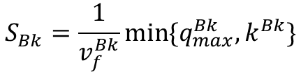


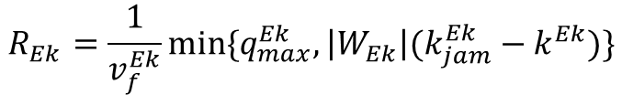

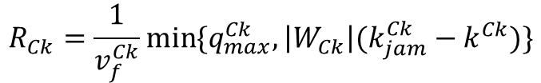

Methodology
Overview
Cell Transmission Model
Travel Cost Prediction
D-VRP & Coverage Optimization
Diverging cells
if Cell Bk is intersection cells
$$y_{ck}$$
$$Ck$$
$$y_{bk}=min⁡\{S_{Bk},\frac{R_{Ck}}{p_{ck}}, \frac{R_{Ek}}{p_{ek}}\}$$
$$Bk$$
$$y_{ek}$$
$$Ek$$
$p_{ck}+p_{ek}=1$
$$y_{bk}=y_{ck}+y_{ek}=p_{ck}y_{bk}+p_{ek}y_{bk}$$
$$R_{Ck}=\frac{1}{v_{f}^{Ck}}min⁡\{q_{max}^{Ck},\left|W_{Ck}\right|(k_{jam}^{Ck}−k^{Ck})\}$$
if Cell Bk is link-diverge cells
$$R_{Ek}=\frac{1}{v_{f}^{Ek}}min⁡\{q_{max}^{Ek},\left|W_{Ek}\right|(k_{jam}^{Ek}−k^{Ek})\}$$
$$y_{bk}=y_{ck}+y_{ek}$$
$$y_{ck}=min⁡\{p_{ck}S_{Bk},R_{Ck}\}$$
$$S_{Bk}=\frac{1}{v_{f}^{Bk}}min⁡\{q_{max}^{Bk},k^{Bk}\}$$
$$y_{ek}=min⁡\{p_{ek}S_{Bk},R_{Ek}\}$$
[1] Daganzo, Carlos F. "The cell transmission model, part II: network traffic." Transportation Research Part B: Methodological 29.2 (1995): 79-93.

