Slide 1
Yilin Wang Aug 2026
Learning to Route for Sensing Coverage
A neural amortized solver trained on Gurobi labels — methodology

Slide 2
Agenda
• Problem: fleet sensing-coverage routing on a fixed network
• Pipeline: offline label farm → supervised training → millisecond inference
• Network & instance definition (bidirectional 4×4, 8 gates, 56 ODs)
• Model architecture & the feasibility mask
• Training recipe: data generation + teacher forcing
• Evidence so far (3×3 / 4×4) · extension-1 evaluation design [results pending]
202608

Slide 3
Methodology
Problem
• One case (an 'operating day'): congestion δ ∈ {0,1}^80 per directed link · V vehicles · per-vehicle task (origin gate, destination gate, departure t0)
• Vehicles run SIMULTANEOUSLY on one timeline; entering link i at time t occupies cells (i, t … t+c−1), travel time c(i,t) = (base(i)+t)//4 + 1 + δᵢ (street-symmetric base)
• Objective (identical to the Gurobi MILP): min [ α₁·total_cost − α₂·fleet_coverage ] / (V·H), α = 0.3 / 0.7
• coverage = |union of occupied (link, time) cells| — overlap counts once; horizon H = 338 is the per-vehicle budget
• Taxonomy: team-orienteering-type (selective, max-utility, budget) — NOT visit-all min-cost CVRP

Slide 4
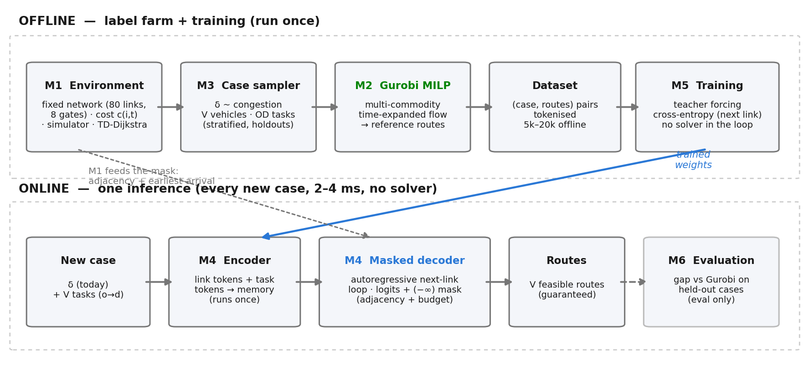
Methodology
Pipeline
• Gurobi = the only solution source (offline labels); the trained model replaces per-case solving at deployment — 2–4 ms, no solver calls

Slide 5
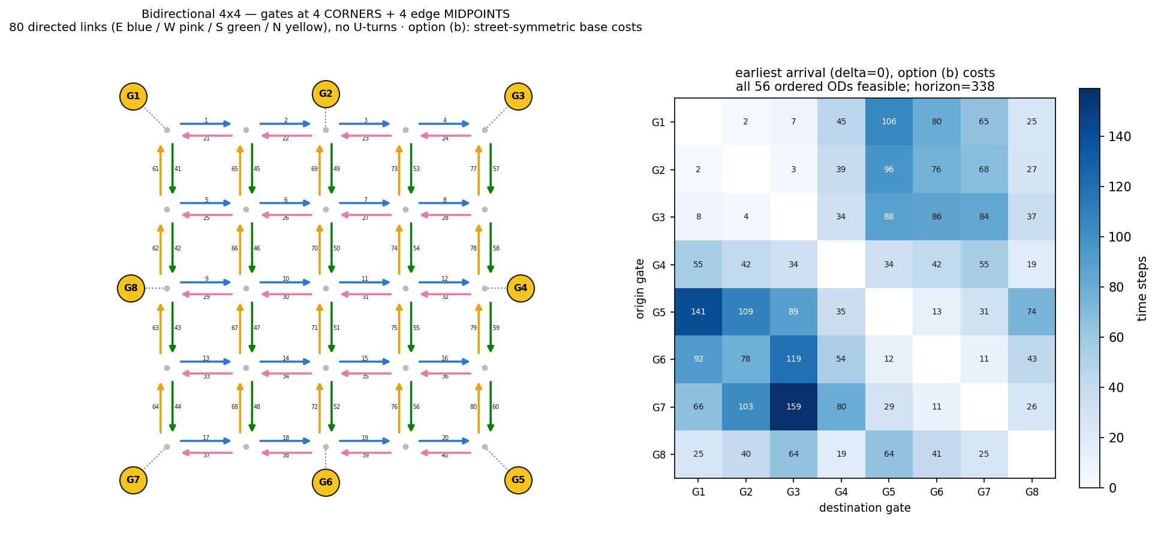
Methodology
Network
• Bidirectional 4×4: 80 directed links, no U-turns · 8 gates (4 corners + 4 midpoints) · all 56 ordered ODs feasible (heatmap) · horizon 338

Slide 6
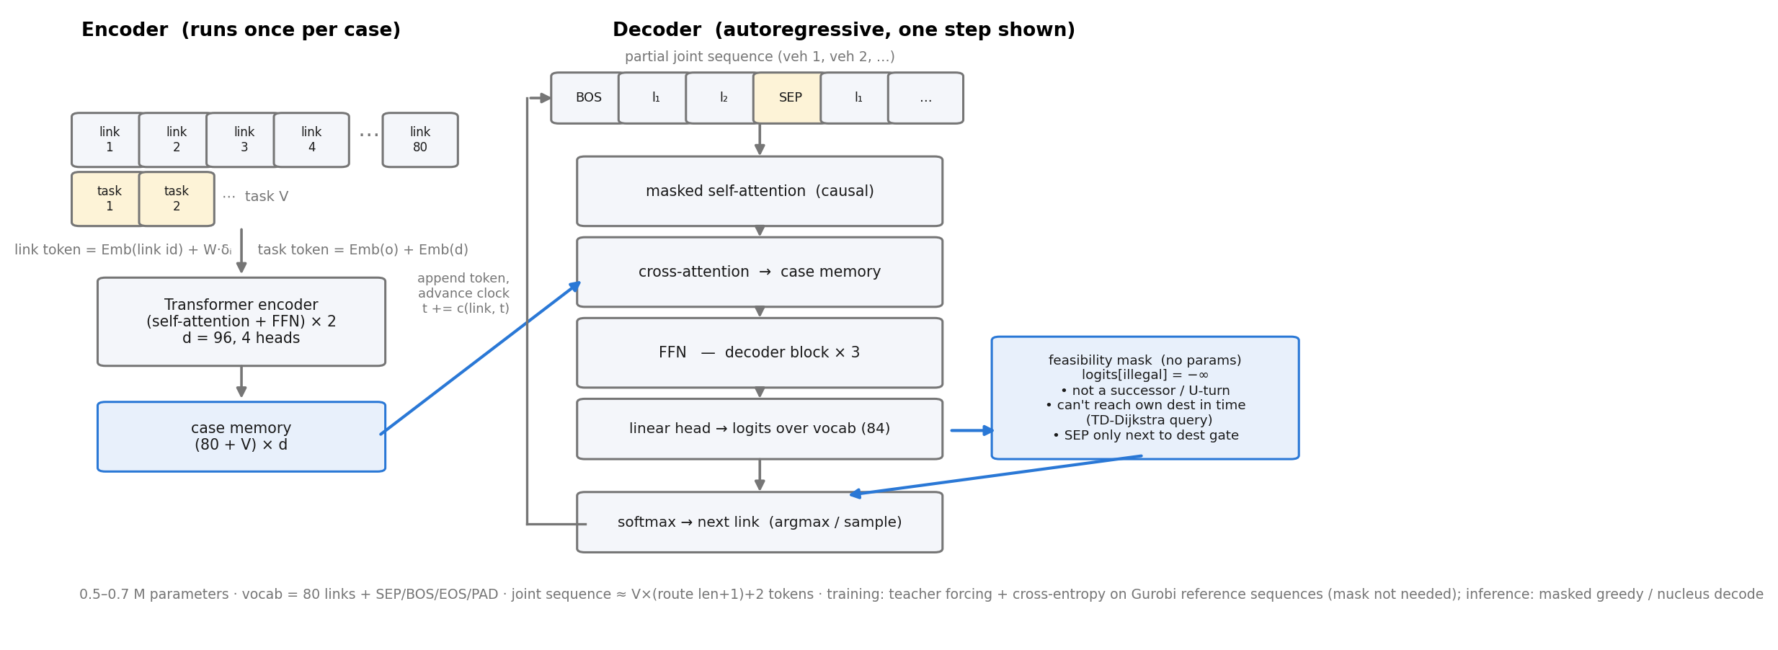
Methodology
Model

Slide 7
Methodology
Feasibility mask
• Three lines between logits and softmax: logits[illegal] = −∞ → illegal probability is EXACTLY zero (grammar-constrained decoding)
– not a successor of the current link / U-turn (road topology)
– cannot reach THIS vehicle's destination gate within the horizon (time-dependent Dijkstra query)
– SEP only when adjacent to own destination; EOS only after V SEPs
• No parameters — rules guarantee feasibility; the network only ranks legal moves (learned from Gurobi)
• Standard in the literature: Kool AM §3 (u=−∞; OP budget rule) · MTPOMO Eq.10 · FM-MCVRP §4.2 (softmax(G·Wo+M)) · TOP-Former Eq.18
• Measured necessity: adjacency-only mask → 10/200 horizon-infeasible decodes; + budget mask → 200/200 feasible

Slide 8
Methodology
Training
• Data (offline label farm, resumable + watchdog-supervised):
– δ ~ iid{0,1}^80 · V ∈ {2,3,4,6} · OD stratified by difficulty terciles (earliest-arrival matrix) · t0 ∈ {0..5}
– labels: multi-commodity time-expanded flow MILP (Gurobi, MIPGap 2%, 60 s cap) — validated vs min-time bound, decomposition-consistent
– 5000 train + 500 test + 300 OD-zero-shot (4 held-out ODs) + 300 fleet-extrapolation (V ∈ {5,8})
• Objective design note: coverage normalized by V·H with α 0.3/0.7 — otherwise optima collapse to min-time routes (no sensing behavior to learn)
• Training: teacher forcing, next-link cross-entropy (PAD ignored); no solver and no generation inside the training loop; AdamW, batch 64
• Model selection: per-epoch MASKED GREEDY generation on validation cases — select on true objective gap, not on CE loss
• Data-volume policy: nested 1k/2k/5k slope experiment; extend the resumable farm only if the curve is still steep

Slide 9
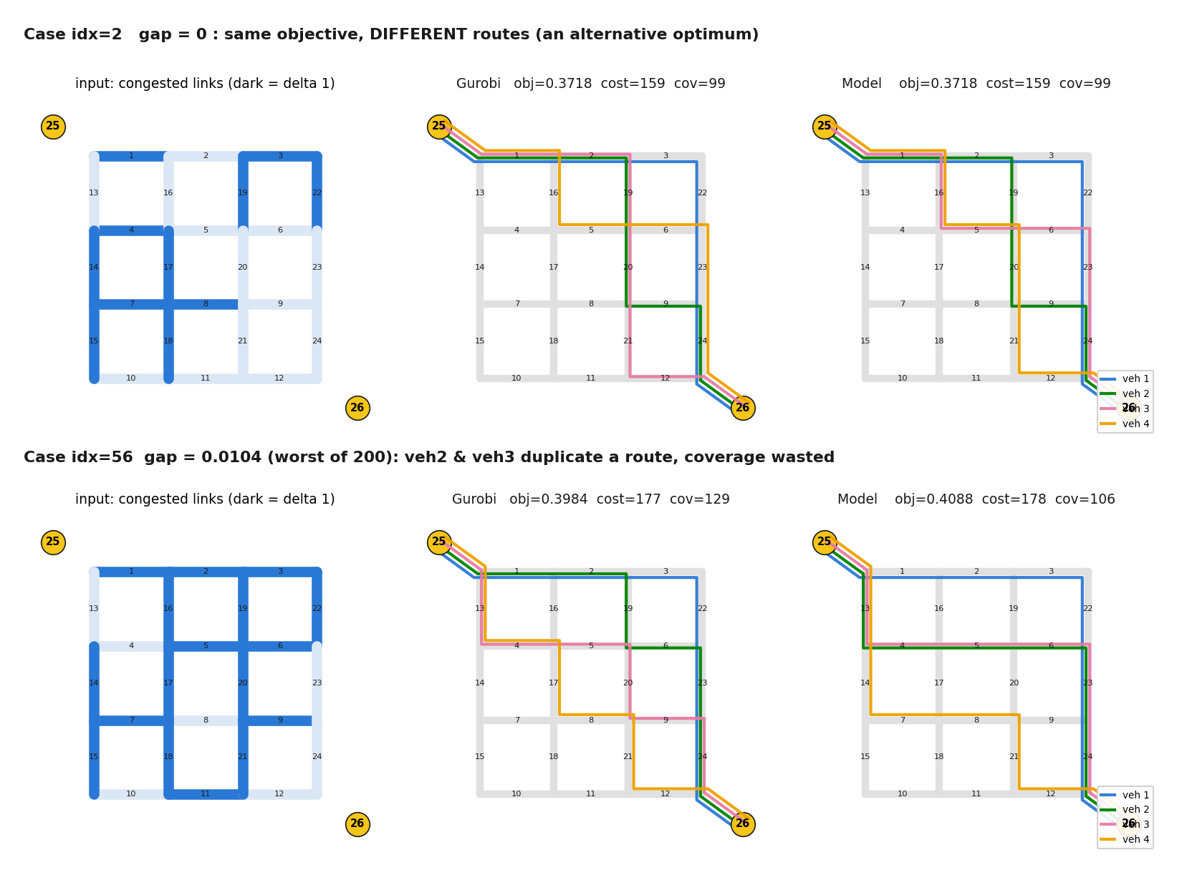
Evidence (toy)
Learned coordination
• Decoder writes the fleet as ONE token sequence — later vehicles attend to earlier routes
• Same prefix, different context: veh-2 flips 3:1.00 → 19:0.85 after seeing veh-1 occupy the 3-22-23-24 corridor (real trace)
• 'Don't duplicate coverage' is learned from joint-optimal labels, not hard-coded

Slide 10
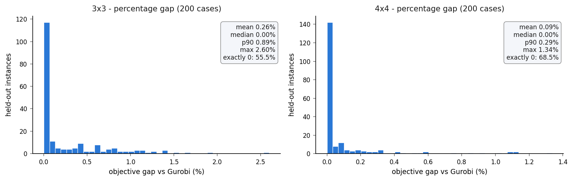
Evidence (toy)
vs Gurobi
• 3×3: 55.5% exact-match, mean 0.26% · 4×4: 68.5%, mean 0.09% · 200/200 feasible · 2–4 ms/case (Gurobi: seconds) · 0.5 M params, <150 MB VRAM

Slide 11
Extension 1
Evaluation
• Three-layer exam for the multi-OD / multi-fleet / staggered-departure model:
– L1 same-distribution: 500 unseen cases (trained ODs, new δ / task mixes)
– L2 OD ZERO-SHOT: 4 OD pairs never seen in training (G1→G5, G6→G2, G4→G8, G7→G3)
– L3 fleet extrapolation: V ∈ {5, 8} (trained on {2,3,4,6})
• Metrics: feasibility rate · % matching Gurobi · absolute + percentage objective gap · per-case CSV + route visualisations
• [ RESULTS PENDING — label farm running (5000 train, ~3 h ETA at deck build time); slides to be filled after training ]

Slide 12
Summary
Next steps
• One recipe, verified twice and now scaling: Gurobi labels offline → small Transformer → guaranteed-feasible millisecond inference
• Verification chain at every step: MILP ≡ brute force (small grids) · decomposition ≡ simulator · per-case CSVs vs Gurobi
• Next: extension-1 results (3-seed) → data-scaling curve → 5×5 real network (760 CTM cells; topology extraction path verified, signals exactly replicable offline)
• Foundation-model gap list: OD conditioning (done in ext-1) → wider instance distributions → coordinate-based encoding for cross-network transfer (paused by decision)

