Slide 1
Yilin Wang August 2026
Learning to Route for Sensing Coverage
A neural amortised solver for budget-constrained fleet routing — method and results

Slide 2
Agenda
• The problem and the network
• Change (a) — the objective: before vs now · why the weight is a switch (rigorous) · how each budget Bᵥ is set
• Where this sits in the literature — setting comparison
• Pipelines: training · case-by-case generation
• Change (b) — the model: overview + encoder + decoder (editable diagrams)
• Evaluation design and results (3 seeds, 2 300 held-out cases)
202608

Slide 3
The problem
Definition
• One case (an 'operating day'): congestion δ ∈ {0,1}⁸⁰ per directed link · V vehicles · per-vehicle task (origin gate o, destination gate d, departure t₀, budget B)
• Vehicles run SIMULTANEOUSLY on one timeline. Entering link i at time t occupies space–time cells (i, t … t+c−1), with travel time c(i,t) = (base(i)+t) mod 24 + 1 + δᵢ — periodic congestion (period 24), bounded ≤ 24 + δᵢ
• Objective: maximise the fleet's sensing coverage (union of occupied cells — overlap counts once), pay for travel, respect each vehicle's own budget (next slide, spelled out)
• Bᵥ = the vehicle's shift length / remaining energy; α = 0.3 / 0.7
• Taxonomy: budget-constrained, selective, max-utility fleet routing = TEAM-ORIENTEERING type — not a visit-all min-cost CVRP
• Gurobi solves it exactly (multi-commodity time-expanded flow) and is the source of training labels AND the benchmark; the learned model replaces per-case solving at deployment

Slide 4
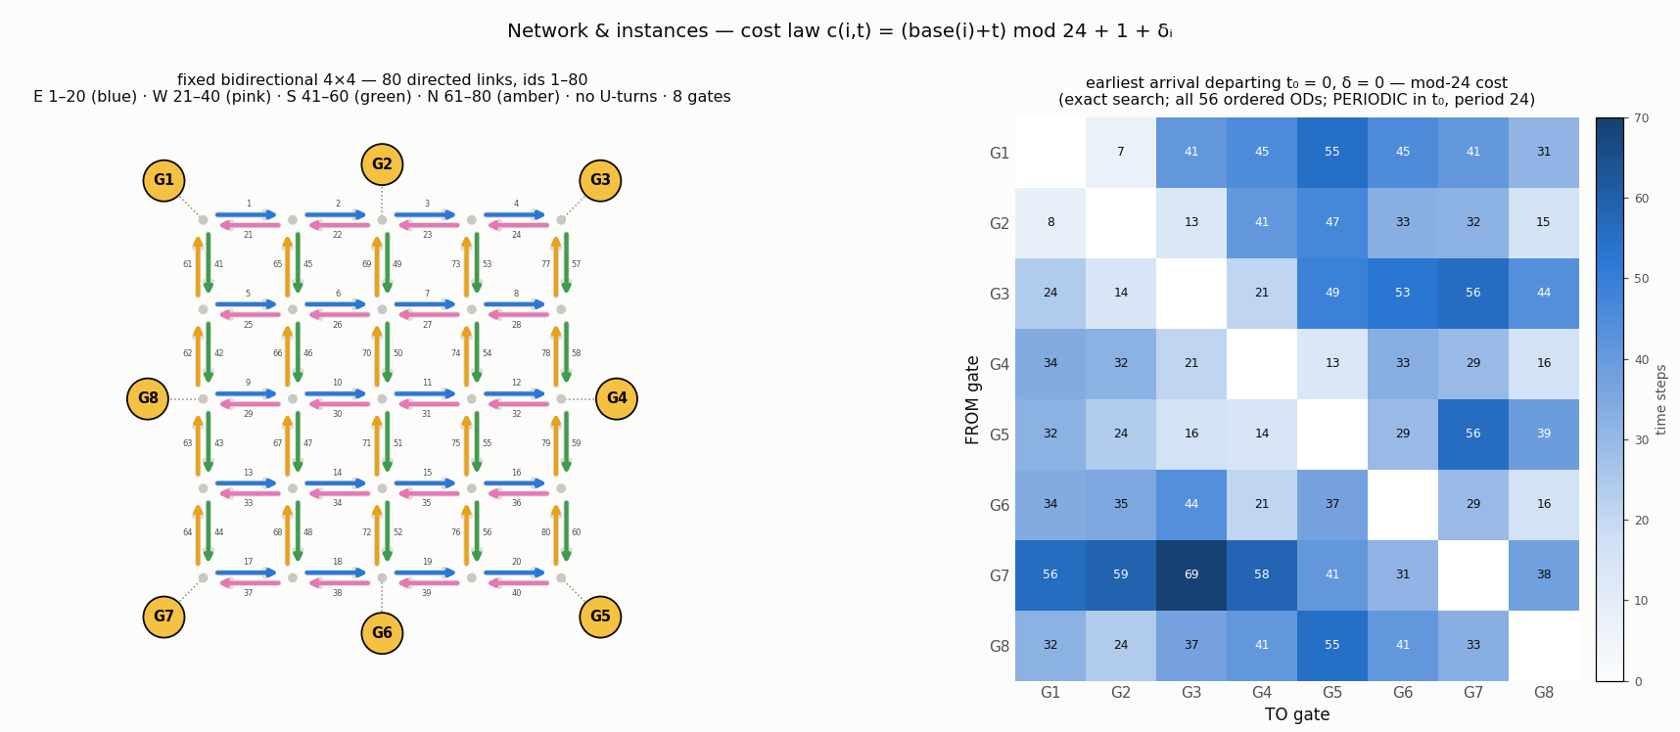
The problem
Network & instances
• Fixed bidirectional 4×4: 80 directed links, no U-turns · 8 gates · all 56 ordered ODs feasible. Link ids 1–80 (E 1–20 · W 21–40 · S 41–60 · N 61–80) = the model's token ids; base(i) = min(id, reverse id) sets each street's congestion PHASE (base mod 24) — every street cycles the same cost range 1–24; streets 24 ids apart share a phase
• Heatmap = earliest arrival departing t₀ = 0 on the δ = 0 day — ONE frame of a PERIODIC quantity (period 24; next two slides)
• Network and OD set FIXED; per case: δ, V, and each vehicle's (o, d, t₀, B) · horizon H = 128 (same worst-case rule; was 135 under mod-96, 338 pre-mod)

Slide 5
The problem
Time-dependence
• The previous slide's heatmap is the t₀ = 0 frame of this loop: t₀ sweeps one FULL congestion cycle 0…23 in steps of 1 and the matrix returns to its start — bounded and periodic: entry cost ≤ 24, every trip ≤ 78 steps at every t₀; G1→G2 swings 4…46, G7→G3 swings 30…69
• Cost law (simplified 2026-08-06): c(i,t) = (base(i)+t) mod 24 + 1 + δᵢ — equal to the earlier mod-96 form with the //4 removed: same amplitude, 4× faster clock. The wrap makes the cost non-FIFO, so these matrices come from an exact search over (link, entry-time) states — details on the Step 0 slide
• Animated GIF — plays in slideshow mode; in print this page shows the t₀ = 0 frame

Slide 6
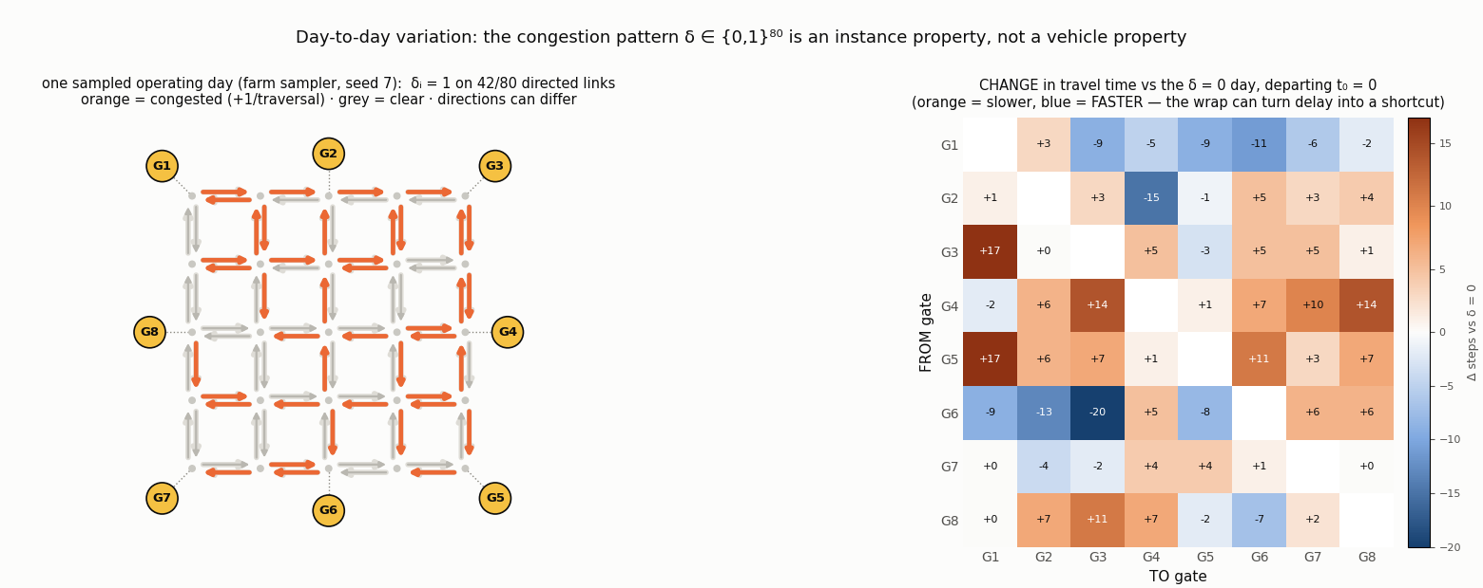
The problem
Day-to-day: δ
• δ ∈ {0,1}⁸⁰: one bit per DIRECTED link, drawn i.i.d. Bernoulli(½) per operating day (the farm's sampler); δᵢ = 1 adds +1 to EVERY traversal of link i that day
• An instance property shared by the whole fleet — not a vehicle attribute; the two directions of one street can differ (left: one-way congestion is visible)
• Effect at t₀ = 0 (right): this sampled day shifts the 56 ODs by −20 … +17 steps — congestion can even make a trip FASTER (18/56 here): a +1 delay can push a later link past its wrap into the cheap zone (stronger under the faster 24-step cycle). The model sees δ per link token: link_emb(i) + Proj(δᵢ) (encoder slide)

Slide 7
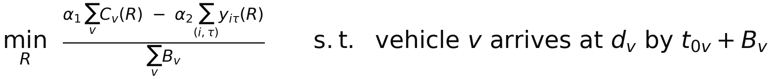
Change (a) — objective
Objective, before vs now
BEFORE — weight-controlled, one global horizon H
NOW — budget-controlled, per-vehicle deadline (objective terms unchanged)
what changed | before | now
control variable | weight α₂ (a preference) | per-vehicle budget Bᵥ (a physical resource)
hard constraint | arrive by the global horizon H | arrive by own deadline t₀ᵥ + Bᵥ
normaliser | V · H (fleet × horizon) | Σᵥ Bᵥ (available driving time); cov ≤ cost ≤ Σᵥ Bᵥ keeps both terms in (0,1]
solution response | step function of α₂ (next 3 slides) | monotone in Bᵥ — a usable dial
• Verified reduction: at Bᵥ ≥ H the new MILP returns the old one's solution link-for-link — a strict generalisation, not a different problem

Slide 8
Change (a) — objective
Why α is a switch — proof I
Setup. For a fixed instance (network, δ, tasks, deadlines), a feasible solution R = (R₁ … R_V):
Lemma (cell accounting). Each time-step of travel occupies exactly one (link, time) cell, and the union counts every cell once. Hence
Measured on all 10 780 mod-24 optimal labels: median K/C = 1.000; K = C exactly (zero overlap) in 84.9 % of labels (62–93 % per shard — larger fleets overlap more). The zero-overlap regime is the TYPICAL one, not a corner case.
Theorem (collapse in the zero-overlap regime). If K(R) = C(R) for the instance's candidate solutions, the objective degenerates to a single scalar multiple of total travel:
• Minimising it therefore means: α₂ < α₁ → minimise C (min-time routes) · α₂ > α₁ → MAXIMISE C (fill the budget) · α₂ = α₁ → every feasible solution ties (total degeneracy)
• The map α₂ ↦ optimal-solution set is a STEP function with its only jump at α₂/α₁ = 1. No value of α₂ selects anything between the two extremes — and this is independent of any normaliser N
• α's only residual role: for α₂ < α₁ it breaks ties AMONG min-cost solutions (more coverage preferred at equal cost)

Slide 9
Change (a) — objective
Why α is a switch — proof II
Proposition A (the cost regime is robust). Let C* = min feasible cost and K₀ = best coverage among min-cost solutions. Using K ≤ C:
• Proof: f(R) ≥ (α₁−α₂)C(R)/N for every R, while the best min-cost solution attains (α₁C* − α₂K₀)/N; compare. If a min-cost solution has zero overlap (K₀ = C*), the threshold is 0: EVERY optimum is min-cost — overlap only shifts the switch point, it cannot create interior positions
Proposition B (the roam regime saturates the budget). A deadline-feasible detour of length k with ΔK fresh cells changes the objective by
• For α₂ > α₁ every FULLY-fresh detour (ΔK = k) strictly improves — so at any optimum, no vehicle can still afford one: budgets bind. The threshold ΔK/k > α₁/α₂ also explains why solutions barely move across α₂ ∈ [0.52, 0.9] — measured: identical (cost, coverage) across that whole range
• Conclusion: α selects one of two regimes; the quantity that positions a solution INSIDE the roam regime is the budget. C*(B) grows monotonically in bounded increments as B grows — a graded, learnable response
• That is change (a): keep α fixed (0.3/0.7, roam regime), move the control to the constraint — the per-vehicle budget Bᵥ. Next slide: both claims measured on one instance

Slide 10
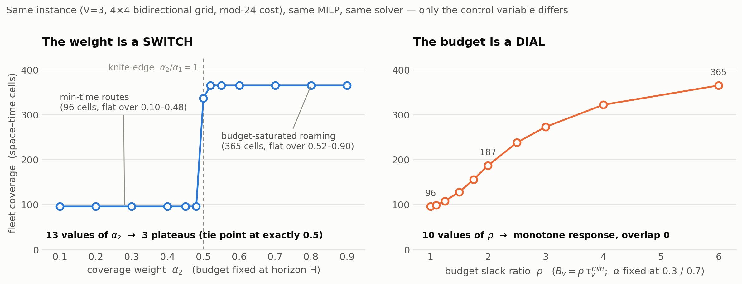
Change (a) — objective
Switch vs dial — measured
• One fixed instance (mod-24), one MILP, one solver. LEFT: α₂ swept, budgets fixed → min-time plateau (cost = cov = 96) for α₂ ≤ 0.48, budget-saturated plateau (365) for α₂ ≥ 0.52; at exactly α₂ = α₁ = 0.5 every feasible solution ties — the theorem's knife-edge, measured. RIGHT: α frozen at 0.3/0.7, ρ swept 1 → 99 → monotone continuous response 96 → 365 cells, overlap 0 at every point, reduces to the full-horizon solution once Bᵥ caps at H − t₀

Slide 11
Change (a) — objective
Step 0: earliest arrival
Before any budget can be set, we must know the fastest this vehicle could possibly make its trip TODAY — earliest arrival on the current network, under this case's congestion δ. One run per vehicle:
EarliestArrival(o, t₀, δ): # one run per vehicle · exact under mod-24
push (t₀, l) for every link l leaving gate o
while queue not empty:
(t, l) ← pop the SMALLEST entry time # state = (link, entry time)
if (l, t) already expanded: continue # dedup STATES, not links
s ← t + c(l, t) # exit time; the clock is INSIDE the cost
if l ends at a gate g: arrive[g] ← min(arrive[g], s)
for every successor j of l (no U-turn): push (s, j)
return arrive # earliest arrival at EVERY gate
τᵐⁱⁿ_v = arrive[d_v] − t₀_v
Where it runs
① budget assignment: V runs per case (~41 000 in the farm) ② decoder mask: min_finish(l, t, d) — same algorithm from one link, memoised ③ horizon calibration: once, all 8 gates
• Ordinary Dijkstra with two changes: a label is a TIME (today's congestion δ sits inside c), and there is one label per (link, entry-time) STATE, popped in time order — exact for any positive time-dependent cost, FIFO or not
• Why states are necessary: the mod-24 wrap breaks FIFO — entering a link one step later can mean exiting 22 steps earlier — so 'the first label per LINK is final' fails (single-label TD-Dijkstra is wrong on 28 % of (OD, t₀) queries under this cost); per-state dedup restores the classic invariant
• One run = bounded states on 80 links → sub-millisecond; ~41 000 runs across the farm are negligible next to the MILP solves, and the mask's memoised state-searches sit inside the per-case inference time. All numbers in this deck are the mod-24 benchmark (H = 128, re-run 2026-08-06)

Slide 12
Change (a) — objective
How Bᵥ is set
In plain words: first compute the fastest this vehicle could make its trip today (τᵐⁱⁿᵥ, previous slide); the budget is that minimum times a slack factor — 'you get ρ× the minimum time'. Not a fixed constant: derived per vehicle, per instance.
• Step 1 — draw the slack ratio ρᵥ. Training farm: per vehicle from the anchors {1.0, 1.5, 2.0, 3.0}; in 35 % of fleets all vehicles share one ρ (homogeneous), in 65 % each vehicle draws its own (heterogeneous). At TEST time ρ is arbitrary — including values never seen in training ({1.25, 1.75} interpolation, 4.0 extrapolation)
• Step 2 — the feasibility floor τᵐⁱⁿᵥ comes from the TD-Dijkstra run of the previous slide (earliest arrival o→d departing at t₀ under THIS instance's δ) — instance-specific, not a table lookup
• Step 3 — Bᵥ = ⌈ρᵥ · τᵐⁱⁿᵥ⌉, floored at τᵐⁱⁿᵥ (a task is never born infeasible) and capped at H − t₀ᵥ (never beyond the coverage grid)
• Why a RATIO and not an absolute number: the same B = 30 is barely above the floor for a near OD (τᵐⁱⁿ = 25) and infeasible for a far one (τᵐⁱⁿ = 45). ρ is comparable across ODs: ρ = 1 ⇔ exactly the min-time trip; ρ = 2 ⇔ twice the minimum time
• Worked example (the sweep instance, V = 3, τᵐⁱⁿ = [26, 45, 25]): ρ = 1.5 for all ⇒ B = [39, 68, 38] — same slack semantics, different absolute budgets
• Bᵥ then enters BOTH sides of the pipeline: the MILP constraint (labels) and the model input (conditioning) + the decoder feasibility mask

Slide 13
Literature
Setting comparison
work | selective (not visit-all) | per-vehicle (o,d,t₀,B) | arc-level fixed network | time-dep. travel | space–time coverage | learned amortised | budget 0-shot
Kool AM '19 (OP) | ✓ | — | — | — | — | ✓ | —
TOP-Former '25 (TOP) | ✓ | budget only, homog. | — | — | — | ✓ | —
UAS-MSTOP '23 | ✓ | start + fuel | — | — | — | ✓ | —
MTPOMO / MVMoE / RouteFinder | — | L / O attrs | — | — | — | ✓ | variant- level
GOAL '25 (incl. OP task) | part | — | — | — | — | ✓ | —
FM-MCVRP '24 (fixed graph SL) | — | — | fixed graph, nodes | — | — | ✓ | —
SED2AM '25 (TD-VRP) | — | — | road data | ✓ | — | ✓ | —
Neural CARP '19–'26 | — | — | ✓ | — | — | ✓ | —
Drive-by sensing OR (Han'24, Chen'24, Zhu'14) | ✓ | part | ✓ | part | ✓ | — | —
OURS (benchmark v1) | ✓ | ✓ | ✓ | ✓ | ✓ | ✓ | ✓
• No existing work is identical: every neighbour misses ≥ 2 columns. The application shelf (bottom) has the right problem but no learning; the neural shelves have learning but not this problem

Slide 14
Literature
Neighbours vs ours
• Closest three, and exactly what they miss:
– TOP-Former (closest neural): team + per-vehicle budget MASKING — but one shared depot, homogeneous budget, synchronized start, Euclidean nodes, static prizes, RL
– FM-MCVRP (closest recipe): fixed graph + SL + joint fleet sequence — but visit-all min-cost CVRP, no budgets, no time dependence, deliberately sub-optimal labels
– Han et al. '24 TR-B (closest problem): space–time sensing utility + budget on real networks — but pure OR, per-instance solving, no learned router at all
• Honesty box — every ingredient of our network exists somewhere: mask kernel (Kool), attribute conditioning (MTPOMO / RouteFinder), fixed-graph SL + joint sequence (FM-MCVRP), centralized team decoding (TOP-Former)
• What is ours: (C1) the first learned amortised solver for THIS problem class — budget-constrained team sensing-coverage routing, arc-level, time-dependent — the bridge between the two shelves
– (C2) the switch-vs-dial analysis: exact characterisation of when a scalarisation weight cannot position solutions, and the constructive replacement (budget in the constraint)
– (C3) value-level zero-shot evaluation: unseen CONTINUOUS budgets (interp + extrap) + a solver-tracked response curve — extends the variant-level zero-shot of MTPOMO / RouteFinder
• Threats we track: uniform-utility degeneracy (wᵢ pending) · toy scale (80 links) · greedy-only decoding · fast-moving neighbours (DeCoST ICLR'26)

Slide 15
Pipeline 1 / 2
Training (offline, run once)
Environment
fixed 4×4 · 80 links c(i,t) time-dependent TD-Dijkstra oracle
Case sampler
δ ~ {0,1}⁸⁰ · V ∈ {2,3,4,6} ODs stratified + 4 held out t₀ ∈ {0…5}
Budget assignment
ρᵥ ~ anchors {1, 1.5, 2, 3} Bᵥ = ⌈ρᵥ·τᵐⁱⁿᵥ⌉ 65 % heterogeneous fleets
Gurobi MILP
time-expanded flow per-vehicle deadline t₀+B MIPGap 2 % · 1.2 s/case
Label set
10 780 (case, routes) 0 errors · 7 hit 60 s cap ~18 min · 15 workers
Tokenise
[BOS v₁-links SEP v₂-links SEP … EOS] · vocab 84 one string = whole fleet
Teacher forcing
predict the next link token cross-entropy (PAD ignored) AdamW 3e-4 · batch 32 · 60 ep
Select by GENERATION
each epoch: masked-greedy decode 150 val cases → TRUE objective gap
Best checkpoint
1.04 M params 3 seeds · ~4 min/seed (one RTX 3090)
• Loss is imitation only: next-link cross-entropy on Gurobi's sequences — no solver, no decoding, no reward inside the training loop
• Model selection is NOT the training loss: CE keeps improving while true solution quality can worsen (imitation overfitting) — selecting on generated-solution gap catches this
• The budget enters twice already at training time: as an input feature ([ρᵥ, Bᵥ/H] in the task token) and inside the validation decoder's feasibility mask
• Everything above runs once; retraining is ~20 min end-to-end (farm + 3 seeds)

Slide 16
Pipeline 2 / 2
Generation (online, per case)
New case
today's δ V tasks (o, d, t₀, B)
Encoder — runs ONCE
80 link tokens + V task tokens → case memory
Autoregressive step
decoder → logits over 84 + feasibility mask (−∞) → argmax next link
V routes
feasible by construction
Feasibility mask (0 parameters)
① not a road successor / U-turn ② cannot reach OWN destination by t₀ᵥ + Bᵥ (TD-Dijkstra query) ③ SEP only when parked next to own gate; EOS after V SEPs
⟲ append token · t += c(l, t) · repeat until EOS
• 8–14 ms per case on one GPU — including the mask's exact state-search queries; no solver call anywhere at deployment
• The mask is why unseen budgets stay feasible: feasibility is ENFORCED by rules, the network only ranks the legal moves (the budget has a hard mechanical channel, not just a soft preference from the labels)
• SEP ends a vehicle; decoding continues with the next vehicle from its own (o, t₀) — later vehicles see earlier routes through self-attention (coordination)
• Today: greedy decoding. Multi-sample (nucleus) decoding is the known next lever — inference-only, no retraining

Slide 17
Change (b) — model
Architecture overview
Inputs
congestion δ (80) V tasks (o, d, t₀, ρ, B/H)
Transformer encoder
×3 layers · d = 128 4 heads · pre-norm runs once per case
Case memory
(80 + V) × d
Autoregressive decoder
joint fleet sequence ×3 blocks → head (84) → masked softmax
the decoder cross-attends to the case memory at EVERY step
Fleet plan
V feasible routes 8–14 ms per case
Feasibility mask
topology · OWN deadline t₀ᵥ + Bᵥ · SEP/EOS grammar
• The two redesign points (details on the next two slides):
– ① instance attributes (o, d, t₀, B) moved OUT of the weights and INTO the input — one model serves every OD, fleet size, departure and budget
– ② the mask threshold is each vehicle's OWN deadline t₀ᵥ + Bᵥ — unseen budgets stay feasible by construction
• All diagram elements are native shapes — fully editable (boxes, elbow connectors)

Slide 18
Change (b) — model
Encoder — token construction
Link tokens (×80, one per directed link)
Task tokens (×V, one per vehicle — redesign ①: attributes as INPUT)
Emb(link id)
W · δᵢ
Emb_o(o)
Emb_d(d)
Proj(t₀)
Proj([ρ, B/H])
sum
sum (4 attribute channels)
link token (d)
task token (d)
concatenate: (80 + V) tokens
Transformer encoder ×3
self-attention + FFN · d = 128 · 4 heads · pre-norm
case memory (80 + V) × d
• Why ①: one set of weights serves every OD pair, fleet size, departure and budget; the encoder reasons about the fleet JOINTLY. Same recipe as the routing foundation models (RouteFinder / MTPOMO attribute embeddings) — our budget plays their capacity's role

Slide 19
Change (b) — model
Decoder — one step
partial JOINT fleet sequence — SEP parks a vehicle, the next one starts from its own (o, t₀)
BOS
l₁
l₂
SEP
l₁
…
masked self-attention (causal)
append next token · advance clock t += c(l, t) · repeat until EOS
case memory
cross-attention → case memory
feasibility mask — redesign ②
logits[illegal] = −∞ ① not a successor / U-turn ② cannot reach own dest by t₀ᵥ + Bᵥ ③ SEP only next to own gate
FFN (decoder block ×3)
linear head → logits over vocab (84)
softmax → next link (argmax / sample)
• Why ②: the budget gets a HARD channel into decoding (mask), not only a soft preference from labels — feasibility is enforced, not learned, so budgets never seen in training still decode to feasible routes. The mask has no parameters

Slide 20
Data
Label set
• 10 780 Gurobi labels · 0 errors · 1.2 s mean per case · 7 solves (0.06 %) hit the 60 s cap — best incumbent kept, optimality not certified there · ~18 min on 15 workers, fully resumable
• Shards:
– train 8 000 · same-distribution test 800
– OD zero-shot 400 (4 gate pairs never trained) · fleet extrapolation 400 (V ∈ {5,8})
– UNSEEN-budget interpolation 400 (ρ ∈ {1.25, 1.75}) · extrapolation 300 (ρ = 4.0)
– response curve: 60 fixed instances × 8 ρ values, re-solved by Gurobi at every ρ
• Trained ρ anchors {1.0, 1.5, 2.0, 3.0}; the three held-out ρ values appear in NO training label
• Every label passes two checks at write time: flow-decomposed objective ≡ Gurobi ObjVal (1e-6) and every per-vehicle deadline re-validated

Slide 21
Evaluation
Design
• Five layers, 2 300 cases, none seen in training:
– L1 same-distribution — 800 fresh cases (trained ODs, new δ / task mixes)
– L2 OD ZERO-SHOT — 400 cases on 4 OD pairs never trained (G1→G5, G6→G2, G4→G8, G7→G3)
– L3 fleet extrapolation — 400 cases with V ∈ {5, 8}, trained on {2,3,4,6}
– L4a UNSEEN budget, interpolation — 400 cases at ρ ∈ {1.25, 1.75}
– L4b UNSEEN budget, extrapolation — 300 cases at ρ = 4.0, beyond the trained range
• Plus the RESPONSE CURVE: 60 fixed instances re-solved at every ρ by both Gurobi and the model — did it learn the budget as a continuous quantity or memorise four settings?
• Metrics: feasibility rate · objective gap vs Gurobi (absolute + relative) · fraction matching or beating Gurobi · inference time · per-case CSV. 3 seeds, mean ± std
• Tuning used a validation slice of the training shard only; every reported number is from held-out shards

Slide 22
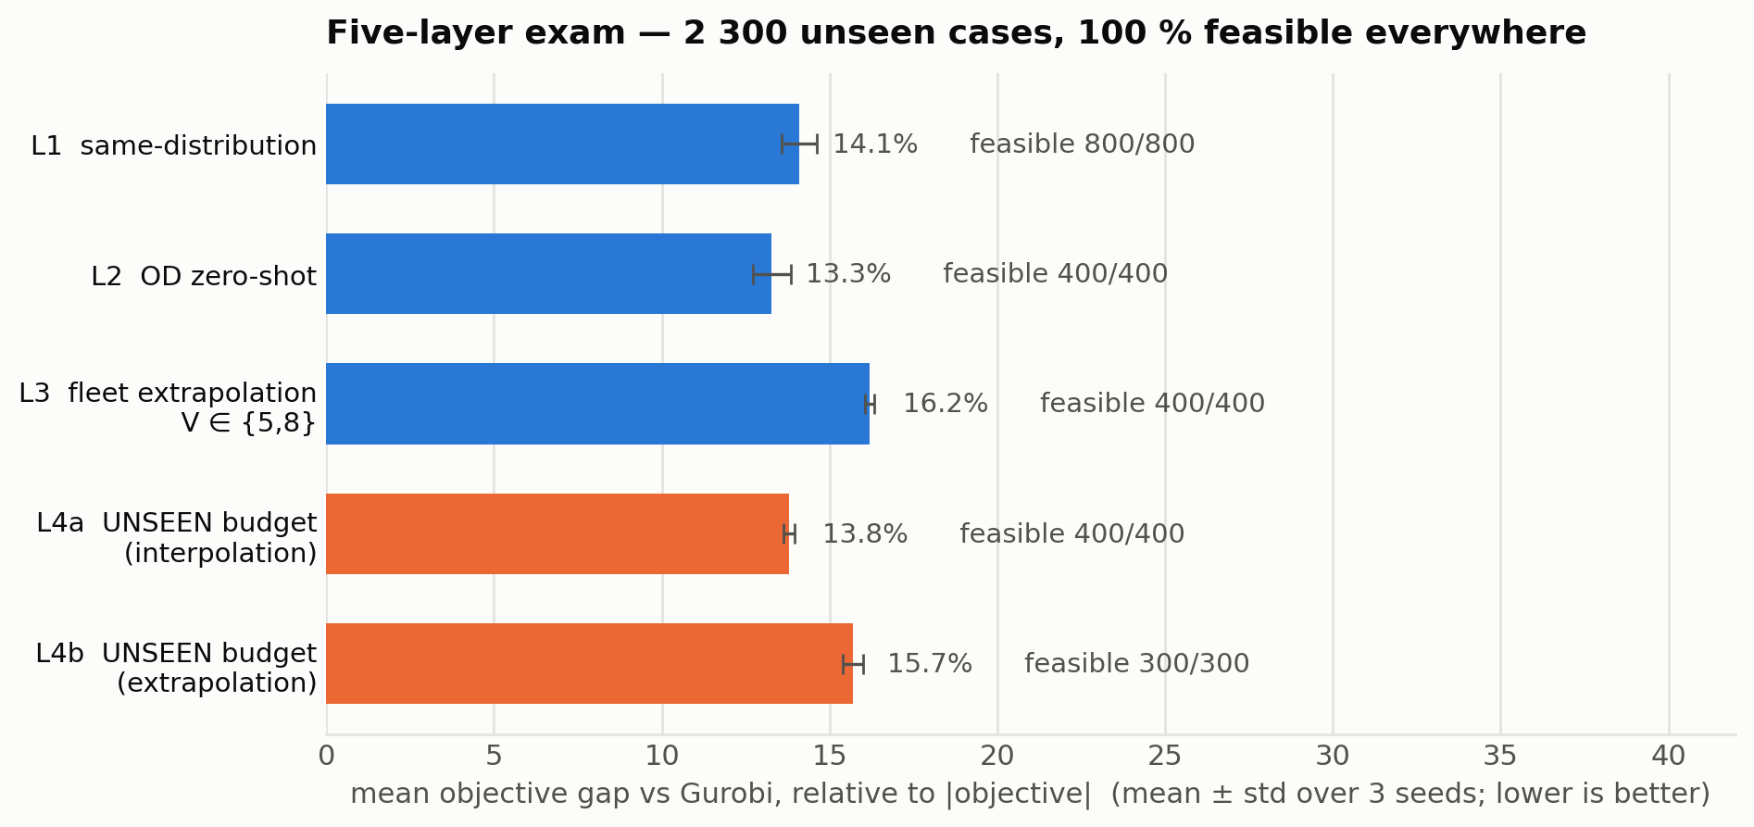
Results
Five-layer exam
• 3 seeds × 60 epochs · 2 300 held-out cases, 100 % feasible in every layer · 8–14 ms per case · 123/800 of L1 match or beat Gurobi
• Unseen budgets (L4a, orange) cost about as much accuracy as an unseen fleet size — the budget generalises like the other conditioned attributes, not worse

Slide 23
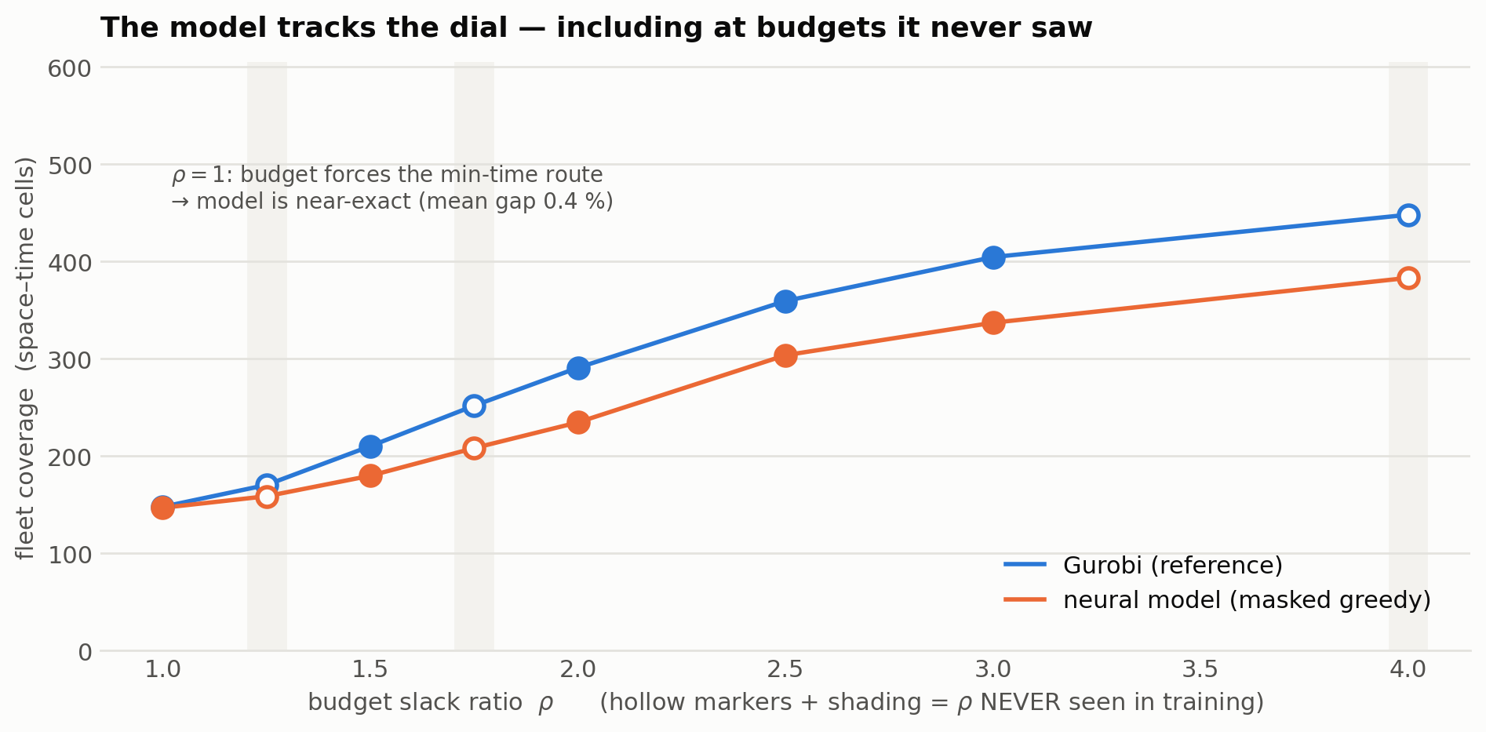
Results
Budget response curve
• Monotone response reproduced — including at ρ = 1.25 / 1.75 / 4.0, absent from every training label. At ρ = 1 the model is near-exact (mean gap 0.4 %); tracking degrades as slack grows (ρ = 4: 383 vs 448 cells) — the limit of greedy decoding

Slide 24
Summary
Where this stands
• One recipe, verified end to end: Gurobi labels offline → 1.04 M-parameter Transformer → guaranteed-feasible millisecond inference, conditioned on each vehicle's own budget
• The control variable is now physical (shift length / energy), continuous, and demonstrably generalises to budgets never trained on
• Positioning: the first learned amortised solver for this problem class — the bridge between the drive-by-sensing OR shelf (right problem, no learning) and the neural routing shelf (right method, different problem)
• Verification chain at every step: MILP ≡ flow decomposition ≡ simulator · budget MILP ≡ the full-horizon MILP at B ≥ H · per-case CSVs against Gurobi on every held-out layer
• Known and deliberately open: with uniform cell utility, overlap = 0 in ~85 % of optimal solutions, so coverage ≈ cost. The budget controls HOW MUCH to roam; making WHICH cells a real decision needs heterogeneous utility wᵢ — the next modelling step, not a fix
• Next levers, in order: multi-sample (non-greedy) decoding · wider ρ range for extrapolation · data-volume slope · heterogeneous wᵢ · then the 5×5 real network

