Slide 1



RSU 4.1 Interface
Testing and Use Cases
Niraj Vasant Altekar (nvaltekar)
06/06/2019

Slide 2
Outline
Objective
Roles of Devices
Architecture
RSU4.1 Specifications: Message Format
Test Cases
Cohda
Savari
Analogous Requirement for OBU
Cohda
Savari
Conclusion

Slide 3
Objectives
Establish and test a message-exchange interface between a roadside DSRC unit (RSU) and MMITSS Roadside Processor (MRP).
Test vendor agnostic operations:
Savari
Cohda
Separate the core functions of devices.
Develop an analogous interface for the vehicle-side devices: DSRC unit (OBU) and MMITSS Vehicle Processor (MVP).

Slide 4
Roles of Devices
MMITSS Roadside Processor
Construct J2735 messages and forward to RSU for broadcast over DSRC.
Receive messages from RSU and feed them to appropriate application for algorithm implementation.
Core functions:
Host the logic-performing applications.
Perform computations using algorithms in applications.
Technical Specifications:
Should be a computing device, based on Linux environment.
Road Side DSRC Unit (RSU)
Core Functions:
Broadcast messages received from MRP, over DSRC.
Forward messages received over DSRC, to MRP.
Tested Vendors:
Cohda (MK5)
Savari (SW1000)
4

Slide 5
Architecture
Direction 1: MRP to RSU
Messages:
MAP
Signal Phase and Timing (SPaT)
Signal Status Message (SSM)
Roadside Safety Message (RSM)
…
Direction 2: RSU to MRP
Messages:
Basic Safety Messages (BSM)
Signal Request Messages (RSM)
MMITSS
Road-Side Processor
MMITSS
Road-Side Processor
Road-Side Unit
Road-Side Unit
5

Slide 6
RSU4.1 Specifications: Message Format
The message sent to the RSU must be in format specified in RSU4.1 Specifications.
Required fields for each message:
Version
Type: <MAP, SPaT, RSM, SSM, …>
PSID
Priority: <0,…,7>
TxMode: <CONT, ALT>
TxChannel: <172,…,184>
DeliveryStart
DeliveryStop
Signature: <True, False>
Encryption: <True, False>
Payload: <UPER encoded Hex formatted message payload>

Slide 7
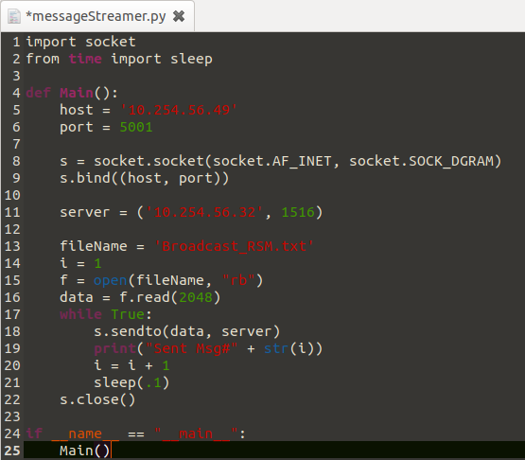
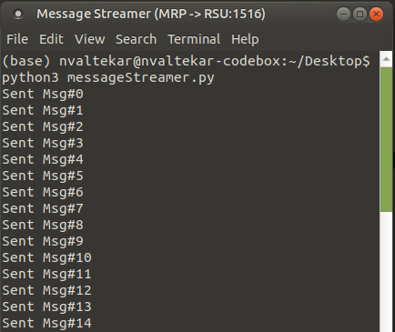
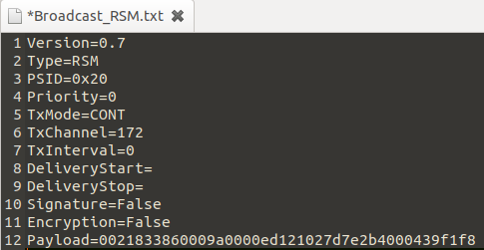
Test Case: Direction 1
MMITSS Roadside Processor:
A message streamer was developed to send stream of RSM messages to port 1516 of the RSU.
Required information for message streamer:
IP Address of RSU.
Port of receiver of messages, on the RSU: 1516 (default).
Complete J2735 messages along with the fields specified in RSU4.1 specifications.
Ethernet connection was established between the MRP and RSU.
IP Address (MRP): 10.254.56.49
IP Address (RSU): 10.254.56.32
This workflow must be same to send messages to RSUs manufactured by any vendor -> vendor agnostic operation.

Slide 8
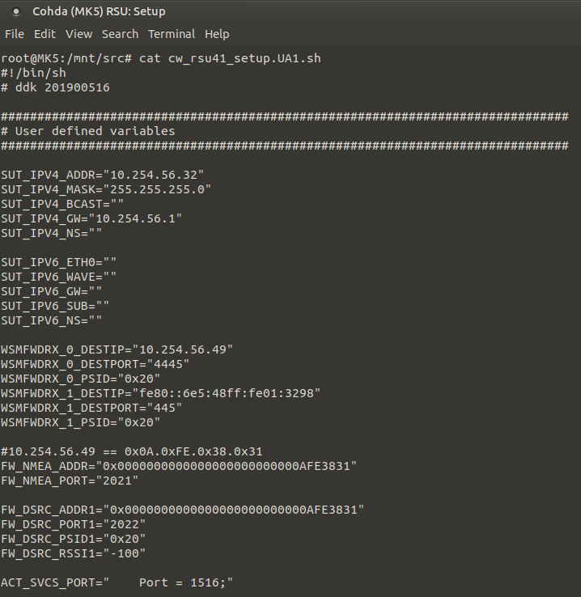
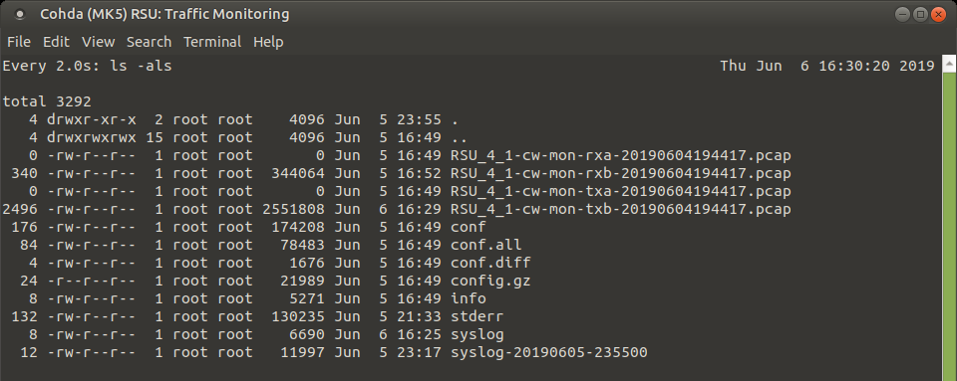
Test Case: Direction 1 (Continued)
Cohda (MK5) Roadside Unit:
A receiving port was setup so as to receive messages on port 1516 and broadcast over DSRC.
Monitors Tx-Traffic on Radio - B

Slide 9
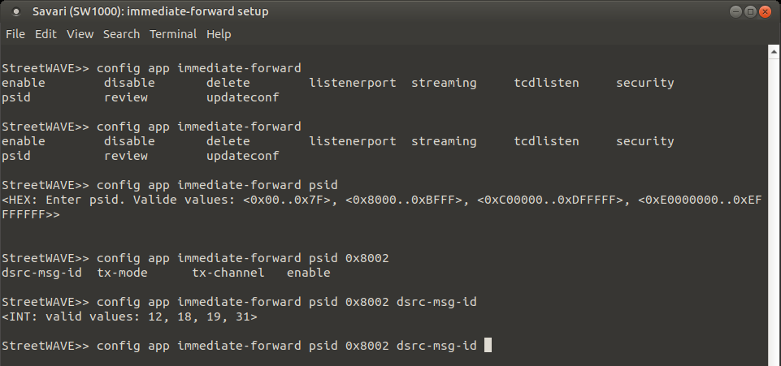
Test Case: Direction 1 (Continued)
Savari (SW1000) Roadside Unit:
A receiving port was setup so as to receive messages on port 1516.
Expected messages need to be defined in proprietary immediate-forward application.
SW1000 accepts only a subset of messages for broadcast.
Accepted messages as of 06/06/2019:
MAP
SPaT
TIM
RTCM

Slide 10
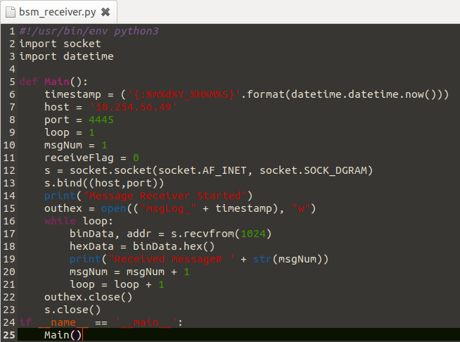
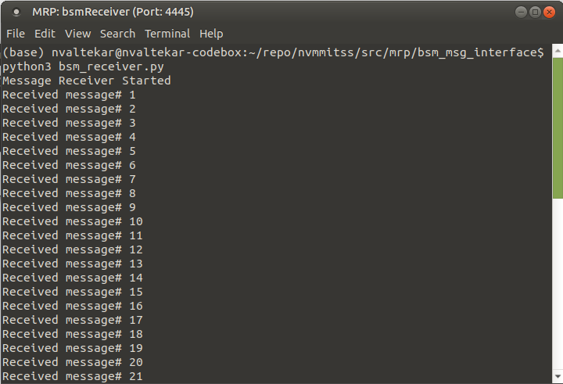
Test Case: Direction 2
MMITSS Roadside Processor:
A message receiver was developed to receive stream of BSM messages to port 4445 of the MRP.
Separate listeners (with distinct ports) must be developed to receive different types of messages.
Ethernet connection was established between the MRP and RSU.
IP Address (MRP): 10.254.56.49
IP Address (RSU): 10.254.56.32
This workflow must be same to send messages to RSUs manufactured by any vendor -> vendor agnostic operation.
Log File

Slide 11
Test Case: Direction 2 (Continued)
Cohda (MK5) Roadside Unit:
A receiver identification (destination) must be configured for each message (distinguished by PSID).
Required information:
Receiver IP Address
Receiver Port
Message PSID
Total 10 types of messages can be configured to be forwarded to specific destination.

Slide 12
Test Case: Direction 2 (Continued)
Cohda (MK5) Roadside Unit (message forwarding - In action):
Monitors Rx-Traffic on Radio - B

Slide 13
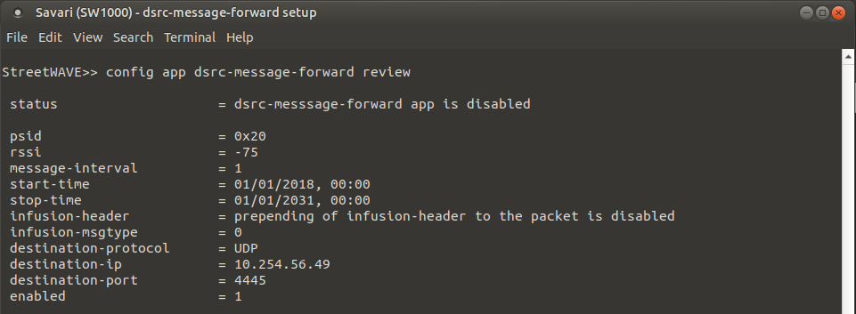
Test Case: Direction 2 (Continued)
Savari (SW1000) Roadside Unit:
A receiver identification (destination) must be configured for each message (distinguished by PSID), in a proprietary dsrc-message-forward application.
Required information:
Receiver IP Address
Receiver Port
Message PSID
Other optional information may be provided.

Slide 14
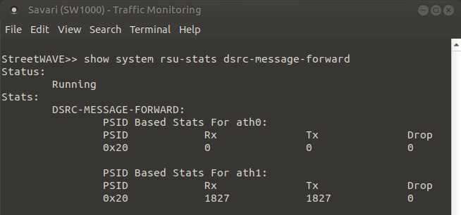
Test Case: Direction 2 (Continued)
Savari (SW1000) Roadside Unit (message forwarding - In action):
Monitors message-forwarding

Slide 15
Analogous Requirement on OBU
Similar message-exchange interface is required on OBU.
Algorithm implementation and computations can be performed on the MMITSS Vehicle-side Processor (MVP).
On-board DSRC units (OBU) can be used to broadcast the messages received over DSRC and forward them to MVP.
In the opposite directions, the messages can be constructed on the MVP and forwarded to OBU for broadcasting over DSRC.
Interface functions are similar to the RSU4.1 specifications discussed earlier.

Slide 16
Roles of Devices
MMITSS Vehicle-side Processor
Construct J2735 messages and forward to OBU for broadcasting over DSRC.
Receive messages from OBU and feed them to appropriate application for algorithm implementation.
Core functions:
Host the logic-performing applications.
Perform computations using algorithms in applications.
Technical Specifications:
Should be a computing device, based on Linux environment.
On-board DSRC Unit (OBU)
Receive messages and corresponding broadcast information from MVP over Ethernet.
Broadcast received messages over DSRC according to its broadcast information.
Core Functions:
Broadcast messages received from MVP, over DSRC.
Forward messages received over DSRC, to MVP.
Tested Vendors:
Cohda (MK5).
Savari (MW1000).
16

Slide 17
Architecture
Direction 1: MVP to OBU
Messages:
Basic Safety Messages (BSM)
Signal Request Messages (RSM)
…
Direction 2: OBU to MVP
Messages:
MAP
Signal Phase and Timing Message (SPaT)
Signal Status Message (SSM)
Roadside Safety Message (RSM)
…
MMITSS
Vehicle-Side Processor
MMITSS
Vehicle-Side Processor
On-Board Unit
On-Board Unit
17

Slide 18
Test Cases
Cohda (MK5) OBU*:
Hosts very similar interface as that of Cohda (MK5) RSUs.
*In this experiment, one Cohda (MK5) RSU was configured to act as an OBU.
As the interfaces on the MK5 OBUs and RSUs are very similar, exactly message-exchange mechanism described earlier, was established between OBU and MVP.
Another RSU was configured to broadcast roadside safety messages over channel 172 of DSRC.
Messages were successfully received by OBU and forwarded to MVP.
The source and sink messages were validated with each other.
Savari (MW1000) OBU:
Receipt of messages over DSRC was confirmed.
As of 06/06/2019, no particular message-exchange interface exists on Savari OBUs, that can forward the messages received over DSRC to MVP.
Similarly, no interface exists for forwarding messages from MVP to OBU for broadcasting over DSRC.
Wave-forwarders (or any other mechanism of forwarding messages in both directions) needs to be developed and tested.
18

Slide 19
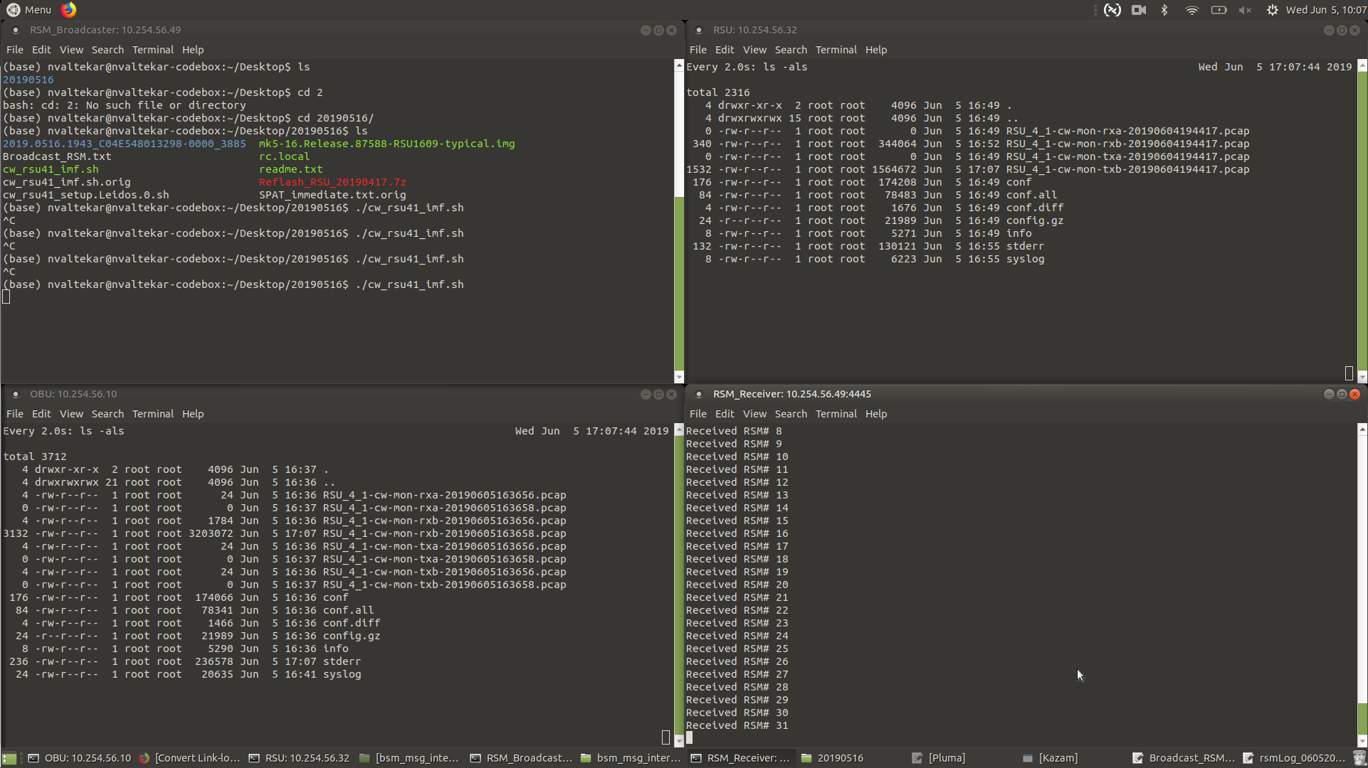
Complete message flow using Cohda MK5 Devices
DSRC
Ethernet
DSRC
Ethernet
19

