Slide 1



Traffic Controller Interface
Proposed Functional Description of Components
Niraj Vasant Altekar (nvaltekar)
05/26/2019

Slide 2
Outline
Proposed Architecture
Component Functions
Components outside MMITSS Boundary
Field Traffic Controller (NTCIP compliant)
DSRC Radio (Road-side Unit)
TC-Observer
TC-Commander
TC-MAP_SPaT-Broadcaster
Information required for other MMITSS components
Sources of required information
SNMP-Set requests
Signal Schedule Class

Slide 3
Proposed Architecture
I added multiple “Other MMITSS Components”
MMITSS Boundary
Other MMITSS Components
SNMP Set Requests (Schedule)
Other MMITSS Components
Other MMITSS Components
TC-Interface Boundary
Subscribed Info
DSRC-Radio
J2735 MAP_SPaT
MAP-SPaT-Broadcaster
SPaT Info
Observer
OID Info
Commander
Port:6053
Where is the MAP message?
UDP
SNMP
Field Traffic Controller
NTCIP1202 SPaT Blob
SNMP Get & Set

Slide 4
Components outside MMITSS boundary (1)
Field Traffic Controller
Should be NTCIP compliant (Econolite ASC/3, Cobalt or any other NTCIP compliant controller) [Currently using NTCIP 1202 v.2, but v.3 is coming]
Broadcasts NTCIP1202 SPaT blob at 10 Hz to port 6053 of the defined server [when 1202 v.3 is used, this will be a different structure]
Phase Group Status
Remaining time
…
IP address of receiver (having listener at port 6053) needs to be defined as Server IP (MM-1-5-1) on Econolite Controller
Responds to SNMP-Get requests from the commander by providing requested information
Responds to SNMP-Set (Schedule) requests from the commander, and changes the signal timing accordingly.
Responds to SNMP-Set (SPaT-Broadcast-Enable) from the commander and starts broadcasting NTCIP1202 SPaT blob to port 6053 of defined server.

Slide 5
Components outside MMITSS boundary (2)
DSRC Radio (Road-side Unit)
Receive J2735 MAP and SPaT on port 1516
Sender: MAP_SPaT-Broadcaster
Packets should be formatted as specified in RSU4.1 Specifications
Forward the messages received on port 1516 over DSRC, using immediate-forward application, specified in RSU4.1-specifications
Channel, TX-Interval needs to be specified.
Messages are identified using PSID

Slide 6
Traffic Controller – MAP-SPaT_Broadcast
Receives NTCIP1202 SPaT blob from the field traffic controller
Receiving port: 6053
Creates a J2735 UPER encoded SPaT message
Creates a J2735 UPER encoded MAP message
MAP message data can come from MAP tool as UPER encoded message
Sends both the messages to DSRC radio for the broadcast
Creates a JSON representation of the NTCIP1202 SPaT information and sends it to the Traffic Controller - Observer.

Slide 7
Traffic Controller – Observer
Retrieves information from the two sources to replicate the current state of the traffic controller.
Source 1 – JSON formatted NTCIP1202 SPaT message
Source 2 – OID based information from TC-Commander
Maintains a information subscription service to which other MMITSS components can subscribe.
Publishes the standard (need to be defined) information to the subscribers every defined time interval. [Can this be unique for each MMITSS Client?]
Maintained and published information (planned):
Static: Signal timing plan, co-ordination settings (offset, cycle-time, …) – OID Based
Dynamic: Current phase group status, current status of remaining time to change – from NTCIP1202 SPaT
Need to track how long Phase has been serving (including Walk, Ped Clear, Yellow, Red)

Slide 8
Traffic Controller – Commander
This is the only component that will communicate with to (?) the field traffic controller via SNMP.
Performs two functions: SNMP-Set and SNMP-Get
SNMP-Set:
Enable the broadcast of NTCIP1202 SPaT message
Change the signal timing based on schedule provided by other MMITSS components
SNMP-Get:
Static information: Current timing plan, coordination settings, …
Dynamic information: Information required by MMITSS components which is not included in NTCIP1202 SPaT blob broadcasted by the controller.

Slide 9
Required Information (Static)
Controller Configuration Information for phase p:
MAX_PHASE_NO: 1.3.6.1.4.1.1206.4.2.1.1.1
PHASE_NUMBER: 1.3.6.1.4.1.1206.4.2.1.1.2.1.1.1.X
CUR_TIMING_PLAN: 1.3.6.1.4.1.1206.3.5.2.1.22.0
PHASE_ENABLED: 1.3.6.1.4.1.1206.4.2.1.1.2.1.21.X
Information from plan 1 for phase p:
PHASE_MIN_GRN: 1.3.6.1.4.1.1206.4.2.1.1.2.1.4.p"
PHASE_MAX_GRN: 1.3.6.1.4.1.1206.4.2.1.1.2.1.6.p"
PHASE_RED_CLR: 1.3.6.1.4.1.1206.4.2.1.1.2.1.9.p"
PHASE_YLW_XGE: 1.3.6.1.4.1.1206.4.2.1.1.2.1.8.p"
Information about plan x for phase p:
PHASE_MIN_GRN_ASC: 1.3.6.1.4.1.1206.3.5.2.1.2.1.9.x.p"
PHASE_MAX_GRN_ASC: 1.3.6.1.4.1.1206.3.5.2.1.2.1.15.x.p"
PHASE_RED_CLR_ASC: 1.3.6.1.4.1.1206.3.5.2.1.2.1.19.x.p"
PHASE_YLW_XGE_ASC: 1.3.6.1.4.1.1206.3.5.2.1.2.1.18.x.p"
Why do we need all the plan data?
Maybe just the current plan?
Plan can change based on Time-of-Day, Traffic Responsive, etc.

Slide 10
Required Information (Dynamic)
Phase Groups:
RED_GROUP: 1.3.6.1.4.1.1206.4.2.1.1.4.1.2.1
YELLOW_GROUP :1.3.6.1.4.1.1206.4.2.1.1.4.1.3.1
GREEN_GROUP: 1.3.6.1.4.1.1206.4.2.1.1.4.1.4.1
DONOTWALK_GROUP: 1.3.6.1.4.1.1206.4.2.1.1.4.1.5.1
PEDCLEAR_GROUP: 1.3.6.1.4.1.1206.4.2.1.1.4.1.6.1
WALK_GROUP: 1.3.6.1.4.1.1206.4.2.1.1.4.1.7.1
VEHICLE_CALL: 1.3.6.1.4.1.1206.4.2.1.1.4.1.8.1
PEDES_CALL: 1.3.6.1.4.1.1206.4.2.1.1.4.1.8.1
Phase status timing status for phase p:
PHASE_STA_TIME_ASC: 1.3.6.1.4.1.1206.3.5.2.1.18.1.1.p
PHASE_STA_TIME2_ASC: 1.3.6.1.4.1.1206.3.5.2.1.18.1.6.p
Detector Information for detector d:
SYS_DET_VOL: 1.3.6.1.4.1.1206.4.2.1.2.5.4.1.1.d
SYS_DET_OCC: 1.3.6.1.4.1.1206.4.2.1.2.5.4.1.2.d

Slide 11
Information in NTCIP1202 SPaT Blob (Subset)
VehMinTimeToChange (for phase 1-16)
VehMaxTimeToChange (for phase 1-16)
PedMinTimeToChange (for phase 1-16)
PedMaxTimeToChange (for phase 1-16)
OverlapMinTimeToChange (for phase 1-16)
OverlapMaxTimeToChange (for phase 1-16)
PhaseStatusReds
PhaseStatusYellows
PhaseStatusGreens
PhaseStatusDontWalks
PhaseStatusPedClears
PedStatusWalks
Intersection Status
System Time

Slide 12
SNMP-Set Requests
Enable broadcast of NTCIP1202 SPaT blob:
asc3_vii_message_enable : 1.3.6.1.4.1.1206.3.5.2.9.44.1.1
Phase control:
MIB_PHASE_HOLD : 1.3.6.1.4.1.1.1206.4.3.1.1.5.1.4.1
MIB_PHASE_FOREOFF: 1.3.6.1.4.1.1.1206.4.3.1.1.5.1.5.1
MIB_PHASE_OMIT: 1.3.6.1.4.1.1.1206.4.3.1.1.5.1.2.1
MIB_PHASE_VEHCALL : 1.3.6.1.4.1.1.1206.4.3.1.1.5.1.6.1
MIB_PHASE_PEDCALL : 1.3.6.1.4.1.1.1206.4.3.1.1.5.1.7.1
Priority/Preempt Control
Identify objects so we can allow the controller to run without MMITSS, but give priority control using controller logic (new mode)

Slide 13
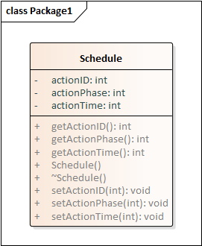
Signal Schedule Class
We need to think about this
Class definition for schedule.
I’ll add some slides below to
Highlight the schedule role.

Slide 14
Understanding the Schedule
The schedule is a very complex and critical part of MMITSS.
Understanding how MMITSS does timing is important to make sure it is implemented on the controller correctly
The Phase-Time diagram is a tool that we have developed that will help us understand signal timing and MMITSS operation

Slide 15
Phase-Time Diagram
X-axis is time in the future (or past)
Y-axis (left side) are intervals for phases 1,2,3,4,1,2,3,…..
There should be Y-axis on the right for ring-2 (assuming dual ring)
Dashed lines show the min (max) times for each phase – creates the feasible region (non-convex)
Green lines represent the possible phase timings for each phase. P1 could time between 5 or 18 seconds
Could gap out from detector data
Must end by 18 seconds to ensure minimum times for P2 and P3 to allow the Priority Request for P4 to be served without delay

Slide 16
Visualization tool for priority algorithm: Time-Phase Diagram: Dual Ring Behavior

Slide 17
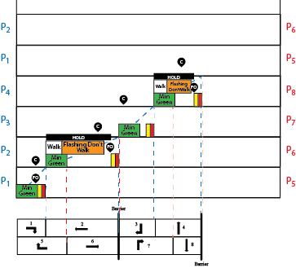
Phase-Time Diagram: Ring 1 Controls
Call (C )
Phases that are to serve must be called
Force-Off (F)
Terminates a phase
Must be Call on opposing Phase
Should be cleared
Hold (H)
Holds phase green
Must be cleared
Omit (O)
Skips a phase
(Not shown)

Slide 18
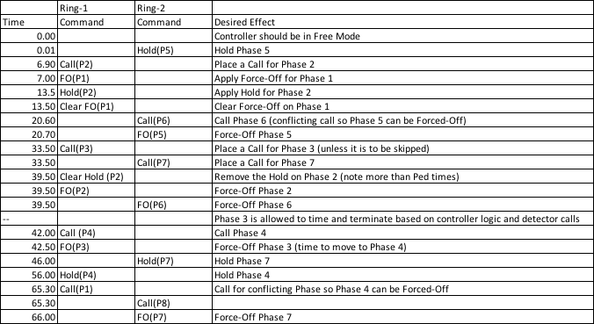
Signal Timing Schedule

Slide 19
General Comments
We typically draw Time-Phase diagrams starting at the start of Phase 1, but it should be viewed as starting at any point in any Phase. For example, the diagram could start (time=0 => Now) as being 12.2 seconds into Phase 3.
A feasible schedule is the result of the Priority Optimization Algorithm and should meet all the phase minimum, Walk, Ped Clear (Flashing Don’t Walk), Yellow Change and Red Clearance intervals)
It would be good to check the feasibility of the schedule
A Phase cannot be forced-off if there isn’t a Call for a conflicting Phase.

Slide 20
General Comments
Ped intervals (Walk, Ped Clear) are optional and may not be called unless there is a Ped Call (or Ped recall)

