Slide 1



RSU4.1 Interface
Test and Examples
Niraj Vasant Altekar
05/23/2019

Slide 2
Outline
RSU to MRP (BSMs/SRMs)
RSU configuration to forward messages received over DSRC
Receiving client on MRP
MRP to RSU (MAP/RSM/SPaT)
Sending client on MRP
RSU configuration to receive packets from MRP and broadcast over DSRC
RSU to Other/Other to RSU (SPaT – Signal Controller)
RSU configuration to receive SPaT blob from the controller and broadcast over DSRC
Signal controller configuration to forward SPaT blob to RSU
Summary and generalization for other messages

Slide 3
Test-1: RSU to MRP
1.1. Basic Safety Message
1.2. Signal Request Message

Slide 4
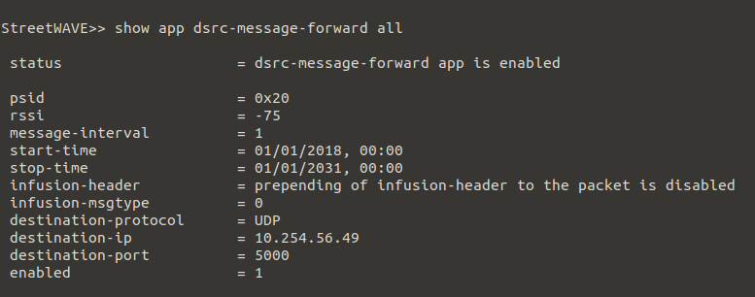
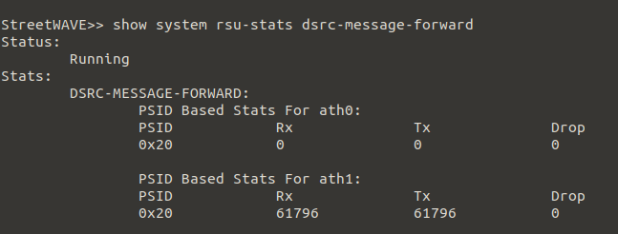
RSU to MRP – RSU Configuration (1)
RSU can forward the packets received over DSRC to a specified IP and port
IP and ports need to be configured for each message (distinguished by PSID)
DSRC-MESSAGE-FORWARD application hosts the configuration information
Example for BSMs is discussed.
Configuration
Status
4

Slide 5
RSU to MRP – RSU Configuration (2)
Configure DSRC-MESSAGE-FORWARD application as follows:
Enable the DSRC-MESSAGE-FORWARD application on the RSU:
Add a PSID of message to be forwarded in the list of PSIDs in DSRC-MESSAGE-FORWARD application using
Set the protocol for forwarding packets as UDP, for created PSID:
Set the destination IP address for created PSID:
Set the port of the listener running on the destination:
config app dsrc-message-forward psid 0x20 destination port 5000
config app dsrc-message-forward psid 0x20
config app dsrc-message-forward psid 0x20 destination protocol UDP
config app dsrc-message-forward psid 0x20 destination ip 10.254.56.49
config app dsrc-message-forward psid 0x20 destination port 5000
5

Slide 6
RSU to MRP – RSU Configuration (3)
Configure DSRC-MESSAGE-FORWARD application (continued):
Review the new configuration:
If the configuration is set up as required, update the configuration to bring it into effect:
To check the status of received (Rx) and forwarded (Tx) packets, type:
Similar process can be followed for forwarding SRMs or any other message (again, distinguished by PSID).
config app dsrc-message-forward review
config app dsrc-message-forward updateconf
show system rsu-stats dsrc-message-forward
6

Slide 7
Test-2: MRP to RSU
1.1. MAP message
1.2. Roadside Safety Message
1.3. Signal Status Message

Slide 8
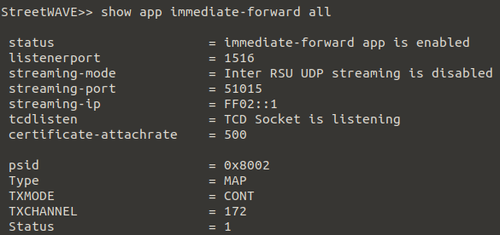
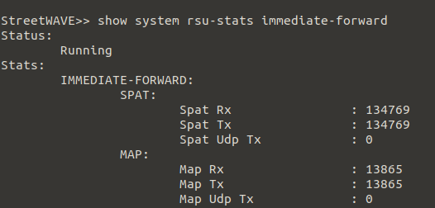
MRP to RSU– RSU Configuration (1)
A stream of messages can be streamed to the RSU (port 1516) from an MRP, to forward it over DSRC.
Messages need to be formatted as specified in RSU-4.1 specs.
IMMEDIATE-FORWARD application on the RSU needs to be configured to listen to the stream of messages.
Example for MAP is discussed.
8

Slide 9
MRP to RSU– RSU Configuration (2)
Configure IMMEDIATE-FORWARD application as follows:
Enable the IMMEDIATE-FORWARD application:
Add a PSID of the message that will be streamed by an MRP:
Enable listening for this PSID:
Configure message type (i.e. DSRC-Message-ID)
Configure Tx mode (0=Continuous, 1=Alternating)
config app immediate-forward enable
config app immediate-forward psid 0x8002
config app immediate-forward psid 0x8002 enable
config app immediate-forward psid 0x8002 dsrc-message-id 12
config app immediate-forward psid 0x8002 tx-mode 0
9

Slide 10
MRP to RSU– RSU Configuration (3)
Configure IMMEDIATE-FORWARD application (continued):
Configure tx-channel (172..184 – even channels):
Review the new configuration:
If the configuration is set up as required, update the configuration to bring it into effect:
To check the received and forwarded packages, type:
If required, listener port of the RSU can be changed by (not recommended):
config app immediate-forward psid 0x8002 tx-channel 172
config app immediate-forward review
config app immediate-forward updateconf
show system rsu-stats immediate-forward
show system rsu-stats immediate-forward listenerport <desired port number>
10

