Slide 1

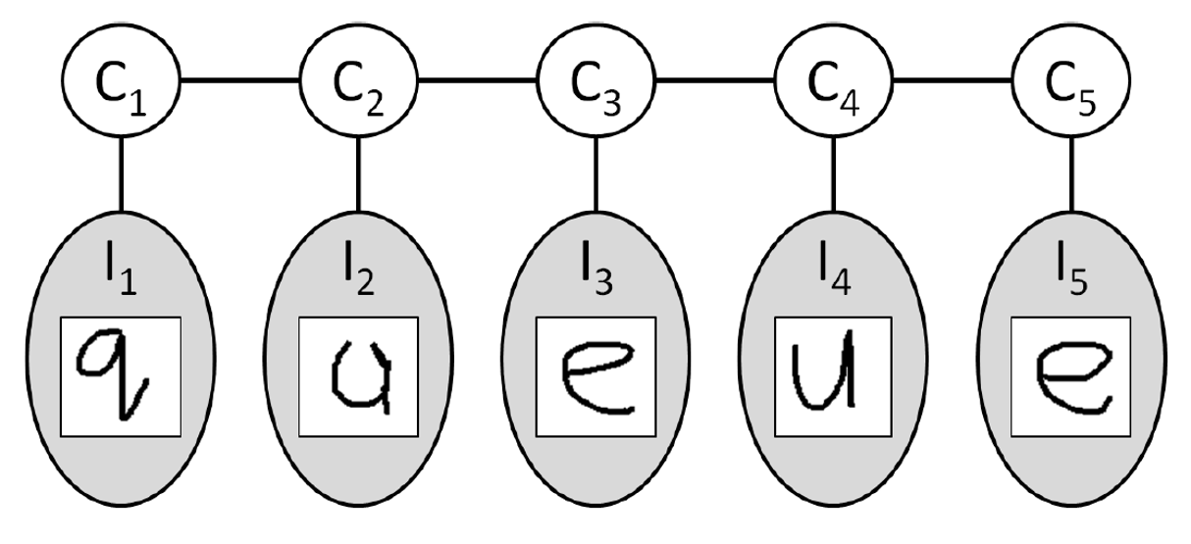
Graphical Models in Machine Learning
Subtitle
Author 1 Name (contact details)
Author 2 Name (contact details)
Introduction
Bayesian Networks
Hidden Markov Models
Neural Networks
Predicting labels of sequential data is a classical supervised learning problem faced in machine learning and many other fields like bioinformatics, computational linguistics and speech recognition. It involves predicting large number of variables that can depend on each other as well as observed variables. For example, the tag of a word in a sentence depends on the observed word itself and also the predicted word thats before it and the predicted word that comes after it.
A popular way of tackling this problem is by using Hidden Markov Models (HMMs). HMMs work by calculating the probability of being in a state given your observations and the probability of transitioning from that state to another state.
(Other examples include classifying regions in an image, digitizing handwritten characters in optical character recognition (Handwritting recognition), and segmenting genes in a strand of DNA). Due to this structure in the data, graphical models have been used to compactly model the the multiple variables and assist classification methods in predicting the labels using large sets of observed values. A popular probibalistic graphical models that are used are conditional random fields (CRFs). CRFs have had wide application in many areas including, computer vision, natral language processing and bioinformatics. They work by defining a conditional probability distribution over the label sequences given a particular observation sequence instead of a whole joint probability distribution over the label and observation sequences.
For instance, in the part-of-speech tagging of a sentence, a verb is more likely to come before a noun than another verb. A common model for predicting these labels is the Hidden Markov Model (HMM).
Text

