Slide 1
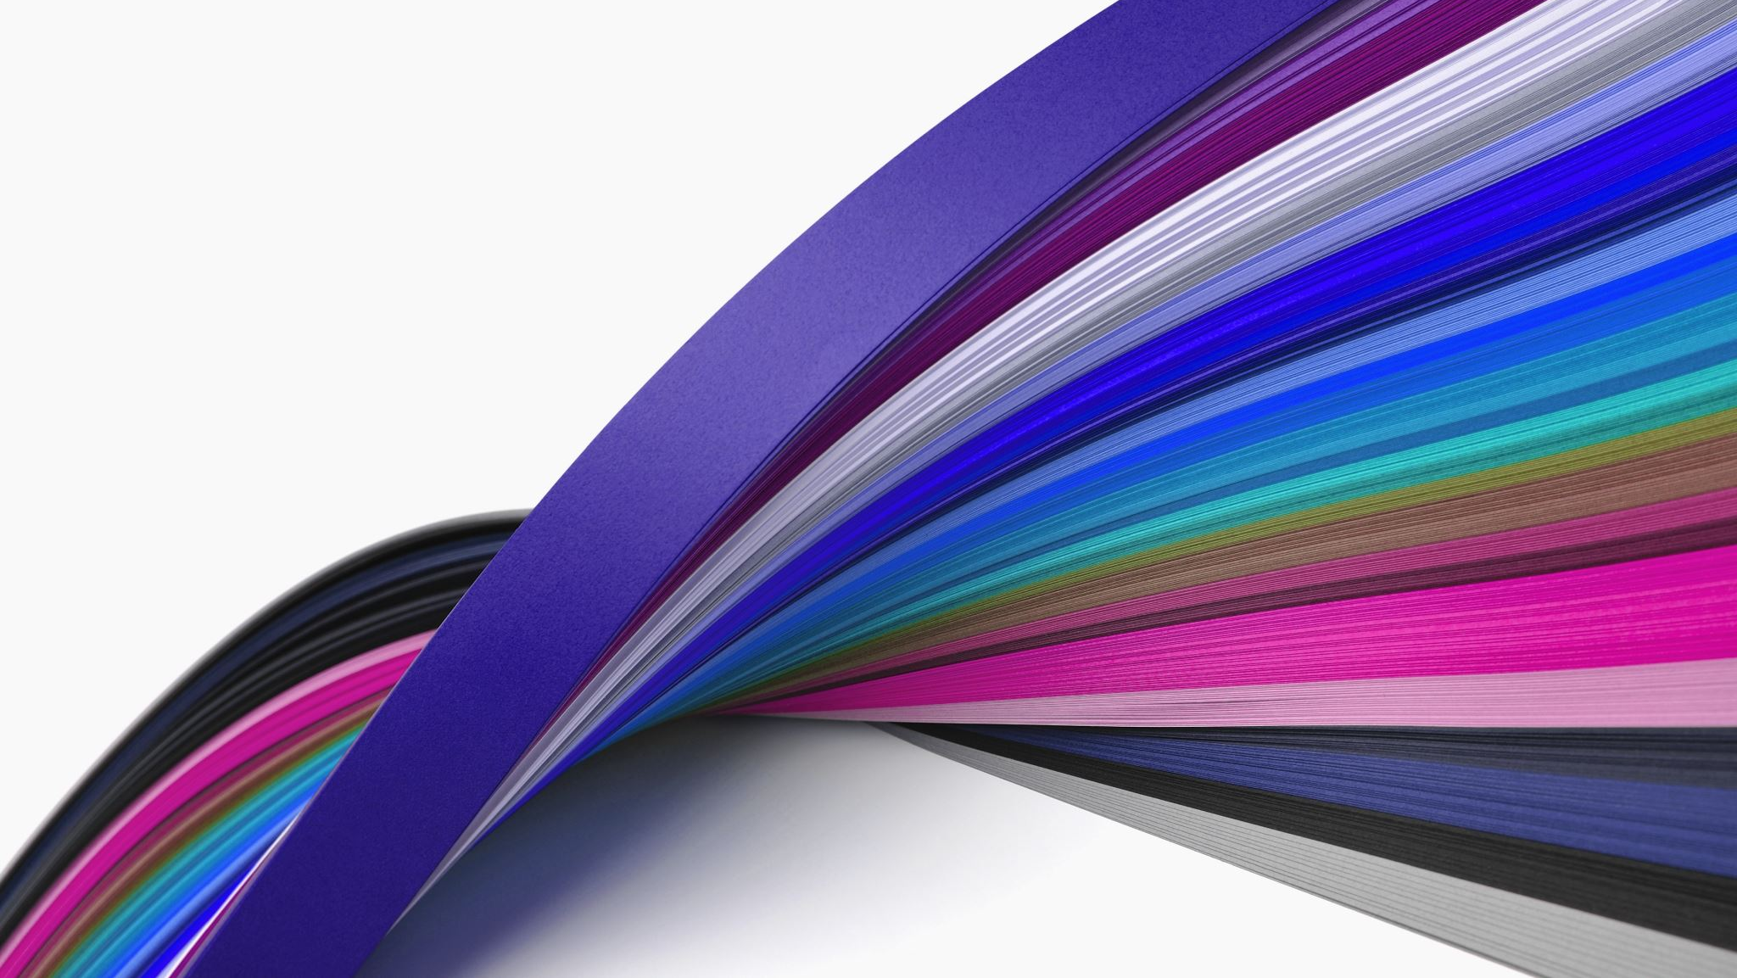

RoCry
Created by:
Dylan Bowsky, Tonia Hurst, Kevin Mau, and Abiy Mekuria

Slide 2


The product
This is a one stop shop for your crypto, stock, and bond portfolio
We make investing easy using our recommended portfolio’s
We use Machine Learning to enhance your portfolios and stay up to date with trends!

Slide 3
The Machine Learning
RoCry uses machine learning in your portfolio by looking at the daily returns summation of the portfolio and creating a random forest classier model.
Why Rf model?
We can use a vast amount of data and also not worry as much with overfitting and biases
For our F-T-W we used a neural network which is looking at daily return trends on our weekly fund picks.

Slide 4
Enough with the slides
Let's take a dive into our website and meet the team along with Cibi our chat bot!

Slide 5

Next step
Creating NLP using news stations and social media cues
Enhancing our portfolios to create bigger funds and continue to expand our variety
Build on with our site and create an even more interactive UI for the user

Slide 6
Struggles
Being able to integrate the bot with Lambda and using voice chat rather than text chat
Getting a large amount of data and then cleaning it for the user
Finding the machine learning that correctly fit with our goal at RoCry

Slide 7
Questions?
Don’t be shy

