Slide 1


RoCry
Created by:
Dylan Bowsky, Tonia Hurst, Kevin Mau, and Abiy Mekuria

Slide 2


The product
This is a one stop shop for your crypto, stock, and bond portfolio
We make investing easy using our recommended portfolio’s
We use Machine Learning to enhance your portfolios and stay up to date with trends!

Slide 3
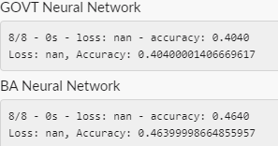

The Machine Learning
RoCry uses machine learning in your portfolio by looking at the daily returns summation of the portfolio and creating a random forest classier model.
Why Rf model?
We can use a vast amount of data and also not worry as much with overfitting and biases
For our F-T-W we used a neural network which is looking at daily return trends on our weekly fund picks.

Slide 4

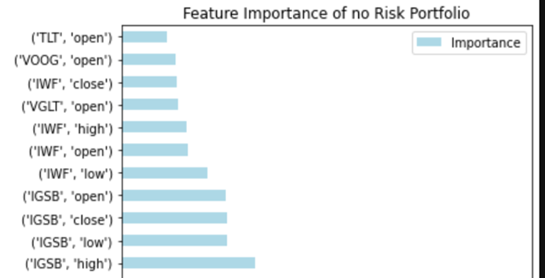
Portfolios
Hand picked by the team.
The goal is to create a well-rounded portfolio for the user
An easy way to get integrated with Crypto
The portfolios are based off of risk tolerance of the user.
Starting from a no risk, pure bond, to a high-risk using stocks and crypto currencies

Slide 5
RoCry Bot
RoCry is our chat bot for the user to get acquainted with investing.
The goal is to create an interactive bot which will give recommendations for which portfolio we will provide
RoCry will be using Lambda for its functions and Kommunicate for its integration to the dash

Slide 6
Enough with the slides
Let's take a dive into our dash and meet the team along with RoCry our chat bot!

Slide 7
Struggles
Being able to integrate the bot with Lambda and using voice chat rather than text chat
Getting a large amount of data and then cleaning it for the user
Finding the machine learning that correctly fit with our goal at RoCry
Speech bot only works with Google and not Lex
Overcoming web deployment issues and app deployment

Slide 8

Next step
Creating NLP using news stations and social media cues
Enhancing our portfolios to create bigger funds and continue to expand our variety
Build on with our site and create an even more interactive UI for the user
Have RoCry be voice activated and be able to handle a full transaction
Be able to implement machine learning/natural language processing for RoCry to be constantly evolving
Finish web build out with all the features we developed

Slide 9
Questions?
Don’t be shy

