Slide 1
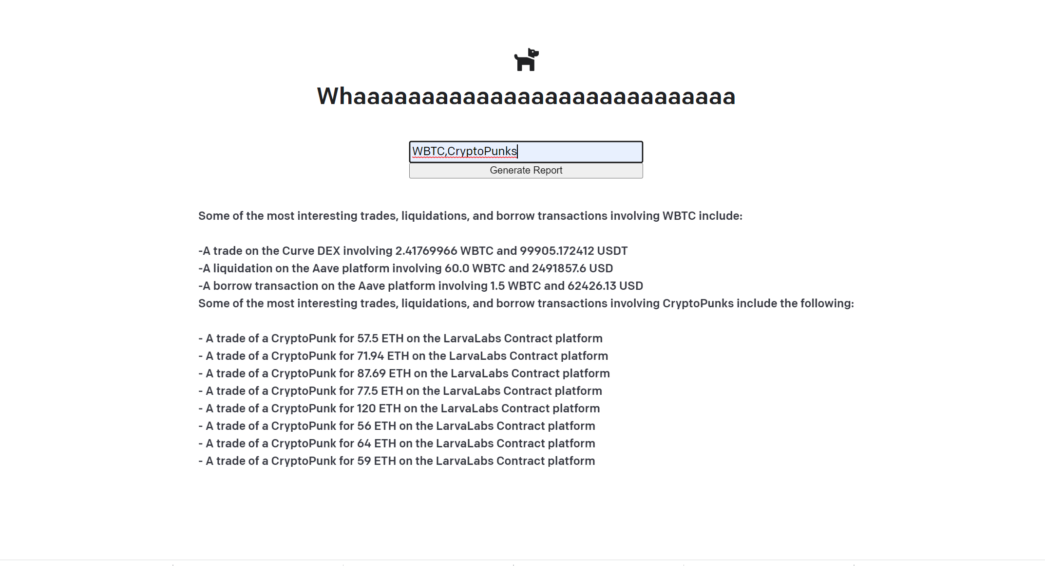

Slide 2
Whaaaaaaaaaaaaaaaaaaaaaaaaaaaa
(An attempt at) Analysis of on-chain data using Dune Analytics and GPT-3.

Slide 3
Whaaaaaaaaaaaaaaaaaaaaaaaaaaaa
(An attempt at) Analysis of on-chain data using Dune Analytics and GPT-3.
Claim to fame?: First web3 project to use python Flask

Slide 4
LIVE DEMO LIVE DEMO LIVE DEMO LIVE DEMO LIVE DEMO LIVE DEMO LIVE DEMO LIVE DEMO LIVE DEMO LIVE DEMO LIVE DEMO LIVE DEMO LIVE DEMO LIVE DEMO LIVE DEMO LIVE DEMO LIVE DEMO LIVE DEMO LIVE DEMO LIVE DEMO LIVE DEMO

Slide 5
How the data flows
On-Chain Data
Function: multicall(uint256 deadline, bytes[] data)
MethodID: 0x5ae401dc
[0]: 0000000000000000000000000000000000000000000000000000000062647eba
[1]: 0000000000000000000000000000000000000000000000000000000000000040
[2]: 0000000000000000000000000000000000000000000000000000000000000001
[3]: 0000000000000000000000000000000000000000000000000000000000000020
Dune Analytic Data
2022-0420T00:00:53+00:00,APE,WETH,4302.59222412472,18.614072015625,Uniswap,DEX,57654.7712,\x56178a0…
2022-04-20T00:01:55+00:00,TUSD,WETH,10000,3.225546,0x API,Aggregator,10004.98,\x74de5…
2022-04-20T00:01:55+00:00,TUSD,WETH,10000,3.225546,0x Native,DEX,10004.98,\x74de5d…
Semantic JSONL
The block time is 2022-04-20T00:00:53+00:00. The token a symbol is APE. The token b symbol is WETH. The token a amount is 4302.59222412472. The token b amount is 18.614072015625. The project is Uniswap. The category is DEX. The usd amount is 57654.7358032712. The trader a is \\x56178a0d5f301baf6cf3e1cd53d9863437345bf9
GPT-3 Response
A trade of 4.61917998594287 ETH for 100,000.0 DOGE on Uniswap, worth approximately $14,602.0593879629 USD

Slide 6
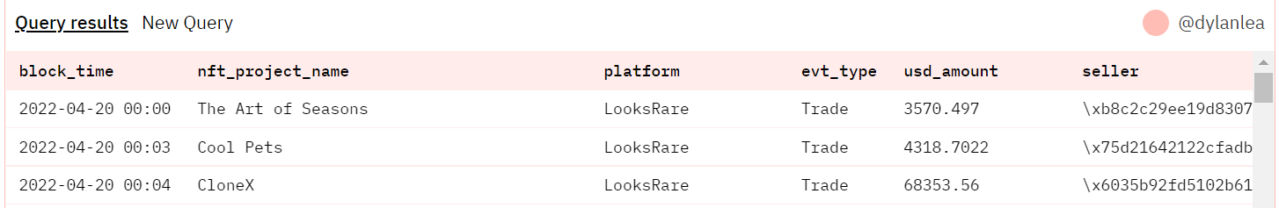
Step 2: Use of Dune Analytics’ Abstractions to provide semantic information

Slide 7
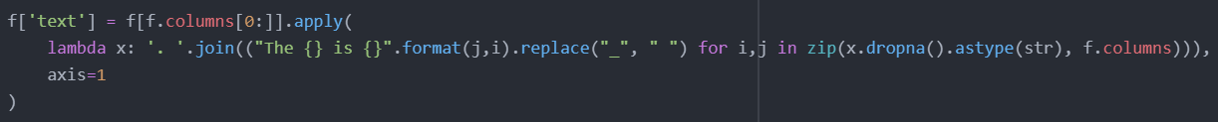
Step 2: Use of Dune Analytics’ Abstractions to provide semantic information

Slide 8
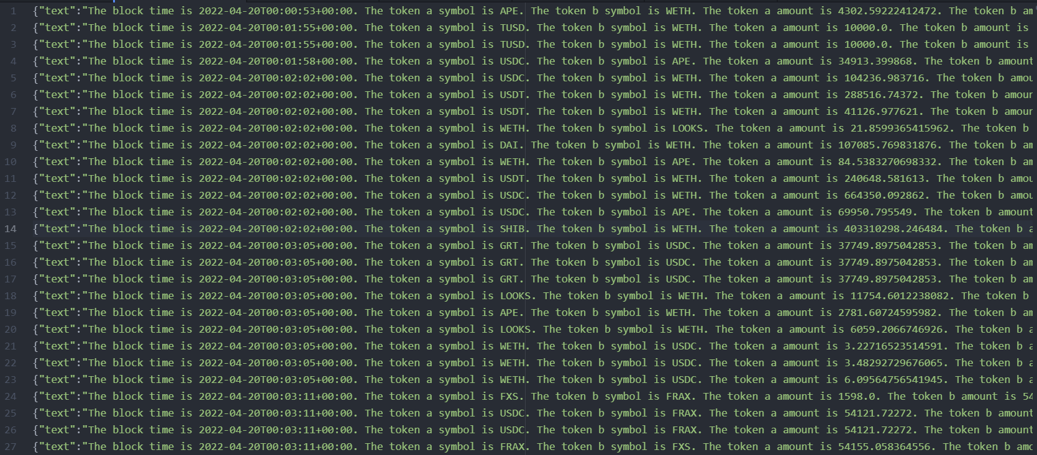
Step 3: Querying GPT-3

Slide 9
Step 3: Querying GPT-3
GPT-3 provides several modes: Completions, Classifications, Search, Answers
Answer queries take a question, examples with context, and documents/file.

Slide 10
Step 3: Querying GPT-3
GPT-3 provides several modes: Completions, Classifications, Search, Answers
Answer queries take a question, examples with context, and documents/file.
The JSONL file for a single day is 10MB. This is much too much for a GPT-3 query.

Slide 11
Step 3: Querying GPT-3
GPT-3 provides several modes: Completions, Classifications, Search, Answers
Answer queries take a question, examples with context, and documents/file.
The JSONL file for a single day is 10MB. This is much too much for a GPT-3 query.
However, we can upload a ‘File’ to the GPT-3 API (up to 1GB!) .
GPT-3 Answers provides a key word search. Followed by a semantic Search. Followed by an answer to the question using the most relevant documents.

Slide 12
Problems
Problem 1: GPT-3 likes to express creative flourishes

Slide 13
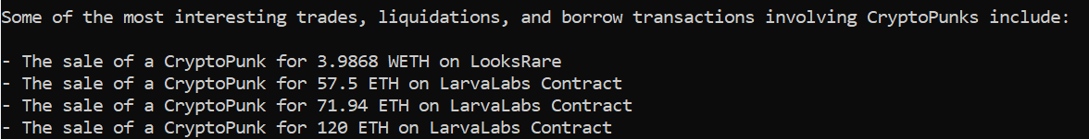
Problems
Problem 1: GPT-3 likes to express creative flourishes
An example:

Slide 14
Problems
Problem 1: GPT-3 likes to express creative flourishes
An example:

Slide 15
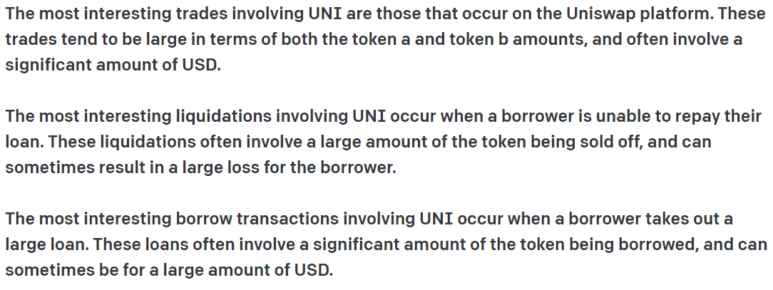
Problems
Problem 1: GPT-3 likes to express creative flourishes
An example:

Slide 16
Problems
Problem 1: GPT-3 likes to express creative flourishes
An example:
This can probably be solved by modifying GPT-3 query parameters, or using a different (less inspired) engine.

Slide 17
Problems
Problem 1: GPT-3 likes to express creative flourishes
Problem 2: GPT-3 rate limits

Slide 18
Problems
Problem 1: GPT-3 likes to express creative flourishes
Problem 2: GPT-3 rate limits
GPT-3 queries are limited in size to 4000 tokens (roughly 3000 words). This includes the prompt (input) and response (output).

Slide 19
Problems
Problem 1: GPT-3 likes to express creative flourishes
Problem 2: GPT-3 rate limits
GPT-3 queries are limited in size to 4000 tokens (roughly 3000 words). This includes the prompt (input) and response (output).
This means the response is ultimately limited to only including information about a few transactions.

Slide 20
Questions?

Slide 22
Next steps
GPT improvements:
Fine-tuning
Backend improvements:
Day selector (realistically requires Dune Analytics API)
Caching
UI improvements:
Add day selector
Proper tags selector
Domain (requires caching)
Hyperlinks
Crazy:
NFT per day where royalties feed into DAO which pays for API calls

Slide 23
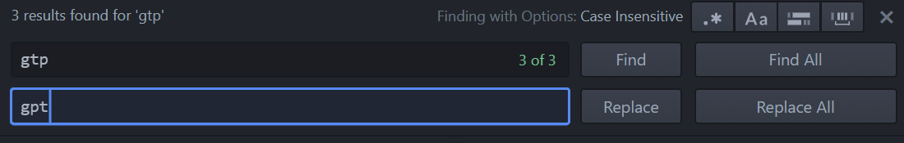

Slide 24
