Slide 1


ALTEA
INFORMATIQUE
Maître de stage :
CARDOCK Alexis
RINEAU Willy
Session 2017-2018

Slide 2






Company presentation
CEO
October 2012
Creation
Limited Liability
Company
Balance sheet
- 52,078€
- 87,640€
Turnover
2013- 173,333€
2014- 314,215€
JAULIN Pierre
November 2012
Opening
IT shop
Net total
2013- 13,528€
2014- 35,036€
August 2013
Employment
Temporary contract
to permanent contract
Treasury
2013- 22,897€
2014- 50,643€
CARDOCK Alexis

Slide 3







Company presentation
TREE SERVICE
SELLIING
INSTALLATION
HOME SERVICE
REPAIR SHOP

Slide 4

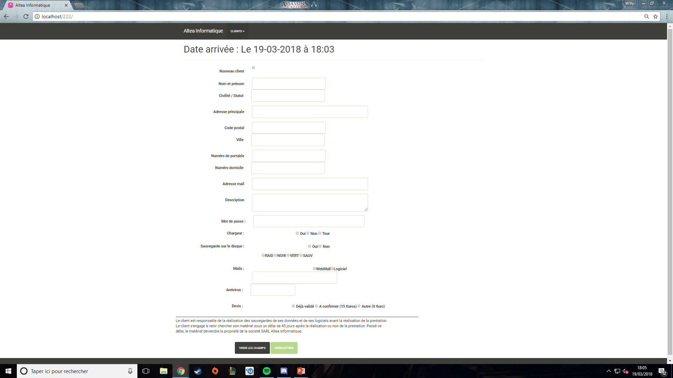
First task
Customer reception
WEB
WEB DESIGN
DATA TRANSFER

Slide 5

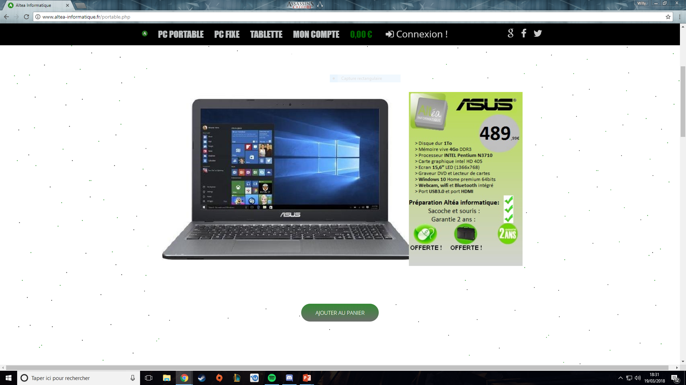

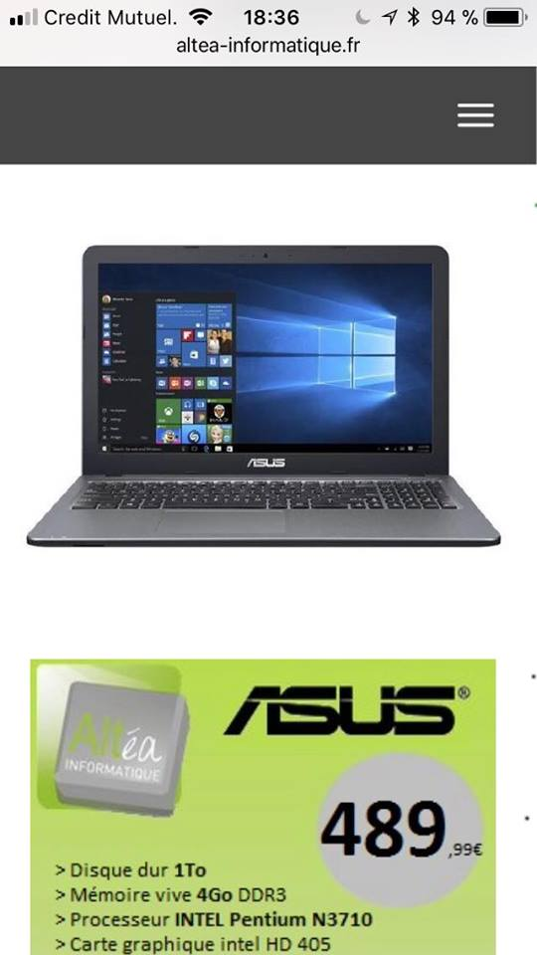
Second task
Website
WEB
ONLINE SHOPPING
SEARCH OPTIMIZATION
RESPONSIVE

Slide 6


Difficulties
TIME
THIRD TASK
UNKNOW LANGUAGE

Slide 7
Conclusion

