Slide 1

Maître de stage : MAJOLET Cédric
CHESNOUARD Dylan
Session 2017-2018

Slide 2
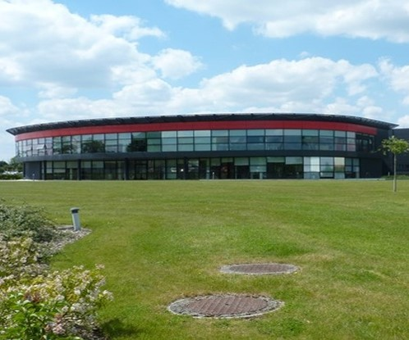
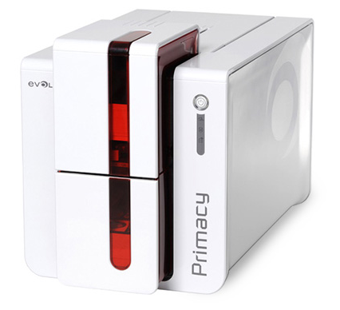
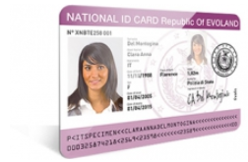

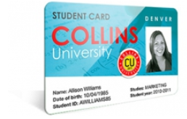
COMPANY PRESENTATION
DESIGN
BUILD
Primacy card printer
SELL
Evolis headquarter in Beaucouzé, France
1

Slide 3




PLASTICS CARDS MARKET
Government
Health
Finance
Leisure
2

Slide 4
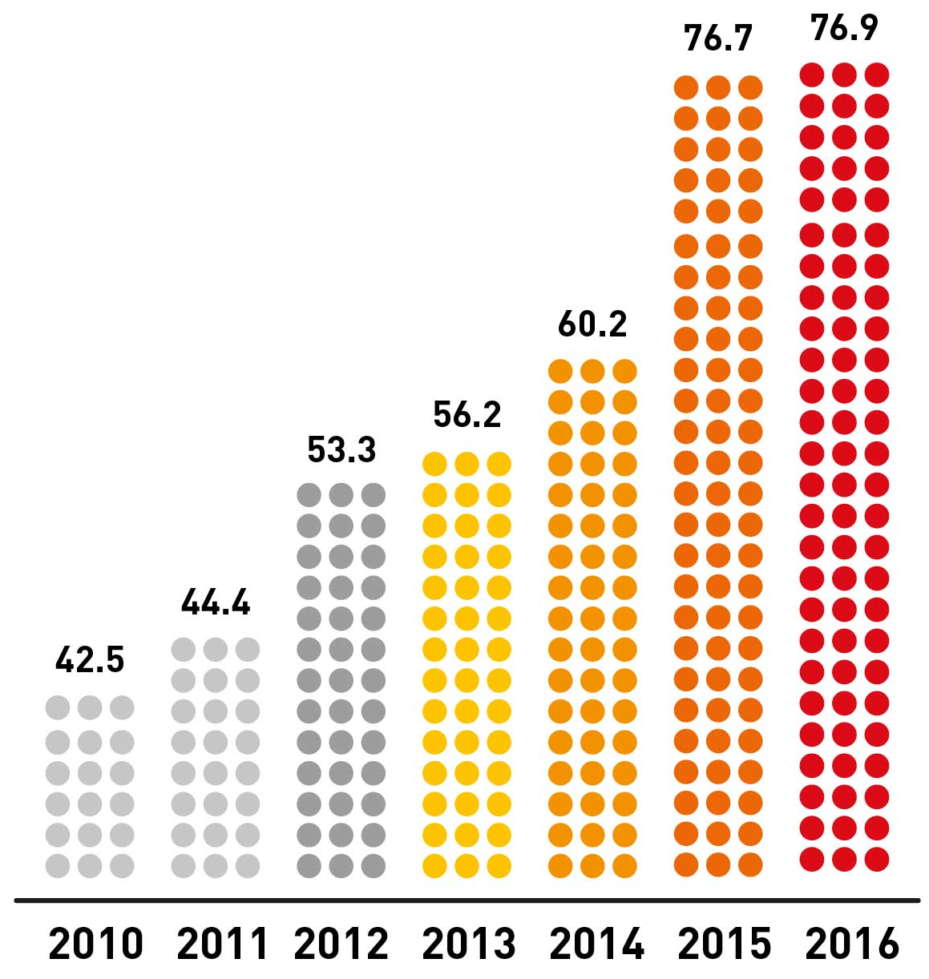
FAST GROWTH
Subsidiary opened
in Shanghai
2014
2013
Subsidiary opened in India
Acquisition of Sogedex
2011
Sales office
opened in Shanghai
2009
Asian subsidiary
opened in Singapore
2006
U.S. subsidiary
opened in Miami
2005
Commercial launch
Evolis revenues in M€
2000
3

Slide 5

MY TASK - GOALS
Speed up the preparation of the computer
Assure the maintenance of the IT infrastructure
Improve security of the IT infrastructure
4

Slide 6







MY TASK - PRODUCT CATALOGUE
Nomad
Sedentary
4

Slide 7




MY TASK - PACKAGE
Software
Script
Package
4

Slide 8



DIFFICULTIES
Organizational
Technical
Project management
4

Slide 9
CONCLUSION
A real enterprise need
Project realized despite the constraints
I.T. culture
4

