Slide 1

Maître de stage : MAJOLET Cédric
CHESNOUARD Dylan
Session 2017-2018

Slide 2
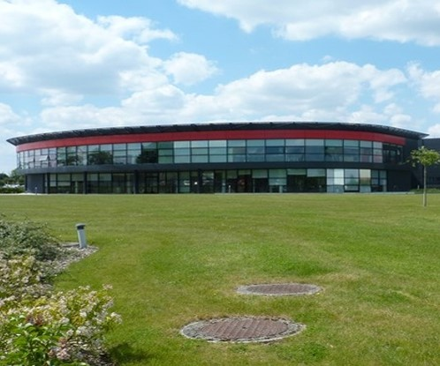
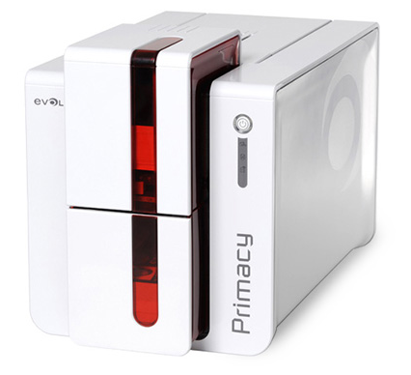
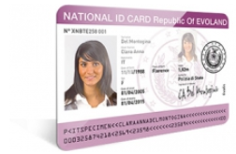

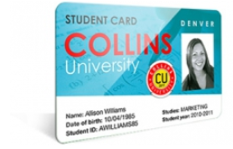
COMPANY PRESENTATION
DESIGN
BUILD
Primacy card printer
SELL
Evolis headquarter in Beaucouzé, France
1

Slide 3




PLASTICS CARDS MARKET
Government
Health
Health
Leisure
2

Slide 4
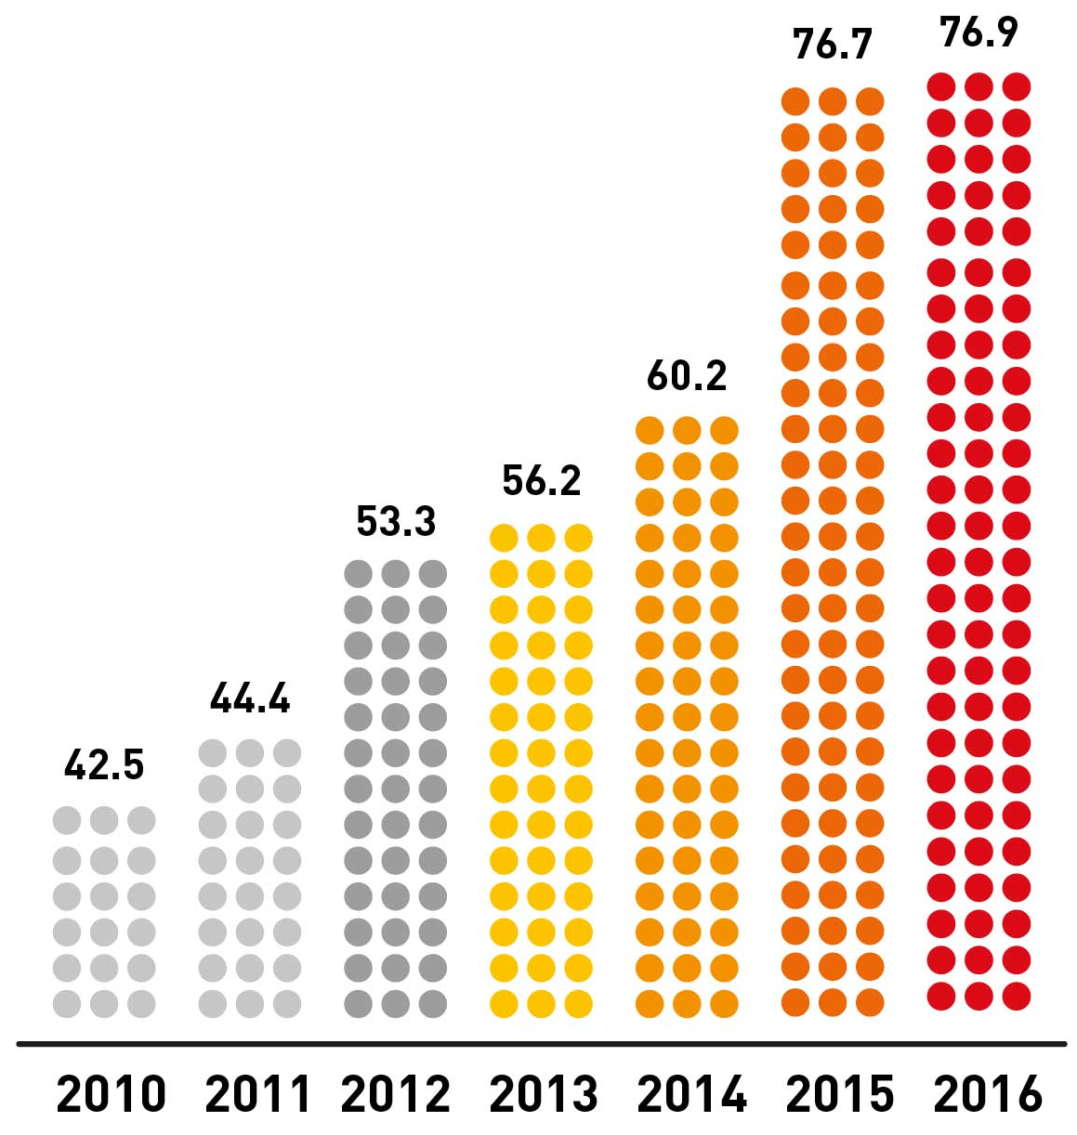
FAST GROWTH
2014
2013
2011
2009
2006
2005
Evolis revenues in M€
2000
3

Slide 5
FIRST TASK
4

Slide 6
FIRST TASK
4

Slide 7
SECOND TASK
4

Slide 8
SECOND TASK
4

Slide 9
DIFFICULTIES
Organizational
Technical
Project management
4

Slide 10
CONCLUSION
4

