Slide 1


CITYNOW BLOCKCHAIN INTERNSHIP
FINAL Report

Slide 2
GROUP Project:
Internet banking
focus on basic banking services; which are deposit, withdrawal and transfer.

Slide 3
Group Members
Nguyễn Hiền MSSV: 15520208
Huỳnh Phú Quí MSSV: 15520695
Dương Hoàng Linh MSSV: 15520421
Nguyễn Ngọc Hoàng Đại
MSSV:15520085
Văn Minh Huy MSSV: 15520321
Lê Hoàng Tuấn
MSSV: 15520967

Slide 4
Main functions
Transfer.
Deposit.
Withdraw.
Our system associates with bitcoin and Ethereum test net to transfer crypto currencies between users. Furthermore, it will be able to deploy on real main net.
Environment: Java

Slide 5

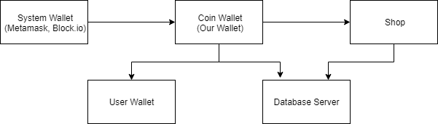

Slide 6
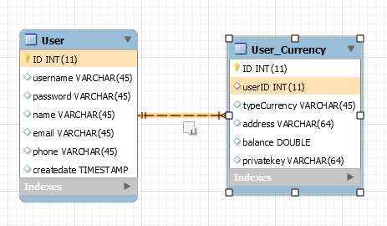
EER MODEL

Slide 7
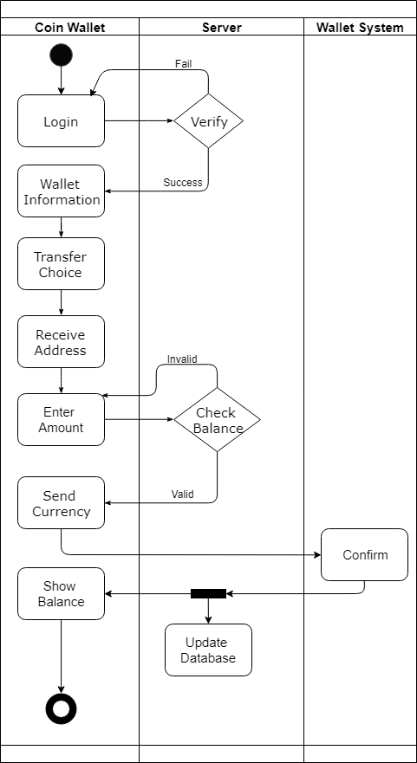
transfer function
Data flow diagram.

Slide 8
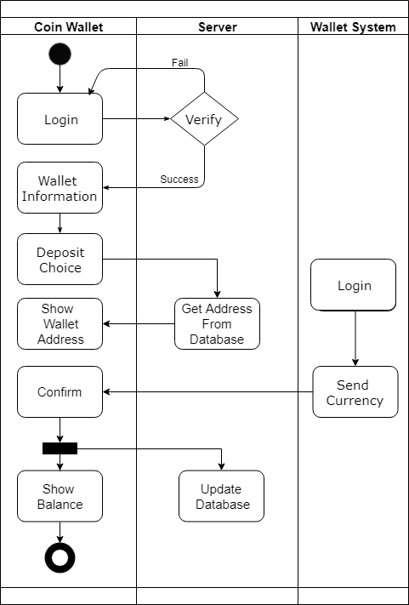
Deposit function
Data flow diagram.

Slide 9
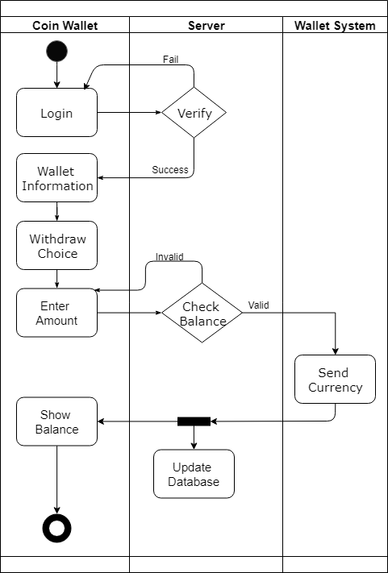
Withdraw function
Data flow diagram.

Slide 10
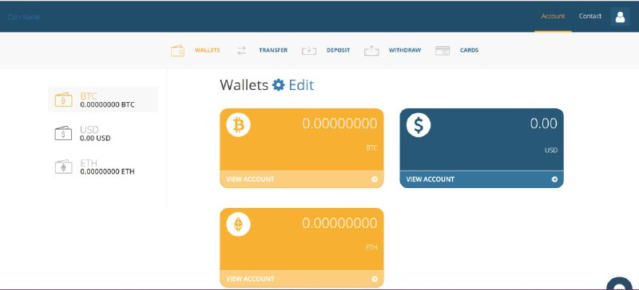
Web interface

Slide 11
Future Work
Finish the back-end and front-end of the project.
Complete deploying on the web app.

Slide 12
Document
https://drive.google.com/drive/folders/1rcR-nrcLS3ul2Jgec9V9LUpqzs_YLiLy?usp=sharing

Slide 13
Q&A

Slide 14
Thank you for listening

