Slide 1
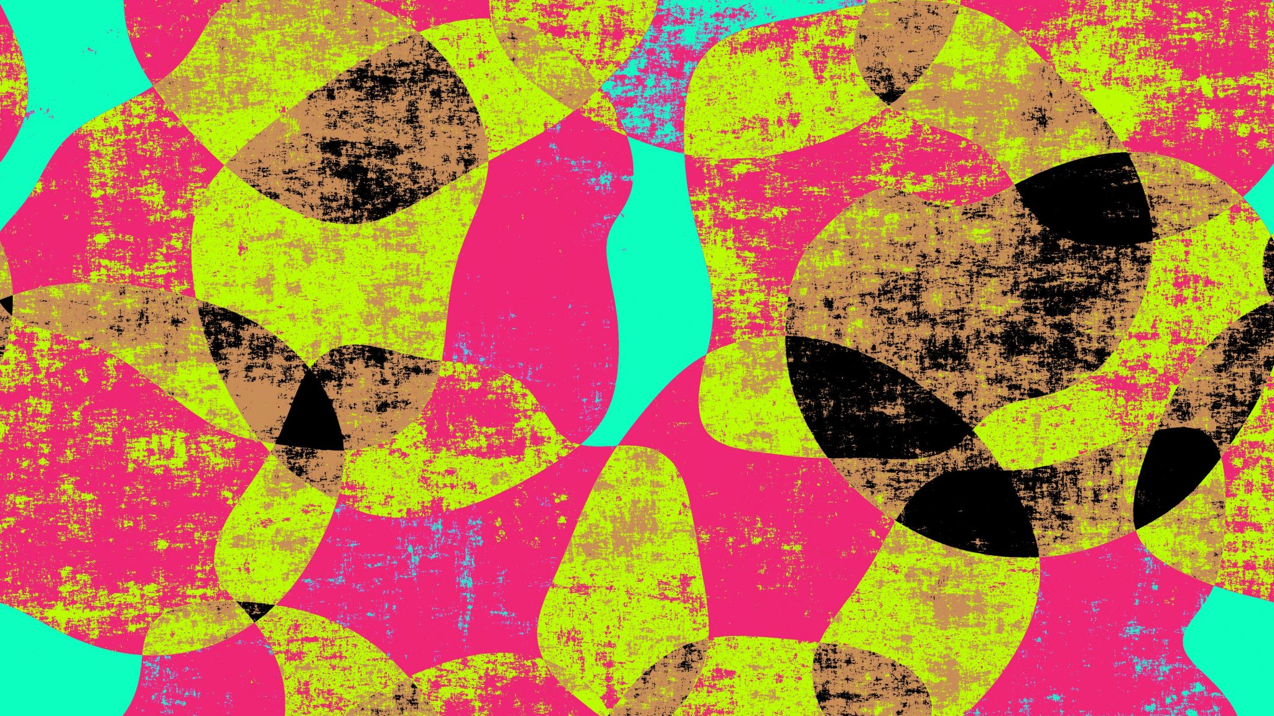
Diffusion
Dylan Deshler

Slide 2
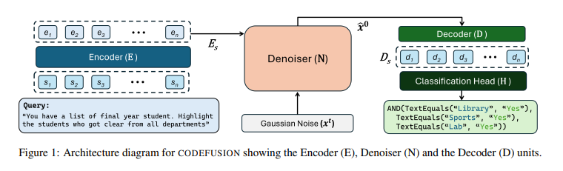
Motivation
Text diffusion (CodeFusion)
Issues
New direction

Slide 3
Comparisons to GANs
Comparisons to Autoregressive Networks
Easier to train (mode collapse)
Discriminator vs Generator
Typically, greater diversity and quality
Requires relatively large datasets
Full sequence attention
Speed vs memory tradeoff
Less literature (depending on the domain)

Slide 4
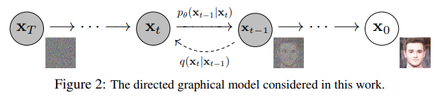
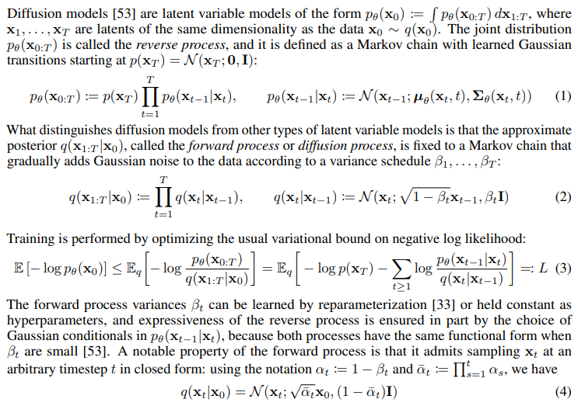
Background on Denoising Diffusion
https://arxiv.org/pdf/2006.11239.pdf

Slide 5
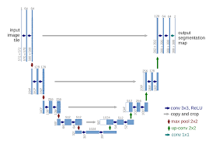
UNet Architecture
Standard for image -> image transformations (semantic segmentation)
Composed of a series of down sampling layers, followed by a bottleneck, and then up sampling layers connected with skip connections
Benefits: feature extraction, computational efficiency, simplicity

Slide 6
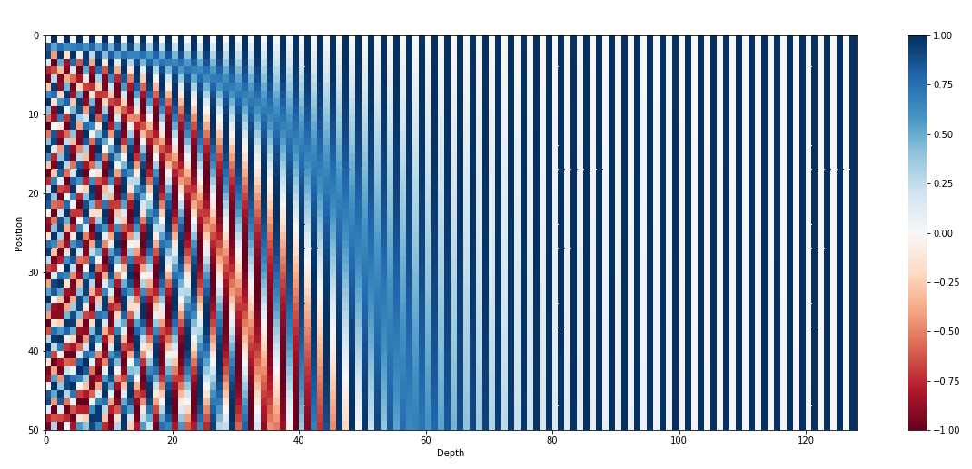
Sinusoidal Embeddings
Initially introduced in Attention is All You Need for providing token positional information to transformers
Sin(t / N^(2 * k/ D)) for even k
Cos(t / N^(2 * k / D)) for odd k
Can be used for any embedding (temporal, high-low frequency NeRF)

Slide 7
Loss
Variational Lower Bound
Assume noising process approaches a pure noise distribution at some non-infinite fixed T
Importance sampling (mini-batch sampling)
KL Divergence
Simplifies to L2 loss (L1 frequently used in practice)

Slide 8
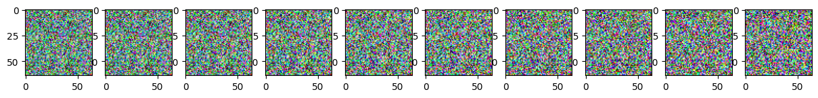
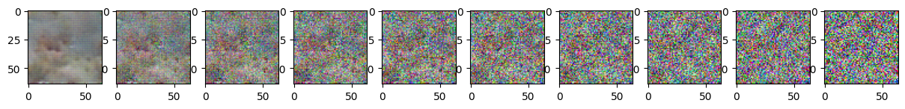
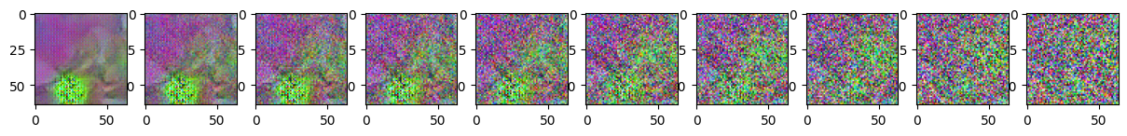
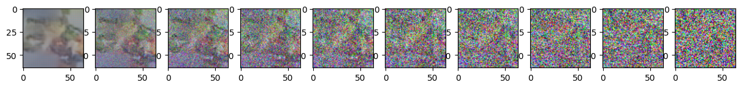
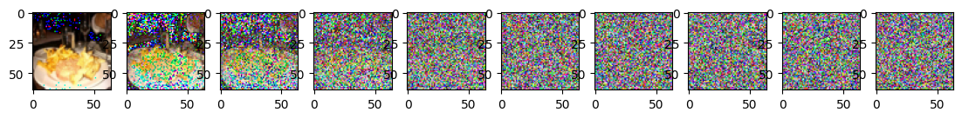
Results on Food101

Slide 9
Future Work
Transformer UNet
Discrete diffusion with text generation

Slide 10
Backup

Slide 11
Optional Assignment
EfficientNetB0 pretrained on noisy student dataset/methodology
Normalize [-1, 1], Resize images to expected size, Center crop
RandAugment
Single linear layer with 80% dropout
Freeze base model and train the head until convergence
Fine-tune the full model with a low learning rate, holding batch normalization parameters constant
Scale up with larger EfficientNets

