Slide 1
Julia
Dylan Deshler

Slide 2

Introduction
Julia is a multiparadigm high-level dynamic programming language designed for numerical analysis and machine learning applications.

Slide 3
Names, bindings, and scopes
Julia is dynamically bound at runtime with a “just-in-time” compiler
Termed a “just-ahead-of-time” compiler in the community because it compiles to machine code prior to execution
Optionally typed
Type inference
Global and local scopes
Multiple dispatch to support overloading functionals with different arguments

Slide 4
Data types
Primitive Types
Abstract Types
Composite Types
Int8, Int16, …, Int128
Uint8, Uint16, …, Uint128
Float16, Float32, Float64
Bool
Char
Also allows user defined primitives
Declared using abstract type keyword
Cannot be instantiated
Can be declared a subtype of an existing type with <: keyword
Structs are Julia’s version objects
Structs are immutable by default
Structs can be made mutable using the keyword mutable

Slide 5
Expressions and assignment statements
Typical bitwise, unary, binary expressions, along with the exponential operator (^)
Large set of update operators += -= *= /= \= ÷= %= ^= &= |= ⊻= >>>= >>= <<=
The dot (.) operator performs vectorized operations on arrays, this can also be done with the map function
Expressions can be chained like in Python:
1 < 2 <= 2 < 3 == 3 > 2 >= 1 == 1 < 3 != 5
Returns true
Numeric literal coefficients are treated as multiplications with highest binary precedence except for (^): 2x^2 with x=3 evaluates to 18

Slide 6
Support to object-oriented programming
Everything is an object
Functions are not contained by their objects but instead operate on them, multiple dispatch (like Haskell)
Supports constructors defined inside and outside of the object
Incomplete initialization supports recursive data structures
Julia generally, subjects OOP design but is not built for it and therefore it is not the recommended paradigm

Slide 7
Concurrency
Julia supports concurrent, parallel, and distributed computing
Coroutines can be used for asynchronous tasks which have wait and fetch operations and communicate through Channels
Scheduled by a runtime library, not the operating system
Multithreading is supported natively, but much of the ownness is on the programmer (i.e. avoiding data-race problems)
Pass data between tasks with Channels
Libraries for distributed and parallel computing

Slide 8
Exception handling and event handling
Julia is eagerly executed
Automatic garbage collection
Try, catch, else, and finally for exception handling
Supports explicit exception calling through the throw keyword

Slide 9
Functional programming
“Like Lisp, Julia represents its own code as a data structure of the language itself”
Julia has support for some functional programming patterns like macros which are designated by @
Many external libraries that have larger support for functional programming (Lazy.jl, LispSyntax.jl, Pipe.jl)

Slide 10

Project
A Taste of Machine Learning in Julia
Written Primarily in Julia
Train + Eval in Real-Time
Interactive Demonstration

Slide 11
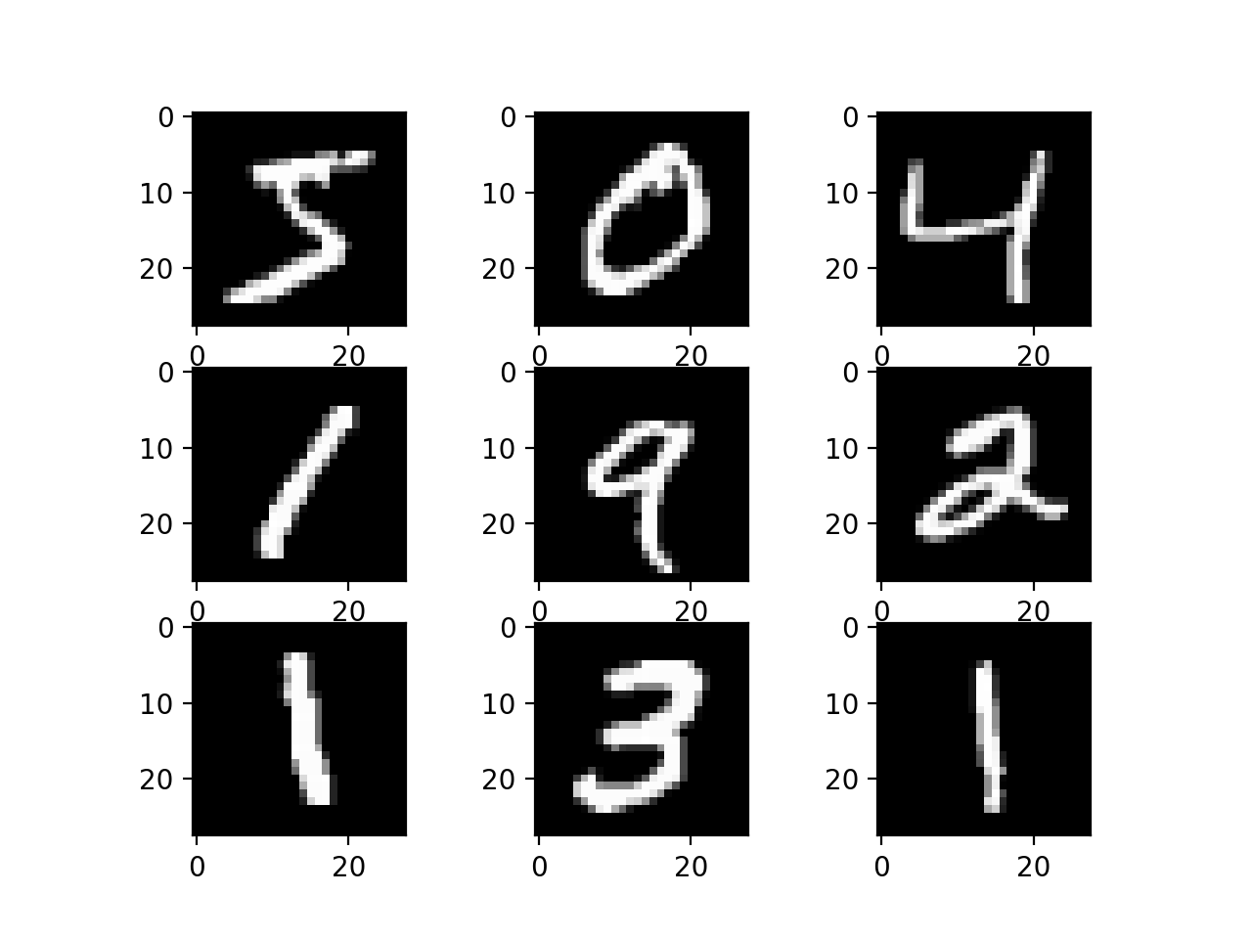
MNIST
Simple to spin up and fast to train
Evaluate Julia’s deep learning libraries
Community
Ease-of-use

Slide 12
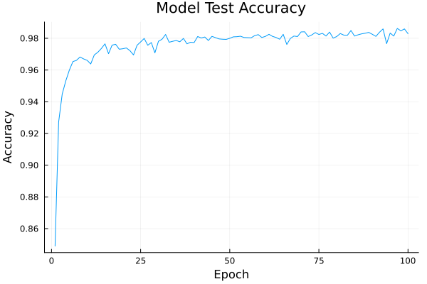
Training

Slide 13




Questions?
Dylan Deshler

