Slide 1

Web Services

Slide 2
Web Services
A web service is a software or application service used to communicate between two devices on a network
A web service involves a service provider and a server requester (client)
A web service is a function that can be accessed by other programs over the web. Data gets outputted in a format that may be consumed by another program that understands that output. The format can be XML, JSON, or something else.
Web services make functional building blocks accessible over standard Internet protocols independent of platforms and programming languages
Simplified definition: a web service allows an application to retrieve information from a resource or submit information to a resource
i.e. Provide a street address and call a web service to have Google Maps API return a graphical map of the location

Slide 3
REST
Representational State Transfer (REST)
Architecture style for designing networked applications
Relies on a client-server protocol, with the main one being HTTP
HTTP is the foundation of the communication of the Internet. To use REST, it needs the delivery methods that HTTP offers.
REST was made to treat objects on the server side as resources that can be created, updated, and deleted. This is accomplished through various requests.
What is so great about REST is it can be used by almost any programming language

Slide 4
REST Composition
Stateless
Doesn’t require server to retain session information or status about each communications partner for the duration of the requests
CRUD (Create, Read, Update, Delete)
HTTP, JSON, URL, XML
Notes:
https://dzone.com/articles/difference-between-rest-and-soap-api

Slide 5
When to Use REST
Limited bandwidth/resources
Simple, web-based operations (i.e. APIs)
Cacheable results
C#, JavaScript applications
See: ASP.NET Web API
Notes:
Limited bandwidth and resources; remember the return structure is really in any format (developer defined). Plus, any browser can be used because the REST approach uses the standard GET, PUT, POST, and DELETE verbs. Again, remember that REST can also use the XMLHttpRequest object that most modern browsers support today, which adds an extra bonus of AJAX.
Totally stateless operations; if an operation needs to be continued, then REST is not the best approach and SOAP may fit it better. However, if you need stateless CRUD (Create, Read, Update, and Delete) operations, then REST is it.
Caching situations; if the information can be cached because of the totally stateless operation of the REST approach, this is perfect.

Slide 6
REST Scenario
You want to build a web app and you decide to decouple the functionality from the presentation of the app
You create an API and let others implement their own frontends over it.
Your API provides interchangeable mechanism between the backend (web service) that generates data, and the frontend that can display the data. The main issue is the backend and frontend must speak the same “language”
That is where REST becomes relevant. They are the two ways you can choose to communicate with a web service.

Slide 7
REST Review
REST was made to treat objects on the server side as resources that can be created, updated, and deleted. This is accomplished through various requests.
REST is an architectural style with no official standard, but uses multiple standards (HTTP, JSON, URL, XML)
REST API uses URL exposure to expose business logic

Slide 8
API
Application Program Interface (API)
Set of routines, protocols, and tools for building software applications
A contract provided by one piece of software to another piece of software
Consists of a structured request and a structured response
Think of it as a messenger between running software
Essentially, one software wants information formatted a specific way and the other software will give the data in such a way, depending on the response
APIs exist everywhere (smart phones, appliances, etc.), but we are going to be focusing on Web APIs specifically

Slide 9
Realistic Analogy to Help Understand API
Scenario: You are at a restaurant. The restaurant consists of cooks in the kitchen as well as waiters taking orders and serving food.
You are a client-side web application
The kitchen is the server or service that processes requests
The waiter is the API. He takes a certain order in a specific way, takes that order to the kitchen, and brings back a meal based on your request

Slide 10
HTTP Methods
GET: retrieve data from a specified resource using a HTTP request.
POST: submit data to be processed to a specified resource. Can make a POST request from a form.
PUT: update a specified resource. Actual data or properties will be in the request body. Must use AJAX, JavaScript, or jQuery to make a request from a form.
DELETE: delete a specified resource
* GET and POST are the most popular due to retrieving and submitting data from one piece of software to another piece of software

Slide 11
Endpoints
Endpoints are the URI/URL where an API can be accessed by a client application
Uniform Resource Identifier (URI)
A way to identify documents using a short string of numbers, letters, and symbols
Uniform Resource Locater (URL)
Contains information about how to fetch a resource from its location
URL is a subset of URI

Slide 12
Endpoints Examples
GET: https://exampleWebsite.com/api/users
Retrieves all of the users
GET: https://exampleWebsite.com/api/users/1
Retrieves a single user
GET: https://exampleWebsite.com/api/users/details/1
POST: https://exampleWebsite.com/api/users
PUT: https://exampleWebsite.com/api/users/1
PUT: https://exampleWebsite.com/api/users/update/1
DELETE: https://exampleWebsite.com/api/users/1
Notes:
WebAppName/Folder/

Slide 13
Authentication
It is common for APIs to require a form of authentication to use the server the API is providing
Typically, you will get x-amount of free API calls. After the x-amount is consumed, you will have to pay for the API calls. Some times the API calls are only available if you pay for them.
Other times all it takes is to register your web app with the owner of the API

Slide 14
Authentication
A popular form of authentication is OAuth2, an authorization framework
It requires a user to get an access token, which is passed along with the user to ensure they get authenticated properly
A user uses a browser (Google chrome) to reach an application. The application has functionalities the user wants to use. In order for a user to use the app, the app will need some privileges from the user to access its protected resource.
OAuth2 is intended to prevent the application from being harmful to the user by allowing only so much privilege and access

Slide 15
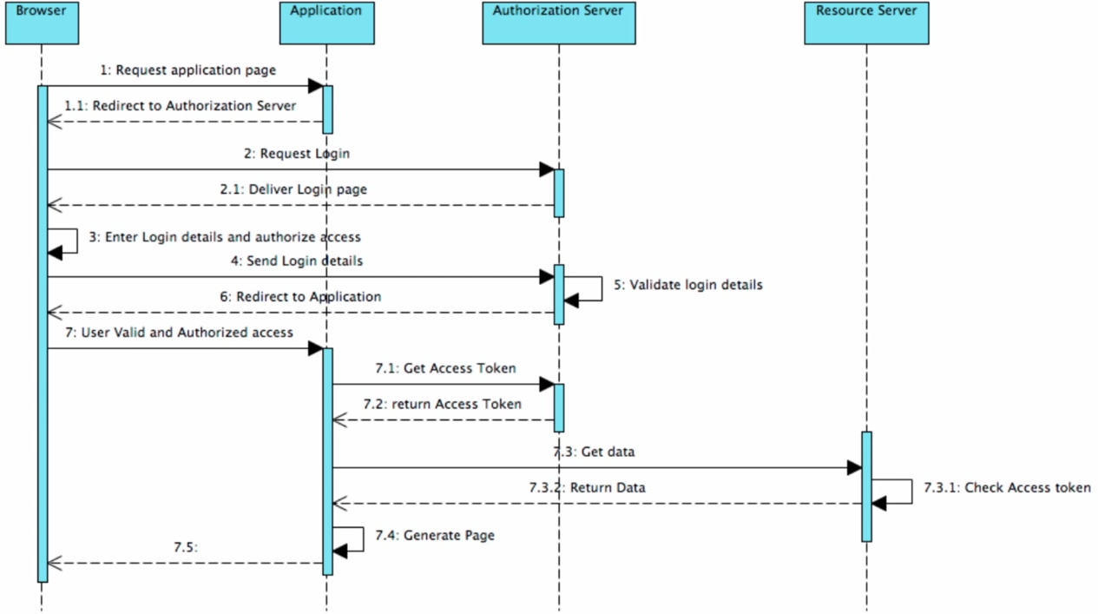
Visual Representation of How OAuth2 Works

Slide 16
Tools for API
Postman allows you to make GET, POST, PUT requests and see the data coming back in various formats
Notes:
https://developer.github.com/v3/users/
Getpostman.com

