Slide 1

Serialize and Deserialize JSON in C#

Slide 2
JSON Object
{
"firstName“ : "Duke“ ,
"lastName“ : "Java“ ,
"age“ : 18 ,
"streetAddress“ : "100 Internet Dr“ ,
"city“ : "JavaTown“ ,
"state“ : "JA“ ,
"postalCode“ : "12345“ ,
"phoneNumbers“ : [
{ "Mobile“ : "111-111-1111" } ,
{ "Home“ : "222-222-2222" }
]
}
Object are closed in braces ( {} ), their name-value pairs are separated by a comma ( , ) and the name and value in a pair are separated by a colon ( : )
Names in an JSON object are strings whereas values may be of any of the seven value types including another object or an array.

Slide 3
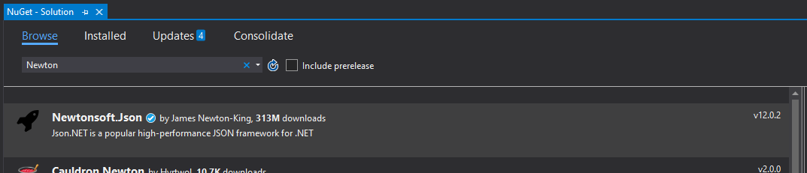
NewtonSoft Json.NET
Serialize and deserialize any .NET object with Json.NET JSON serializer.
Install the Newtonsoft.Json NuGet package.

Slide 4
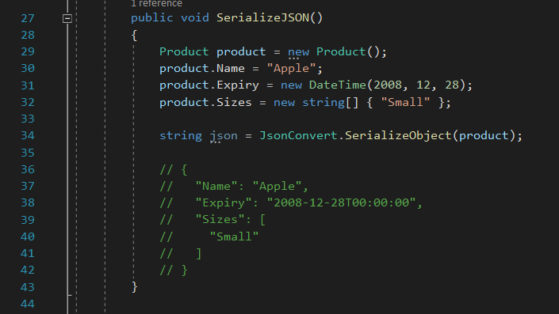
Serialization

Slide 5
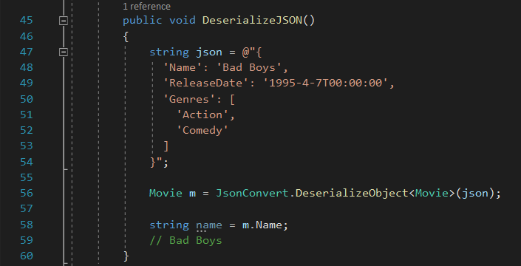
Deserialization
@ means to interpret the string literally (that is, you cannot escape any characters within the string if you use the @ prefix)

Slide 6
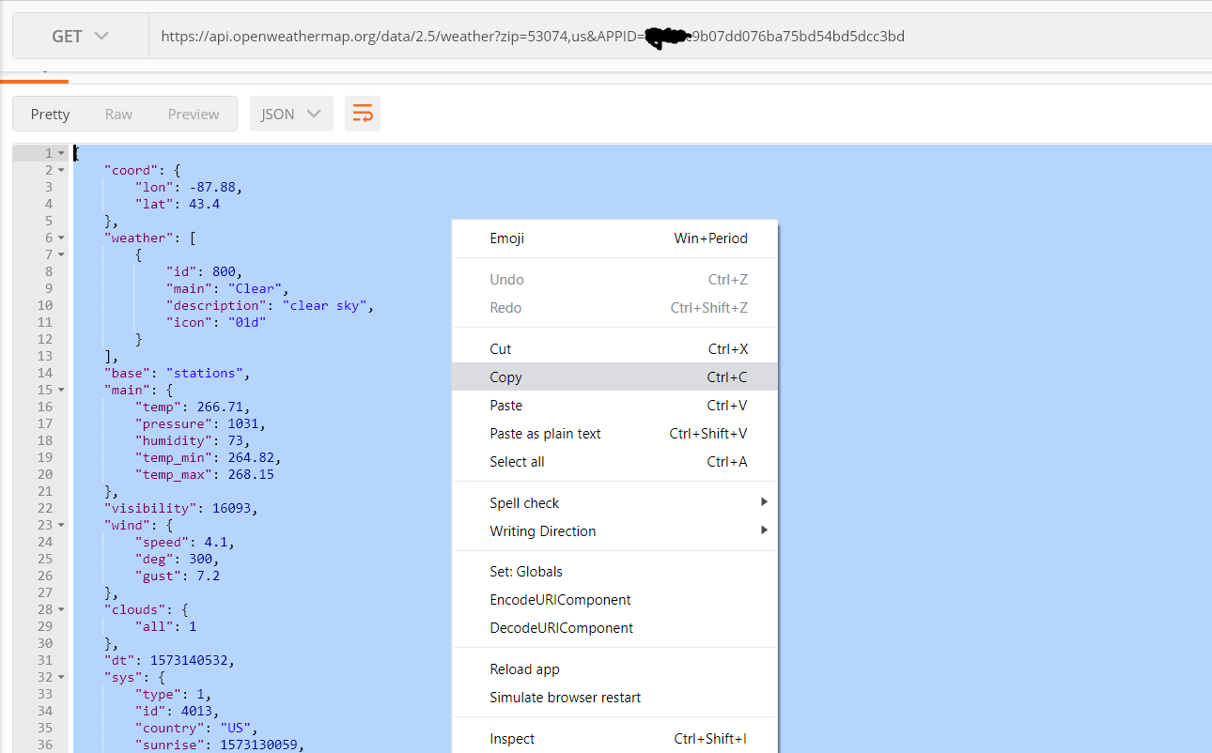
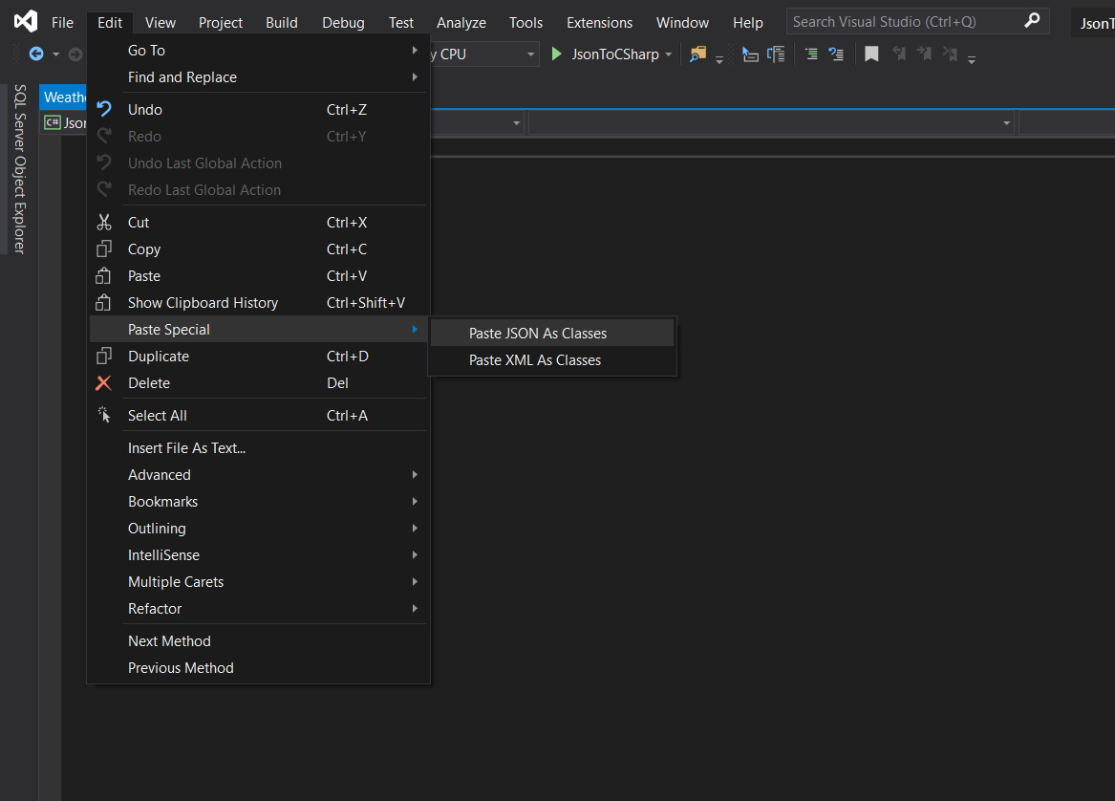
Paste Special in Visual Studio
Copy JSON response from postman and use Paste Special in an empty .cs file.

Slide 7
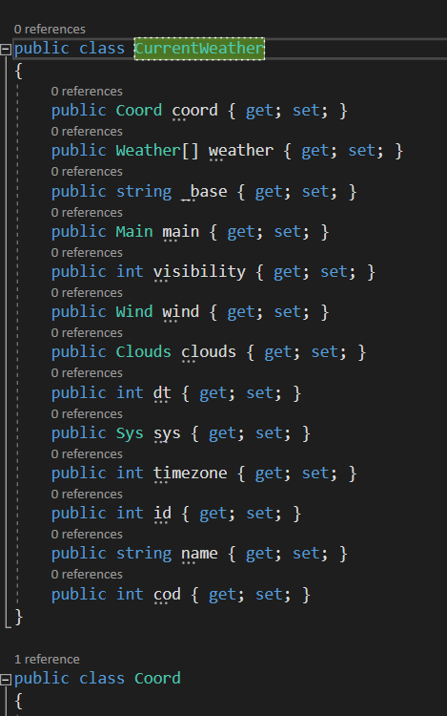
Change Rootobject to Unique Name
The class will generate with the class name of “Rootobject”.
Rename the class to something descriptive to what the object represents.

Slide 8
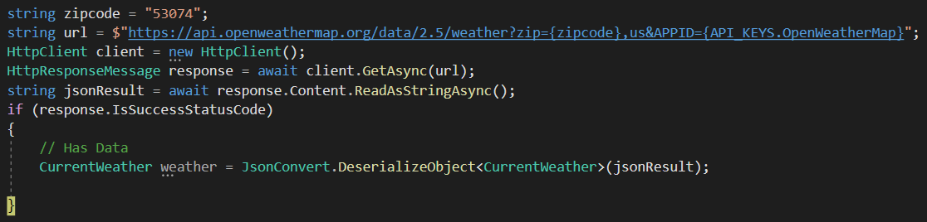
Use Deserialization on the Object!
Now that we have generated our class, we can use the Newtonsoft.Json to deserialize our JSON response.

Slide 9
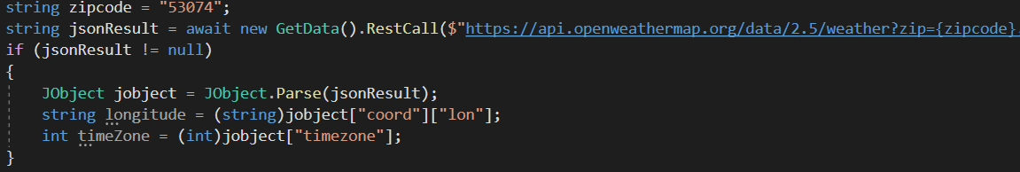
Using JObject to Retrieve Values
If we do not want to deserialize the entire response, we can grab specific values using JObject.
Using JObject.Parse we can parse our string into a map and access values using the JSON keys.
Notes:
Jobject is not smart enough to know the expected data type so we must cast.

Slide 10
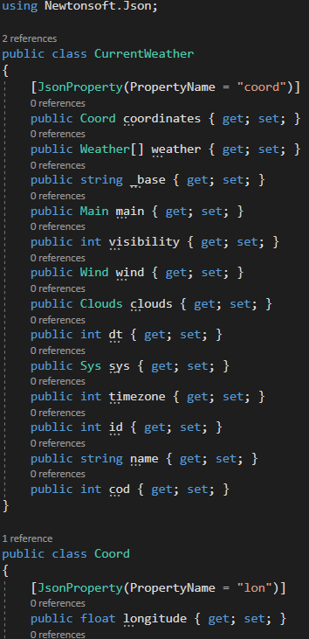
Custom JSON Property Binding
We can use the JsonProperty attribute to specify data binding to custom named properties on our models.
This allows us to use one model for multiple different API responses.
The JsonProperty attribute is part of the NewtSoft package.

