Slide 1

Welcome to JavaScript

Slide 2
What is JavaScript?
JavaScript is a scripting language that was created for use with the Netscape browser
The goal was to allow developers to create interactive websites
JavaScript and Java are 100% different languages
JavaScript was originally called LiveScript
Rumor has it that the name was changed as a marketing ploy

Slide 3
Getting Started
JavaScript in its purist form is attached to and run from an HTML document
Like with CSS, this can be inline, or external
Use external linking instead of inline

Slide 4
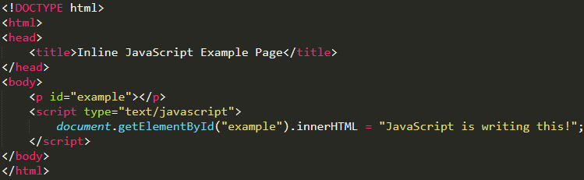
Inline Example
Notes:
We don’t like this.

Slide 5
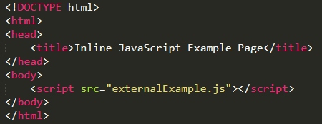
External Example
Notes:
We love this!

Slide 6
JavaScript Forgives
JavaScript tries to forgive minor mistakes, but this can cause some bad habits while learning
Adding "use strict"; as the first line of a .js file removes this forgiveness
Students at devCodeCamp are required to use "use strict";
Notes:
Among other things, “use strict” will not allow:
The use of undeclared variables.
Duplicate parameter names; i.e. function addTwoNumbers(num, num);

Slide 7
Browser as an IDE
When we use our browser as an Integrated Development Environment (IDE), it is easy to see our changes
Save changes made to the .js file
Refresh the window running the application to re-run the JavaScript

Slide 8
Write Options
We have two options for producing output:
console.log(“This is the text to write”);
.innerHTML = “This is the text to write”;
Notes:
The innerHTML property sets or returns the HTML content (inner HTML) of an element. Use this over document.write in most cases.

Slide 9
console.log(“message”);
console.log() will log text to the browser console window. It does NOT output to the webpage
When using a browser as our IDE, the console window can be accessed from the developer tools by doing one of the following:
Press F12 and navigate to the “console” tab.
Right-click and select “Inspect”. Then navigate to the “console” tab.
There is more than just the “console” tab in the developer tools that we will explore soon
Notes:
Integrated Development Environment

Slide 10
.innerHTML
Allows JavaScript to generate content for HTML id’s
The innerHTML property sets or returns the HTML content (inner HTML) of an element
document.getElementById(“myId”).innerHTML = “Hello world!”;
Notes:
The innerHTML property sets or returns the HTML content (inner HTML) of an element. Use this over document.write in most cases.

Slide 11
Assignment
Use JavaScript to:
Write your name to an HTML page
Write your age to the console
Write what state you were born in as an alert
*The last one may require additional research

