Slide 1

UML

Slide 2
Unified Modeling Language
Standard language for software diagramming
Essentially it a pictorial language used to make software blueprints

Slide 3
Class Diagram
Class diagram shows classes, interfaces, and associations
It describes the responsibilities within a software application
By far the most popular of the UML diagrams
Part of the structure diagram

Slide 4
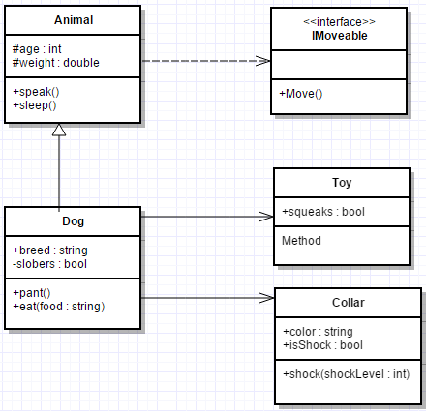
Class Diagram Example
Dotted Arrow: interface relationship
Closed Arrow: Is-A relationship
Open Arrow: Has-A relationship

Slide 5
Other Structure Diagrams
Object: represents an instance of a class diagram; dependent on class diagram
Component: model physical aspects of a system, such as executables, files, documents, etc.
Deployment: describe the hardware components where software components are deployed
Notes:
Object:
- http://creately.com/blog/wp-content/uploads/2012/01/UML-Object-Diagram.png
Component:
http://www.ibm.com/developerworks/rational/library/dec04/bell/
http://www.ibm.com/developerworks/rational/library/dec04/bell/Bell-Fig7.gif
Deployment:
- http://www.tutorialspoint.com/uml/images/uml_deployment_diagram.jpg

Slide 6
Behavior Diagrams
Activity: shows flow from one activity to another. In this case, activity refers to an operation of the system.
Statechart: shows different states of a component in a system
Use Case: gather design requirements for the functionalities of a system
Notes:
Activity:
- http://www.tutorialspoint.com/object_oriented_analysis_design/images/activity_diagram.jpg
Statechart:
- http://www.tutorialspoint.com/object_oriented_analysis_design/images/state_chart_diagram.jpg
Use Case:
- http://www.tutorialspoint.com/object_oriented_analysis_design/images/use_case_automated_trading_house.jpg

Slide 7
Interaction Diagram
Describes interactions among different elements in a model
Describe message flow of a system
Sequence Diagram: involved with time sequence of messages
Collaboration Diagram: organization of objects that send and receive messages
Notes:
Sequence:
- http://www.tutorialspoint.com/object_oriented_analysis_design/images/sequence_diagram.jpg
Collaboration:
- http://www.tutorialspoint.com/object_oriented_analysis_design/images/collaboration_diagram.jpg

Slide 8
Relationships
One-to-Many
Body has many Body Parts (head, chest, legs, arms, feet, hands)
Many-to-Many
Students take many Subjects and Subjects will be studied by many Students
One-to-One
One Person has one Social Security Number

Slide 9
Multiplicity Indicators and Values
Indicator
0..1
1
0..*
1..*
Values
Zero or one
One only
Zero or more
One or more
Note: Indicators can be whatever you want it to be

Slide 10
Class Diagram Example
Notes:
Dog → Toy is 0..*
Dog → Collar is 0..*

Slide 11
Class Diagram Example
Dog → Toy is 0..*
Dog → Collar is 0..*

Slide 12
UML Diagrams
There are many different types of UML diagrams.
Even though class diagrams are the most popular, UML diagrams, like anything else in coding, applies to the right tool for the job philosophy.
UML Drawing Resource:
www.gliffy.com
Microsoft Visio

Slide 13
Visual Studio 2017
Open an existing or create a new project
Install Class Designer
Create a new class diagram, give the diagram a name, click Add
You can then add the different classes from your project to the diagram
Open the toolbox to drag and drop different parts of the diagram.

