Slide 1

Properties vs. Fields

Slide 2
Properties vs. Fields
Fields are variables of any type that are declared directly in the scope of a class.
Properties are a way of getting values without exposing the member variables of a class.
Properties have accessors through which the private fields can be read or written.
Think of properties as an extension of fields.

Slide 3
Properties
Properties prevent the methods and attributes of a class from being accessed from outside of the class.
This means having private fields with public properties to access those fields.
It is important to prevent people from inserting illegal values or change the value of a field in a way you (the developer) did not expect.
You, as the developer, decide how your data can be accessed.

Slide 4
Accessors
The accessor of a property contains the ability to get (read or compute) or set (write) the property.
A property can have a get accessor, a set accessor, or both.

Slide 5
Get Accessor
Think of the get accessor as similar to that of a method. It will return the property type, just like a method will return the return type.
The get accessor will return the value of a private field.
Only using the get accessor is a read-only property, which means a value can’t be assigned to it.

Slide 6
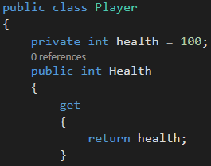
Get Accessor Example
In this example, you can only get the integer of what a Player’s health is, not set it.

Slide 7
Set Accessor
The set accessor uses the value keyword to store values in a private variable.
Only using the set accessor is a write-only property.

Slide 8
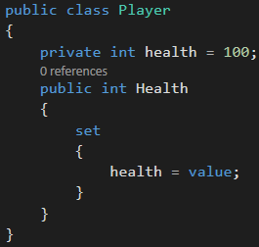
Set Accessor Example
In this example, you can only set the integer of what a Player’s health is, not get it.

Slide 9
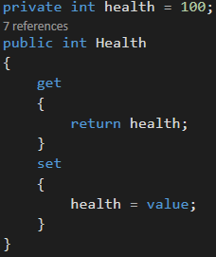
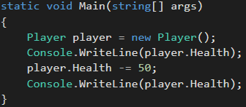
Properties Example
//Output
//100
//50

Slide 10
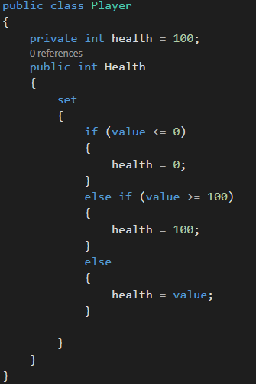
Advantages of Properties
Able to later add extra logic when needed, which won’t break existing code.

Slide 11
Advantages of Properties
Vary the get/set accessibility
For read-only properties where you don’t want to explicitly declare the backing variable
Ability to access setter from within class, but not outside of the class.

Slide 12
Advantages of Properties
Allows data binding to work properly
Data binding is the process of connecting the user interface and business logic of an application.
Data binding set up correctly: When the data in an element changes, data binding allows for an automatic update to reflect the change.

Slide 13
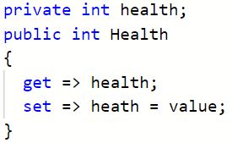
C# 7.0 Properties
Expression-bodied definitions can be used with properties whenever the expression for a supported member consists of a single expression
Notes:
https://docs.microsoft.com/en-us/dotnet/csharp/programming-guide/statements-expressions-operators/expression-bodied-members

