Slide 1

Four Pillars of OOP

Slide 2
Object-Oriented Programming (OOP)
OOP is a programming paradigm organized around objects rather than actions.
Objects have attributes (member variables, fields)
Objects have actions (member methods)

Slide 3
What Are Four Pillars of OOP?
Encapsulation, Data Abstraction, Inheritance, and Polymorphism combine to make an object-oriented programming paradigm.
These concepts as individuals can be used in a non-OOP way, but combined they define what OOP is all about.

Slide 4
Access modifiers
Access modifiers specify the accessibility of member or type
public: can be accessed by any other code. Its access is never restricted
private: can only be accessed by code in the same class
protected: similar to private. Difference is it can be accessed in a child class (any class that inherits from the parent class)

Slide 5
Encapsulation
The hiding of implementation details
Preventing access to irrelevant data
Only care about the object as you see it, not the implementation details
Access modifiers are used to implement encapsulation
Use public properties to access private member variables
Notes:
Turning on a game system:
Who cares what actually happens, I just want it to turn on!

Slide 6
Data Abstraction
Making relevant information visible
Gives the user access to relevant data
Focus on what the object does instead of how it does what it does
Notes:
Phone:
I care about the power button, volume rocker, camera (public)
I don’t care about how they work specifically (private)
Making a user interface for the phone!

Slide 7
Encapsulation & Abstraction Example
Think of when you purchase a mobile phone
You don’t see how the circuit board, or any of the other inner parts, work. Truthfully, you don’t really care how it works. The inner parts are encapsulated inside the phone casing, and the irrelevant information is kept from you.
Abstraction is when you see the different features (ability to make a call, take photos, download apps, listen to music, etc.) of the phone, instead of the internal parts of the phone. You see only the relevant information to you.
A user and an engineer will look at a phone very differently.

Slide 8
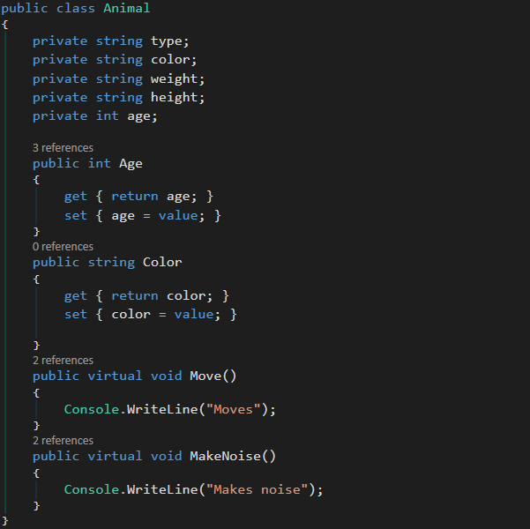
Encapsulation Code Example
Animal class has public properties to access private member variables
This allows the ability to hide implementation details

Slide 9
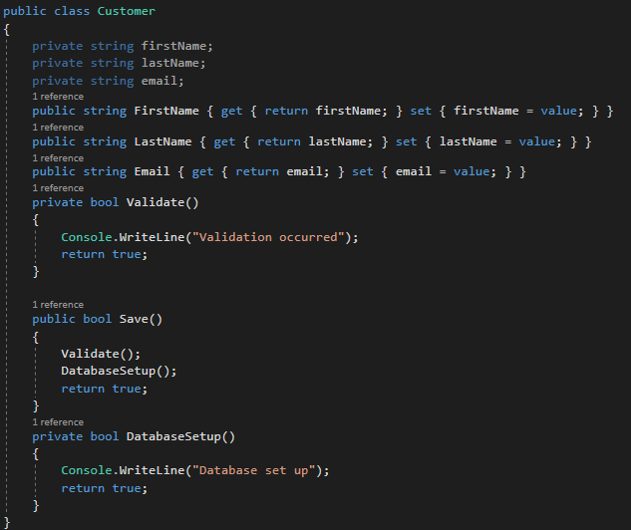
Data Abstraction Code Example
Abstraction achieved through the use of the "private" access modifier to hide some methods and all member variables from the outside world
Notes:
We have achieved Data Abstraction by making Save() visible (relevant info the the user; encapsulation), but making the actual logic (Validate() and DatabaseSetup(); data abstraction)

Slide 10
Inheritance
Process where one class acquires the member variables and methods of another class
The derived class (child class, subclass) inherits all of the members (variables and methods) from its base class (parent class, superclass).

Slide 11
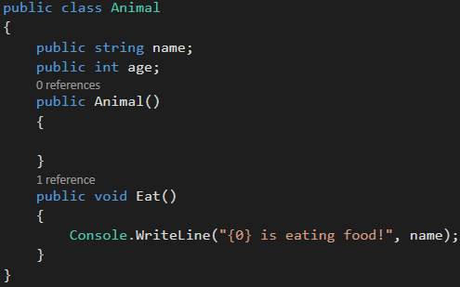
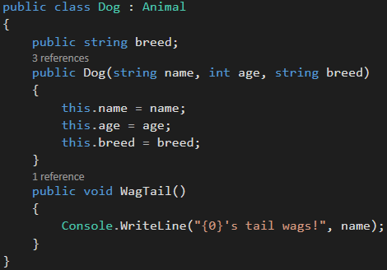
Inheritance Example

Slide 12
Polymorphism
Many forms of a single object
Static Polymorphism
Function overloading
Operator overloading
Dynamic Polymorphism
Abstract class, virtual, override

Slide 13
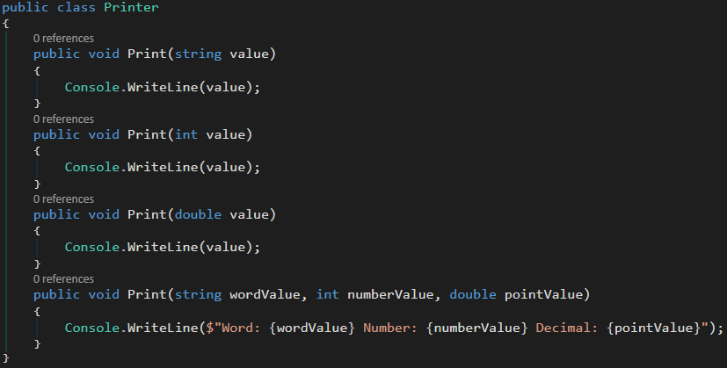
Static Polymorphism Example

Slide 14
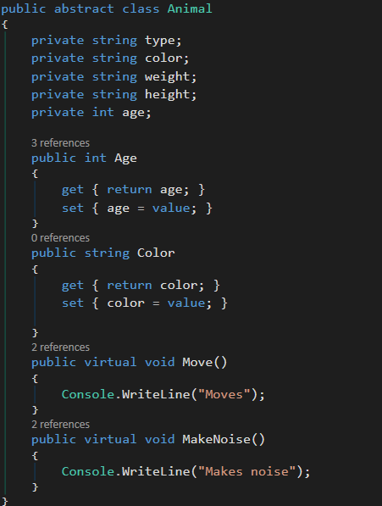
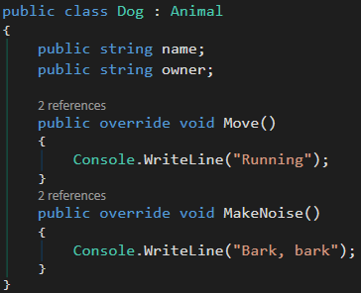
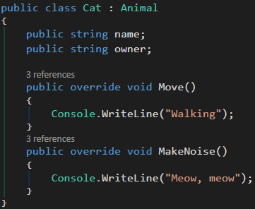
Dynamic Polymorphism Example

