Slide 1

Static vs. Non-Static

Slide 2
Difference Between Static & Non-Static
Main difference between static class and non-static class is a static class can’t be instantiated.
A static class has one version regardless of how many instances of its enclosing type are created.
You can never use the new keyword to create a variable of the class type.

Slide 3
When To Use Static
A static class can be used when you want methods that only have input parameters and won’t ever need to get or set any fields of an instance.
Essentially, use a static class when you only care about the output, opposed to an object performing an action or instantiating multiple objects.
Common examples of this are a Math class, Shape class, or Menu class. Also, a class that contains a bunch of helper methods.

Slide 4
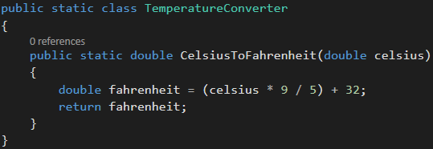
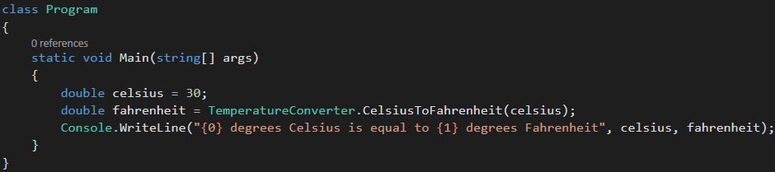
Static Class Example

Slide 5
Static Class Members
A static class can have static fields, static properties, and static methods

Slide 6
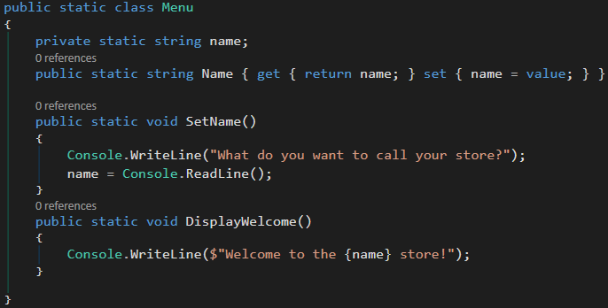
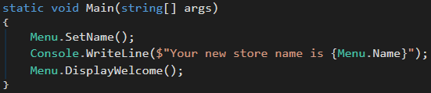

Static Class Example

Slide 7
When To Use Non-Static
Non-static is more appropriate for an object that has an action that affects member fields, in which case there will need to be instantiations of the object.
Non-static is also appropriate when you want to create multiple objects from the same class.
For example, a red car and black car instantiate from the non-static Car class.

Slide 8
Non-Static Class Members
A non-static class also can have static fields, static properties, static methods, and static constructors
Static constructors exist to initialize static fields and properties

Slide 9

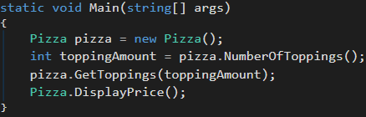
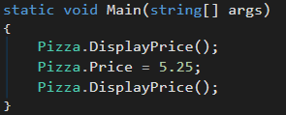
Non-Static with Static Members Example
What will the static methods output in each static void Main method?
Notes:
Pizza pizza = new Pizza() instance can’t see static property as a member variable b/c it’s a non-static class

Slide 10
Non-Static with Static Members Example
The price of your pizza is 4.5
The price of your pizza is 3.5
The price of your pizza is 5.25
Notes:
Pizza pizza = new Pizza() instance can’t see static property as a member variable b/c it’s a non-static class

