Slide 1

C# Generics

Slide 2
What Are Generics in C#?
Generics allows the ability to delay the data type of a class or method until it is actually used
Generics are represented by T, where T represents the type being passed in

Slide 3
Before Generics
Before generics, developers needed to create different classes with essentially the same functionality over and over again in order to store objects of that type
For every newly created type, developers needed to create a different list to store the objects, which is very unproductive.
Not to mention, if there were any bugs in the functionality, it was likely that developers would need to fix the bugs in multiple places in the code

Slide 4
Why Generics Are Great
Allows developers to reuse code
Provides type safety:
ensures the right data is being used before the operation is performed
prevents type errors
Allows developers to create their own generic classes, methods, interfaces, and more

Slide 5
List<T>
The most common use of generics that you are likely aware of up to this point is the C# List<T> class located within the System.Collections.Generic namespace
We can make a list of any data type, and we wait until we use the List<T> to specify the type we want to use in that moment.
Example:
List<int> numbers = new List<int>();
List<Player> players = new List<Player>();

Slide 6
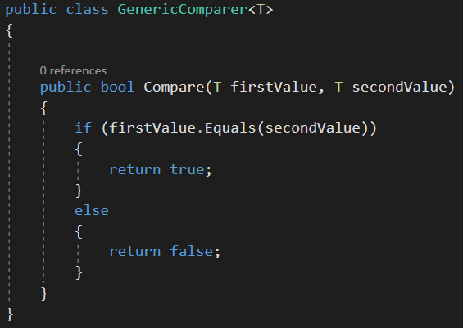
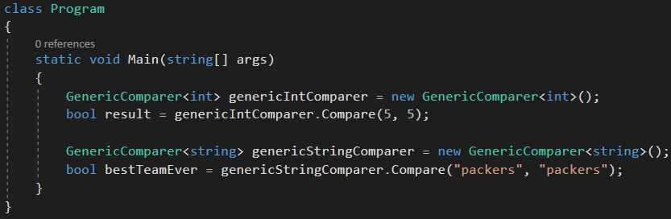
Generic Class

Slide 7
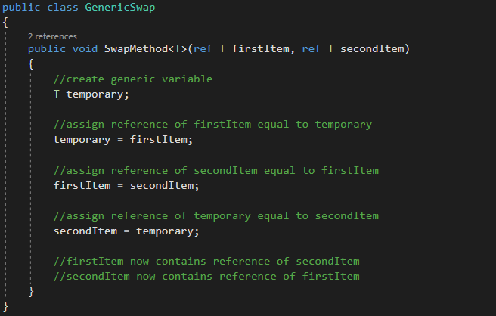
Generic Method
“ref” keyword passes arguments by reference
Any changes made to this argument in the method will be reflected in that variable when control returns to the calling method
Notes:
Reference parameters don't pass the values of the variables used in the function member invocation - they use the variables themselves.
Rather than creating a new storage location for the variable in the function member declaration, the same storage location is used, so the value of the variable in the function member and the value of the reference parameter will always be the same.

Slide 8
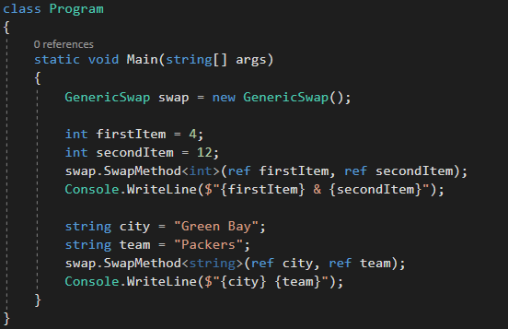

Generic Method

Slide 9
Generic Constraints
Generic constraints are used to restrict the data types that can be substituted for data type parameters
Essentially, if a data type that doesn’t abide by the rules of the constraint attempts to get substituted, a compile-time error occurs.
The compile-time error that occurs consists of “cannot be used as type parameter ‘T’ in the generic type or method… there is no implicit reference conversion…”
There can be more than one generic constraint

Slide 10
Generic Constraints
Developers can specify constraints using the “where” clause
Four examples of this are:
where T : struct (value type)
where T : class (reference type)
where T : new() default parameter
where T : interface

Slide 11
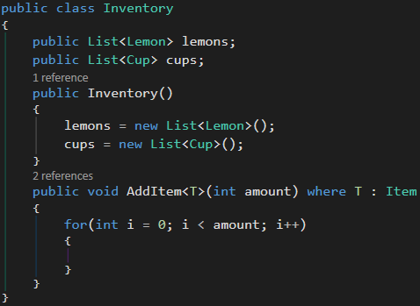

where T : class
Add constraint to a class (reference type). In the below example, the constraint will allow child classes.
Lemon inherits from Item
Pizza doesn’t inherit from Item

Slide 12
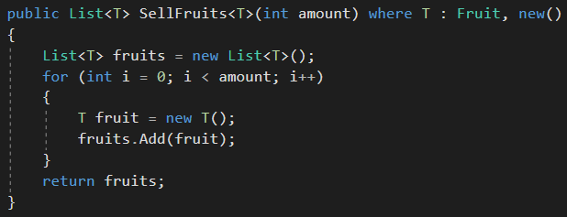
where T : new()
Must use new() constraint in order to create an instance of a generic (T) type

Slide 13
Review Questions
What are generics?
What is a generic class? What is a generic method?
Give an example of a generic class you have already used.
What are generic constraints?

