Slide 1

Interfaces

Slide 2
Interfaces
Where classes define what something is, interfaces define what something can do.
Interface is a contract in which any class that implements a given interface must use the signature of methods and/or properties as they are presented in the interface.
Interface is used for design. It does not contain any actual code.
Interface provides a layer of abstraction in code.
Interfaces are used heavily in Dependency Injection

Slide 3
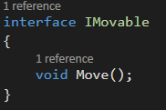
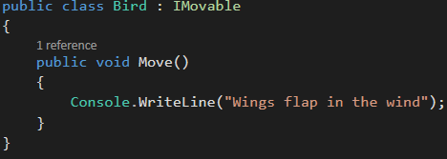
Interface Example

Slide 4
Interface Example
In the previous example, Bird inherits from class Animal.
Why not just put the move method in the Animal class?

Slide 5
Interfaces
Interfaces allow us to create nice layouts for what a class is going to implement.
It is possible to have several different implementations of an interface and swap them out when desired.
This is useful when you want to use a type to represent many different objects
Interfaces are good for situations in which your applications require many possibly unrelated object types to provide certain functionality.

Slide 6
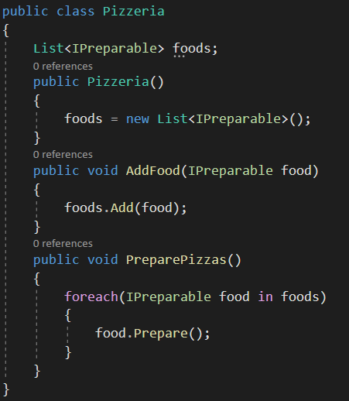
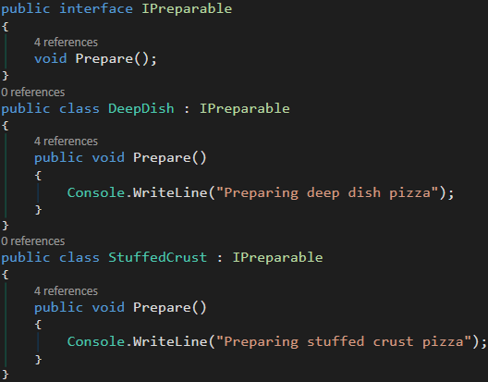
Interfaces Example
Above code doesn’t need to know what kind of pizza.
It only needs to know there are pizzas that must be prepared.
Each pizza has to be prepared, but each pizza is prepared differently.
Notes:
Each pizza has to be prepared, but each pizza is prepared differently.
Deep dish pizza may need different ingredients or be prepared differently
IList implements ICollection and IEnumerable

Slide 7
Interface vs Abstract Class
Interfaces ensure a common bond, whereas abstract classes ensure that all derived classes share functionality.
Where an abstract class is an “is a” relationship, implementing an interface is a “can be” relationship.
For example, a Dog “is an” Animal, while a Dog “can be” a race Dog.

Slide 8
Interface vs Abstract Class
If you anticipate creating multiple versions of your component, create an abstract class.
If the functionality you are creating will be useful across a wide range of different objects, use an interface.
If you are designing small, concise bits of functionality, use interfaces. If you are designing large functional units, use an abstract class.
If you want to provide common, implemented functionality among all implementations of your component, use an abstract class. Abstract classes allow you to partially implement your class, whereas interfaces contain no implementation for any members

Slide 9
Interface vs Abstract Class
Classes can inherit from multiple interfaces but only inherit from one class
Interfaces are a way to actually have multiple inheritance

