Slide 1

Custom Iterators

Slide 2
Difference Between Iterating & Enumerating
Iterating means to step through a collection where some steps might be repeated.
Enumerating means going step by step through all of the values in a collection of values.
This means that enumerating requires iterating, where each step is getting a value from a collection.

Slide 3
Custom Iterator
An iterator is used to step through a collection such as a list and an array.
An iterator method does a custom iteration over a collection.
By having a class inherit the IEnumerable interface, it makes it possible to enumerate (mention a number of things one by one) through a collection of objects using a foreach loop.
Notes:
IEnumerable: supports iteration over a collection. Contains a method called GetEnumerator.
GetEnumerator: returns an IEnumerator
IEnumerator: provides the ability to iterate through the collection by exposing MoveNext method
MoveNext: advances enumerator to get the next element of the collection

Slide 4
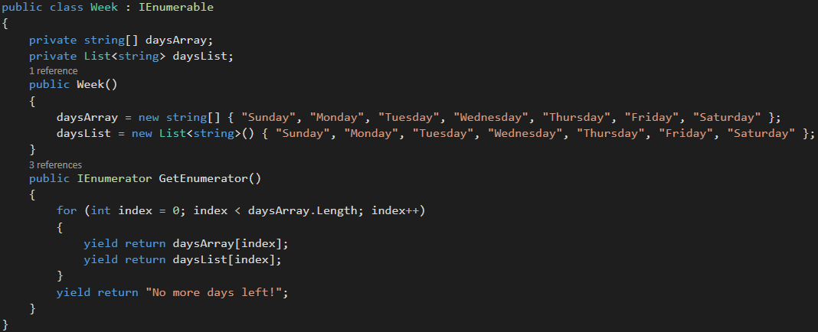
Custom Iterator Example
Notes:
IEnumerable: supports iteration over a collection. Contains a method called GetEnumerator.
GetEnumerator: returns an IEnumerator
IEnumerator: provides the ability to iterate through the collection by exposing MoveNext method
MoveNext: advances enumerator to get the next element of the collection

Slide 5
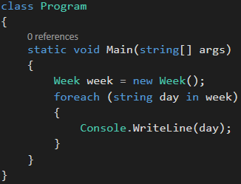
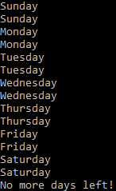
Custom Iterator Example
Once the foreach loop is hit, it calls on the GetEnumerator method in the Week class.
Notes:
IEnumerable: supports iteration over a collection. Contains a method called GetEnumerator.
GetEnumerator: returns an IEnumerator
IEnumerator: provides the ability to iterate through the collection by exposing MoveNext method
MoveNext: advances enumerator to get the next element of the collection

Slide 6
Yield Keyword
Iterator method uses the yield return keyword to return each value in a collection one at a time.
The current location of your code is remembered!
This means that the iteration will only stop when another yield return statement is hit, leaving off with the previous yield return.
This is enabled by the MoveNext method
Notes:
IEnumerable: supports iteration over a collection. Contains a method called GetEnumerator.
GetEnumerator: returns an IEnumerator
IEnumerator: provides the ability to iterate through the collection by exposing MoveNext method
MoveNext: advances enumerator to get the next element of the collection

Slide 7
Why not just use foreach loop?
A foreach loop internally (under the hood) gets the iterator and calls the correct methods, essentially using the IEnumerable and IEnumerator interfaces.
Use a custom iterator when you want to implement your own type or custom iteration. This is where explicitly inheriting IEnumerable interface comes into play.
Notes:
IEnumerable: supports iteration over a collection. Contains a method called GetEnumerator.
GetEnumerator: returns an IEnumerator
IEnumerator: provides the ability to iterate through the collection by exposing MoveNext method
MoveNext: advances enumerator to get the next element of the collection

Slide 8
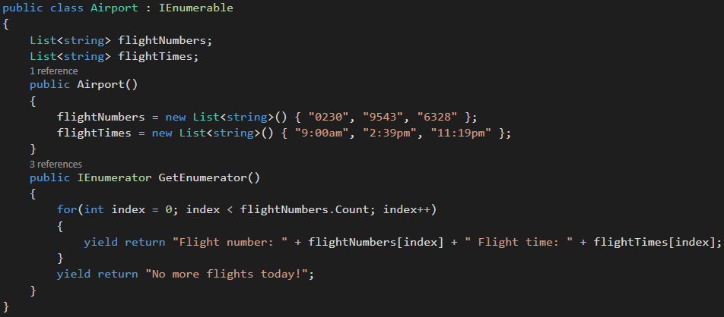
Custom Iterator Example

Slide 9
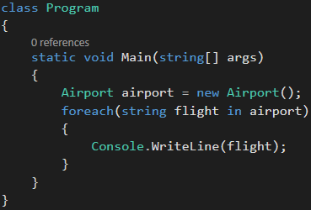

Custom Iterator Example

