Slide 1

Algorithms & Performance

Slide 2
Algorithms
To be a developer, it is essential to know how to write algorithms.
An algorithm is a finite set of instructions that must be followed to complete a calculation or operation.
Step by step procedure to solve a problem
Good examples of algorithms are sorting a collection of objects, searching through a database table, and calculating the shortest path to get to a location.
With algorithms, it is better to prove mathematically that it works as expected for every possible input value, opposed to assuming it works through testing.

Slide 3
5 Characteristics of an Algorithm
Defined input
Defined output
Precise steps
Finite set of steps
Uniqueness (the output of every step of algorithm transfers as input to the next step)

Slide 4
Algorithms
When implementing an algorithm, we must select and use a data structure
There are many algorithms to solve the same problem. It is up to us to decide which algorithm is best for the given scenario
Use the most efficient algorithm based on requirements
To decide which algorithm to use, you must compare all of the given algorithms to find the most efficient one.

Slide 5
Algorithms
Algorithm efficiency depends on:
Running time of algorithm
We want less running time
Memory occupied by algorithm
We want less memory
Generally, we care more about running time than memory occupied

Slide 6
Algorithms – Measure Running Time
Analytical Method
Analyze running time based on input size, which allows us to consider all possible inputs
We study how the running time of the algorithm increases with the increase in input size. If the running time of an algorithm increases very rapidly with the input size, then that algorithm is inefficient
To determine efficiency of an algorithm, we must see how the algorithm behaves when the input size is increased

Slide 7
Time Complexity
Time Complexity of an algorithm is the amount of time required for an input of a given size.
Time Complexity is used more for recursive calculations and sorting algorithms, which can take more computing time, opposed to being used for simple functions such as concatenating strings.
The reason is because the difference in milliseconds for a simple calculation can be minimal, whereas the difference in milliseconds for a more complex function (recursive sorting algorithm) can be much bigger.
Notes:
Ex: 5n^3 + n => O(n^3) Constant O(1), logarithmic O(log n), linear O(n), polynomial(n^c), quadratic O(n^2), cubic O(n^3), exponential O(c^n), factorial O(n!)

Slide 8
Big O Notation
Big O notation is used to describe the time complexity of an algorithm. It is how to find the rate of growth of running time.
Essentially, it is how programmers talk about algorithms.
Big O notation operates off worst-case time, which means it always looks at the performance of the worst-case scenario.

Slide 9
Big O Notation
A function’s Big O notation is figured out by how that function responds to different inputs.
For example, a function that has 5,000 things to work on is going to be slower compared to a function that has five things to work on.
The questions is, how much slower?

Slide 10
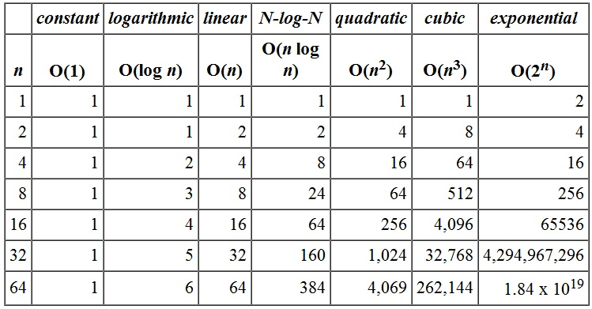
Time Complexity/Big O Notation
Notes:
The n in Big O notation refers to the thing the complexity is in relation to, which is usually always the size of the collection.
Ex: 5n^3 + n => O(n^3) Constant O(1), logarithmic O(log n), linear O(n), polynomial(n^c), quadratic O(n^2), cubic O(n^3), exponential O(c^n), factorial O(n!)

Slide 11
Big O Notation
O(1) constant time: the running time is constant, and it’s not affected by the input size
O(log n) logarithmic time: divides the problem into sub problems with the same size (i.e. binary search)
O(n) linear time: an algorithm that accepts n input size will perform n operations as well
O(n log n) linearithmic time: divide and conquer; divides the problem into sub problems recursively and then merges them in n time.

Slide 12
Big O Notation
O(n²) quadratic time: performance is directly proportional to the square size of the input data. A nested iteration is a good example of this.
O(n³) cubic time: same as quadratic time, except it will have a deeper nested iteration.
O(2^{n}) exponential time: growth doubles with each addition to the input data set. (i.e. Brute force algorithm)
O(n!) factorial time: product of all positive integers less than or equal to n. (i.e. Traveling Salesman problem)
Notes:
There are n cities. The salesman starts his tour from City 1, visits each of the cities exactly once, and returns to City 1.
For each pair of cities i,j there is a cost c_{ij} associated with traveling from City i to City j .
Goal: Find a minimum-cost tour.
Brute Force way to solve: 1) Compute the costs of all possible tours;
2) Choose the tour with minimum cost.

Slide 13
Finding Big O Rules
Keep the fastest growing term and discard the lower terms and constants (remember, we are looking for worst-case scenario)
Ignore coefficients
For example, 5n² is the same as saying O(n²)
Base of logarithm is not important
For example, 8log₂n is the same as saying O(log n)

Slide 14
for (int i = 0; i < n; i++) {
//logic
}
for (int i = 0; i < (n*n*n*n*n); i++) {
//logic
}
for (int i = 0; i < (3*n*n*n*n*n) + (2*n*n*n); i++) {
//logic
}
int limit = (today == “Tuesday”) ? (n*n*n*n*n) : 2;
for (int i = 0; i < limit; i++) {
//logic
}

Slide 15
for (int i = 0; i < n; i++) {
//logic
}
for (int i = 0; i < (n*n*n*n*n); i++) {
//logic
}
for (int i = 0; i < (3*n*n*n*n*n) + (2*n*n*n); i++) {
//logic
}
int limit = (today == “Tuesday”) ? (n*n*n*n*n) : 2;
for (int i = 0; i < limit; i++) {
//logic
}
for (int i = 0; i < n; i++) {
Console.WriteLine(“ Linear time: O(n) ”);
}
for (int i = 0; i < (n*n*n*n*n); i++) {
Console.WriteLine(“ Polynomial time: O(n⁵) ”);
}
for (int i = 0; i < (3*n*n*n*n*n) + (2*n*n*n); i++) {
Console.WriteLine(“ Polynomial time: O(n⁵) ”);
}
int limit = (today == “Tuesday”) ? (n*n*n*n*n) : 2;
for (int i = 0; i < limit; i++) {
Console.WriteLine(“ Polynomial time: O(n⁵) ”);
}

Slide 16
Big O Notation
Express the running time as a function of input size(n)
Supposed T(n) = running time in terms of n, where n represents the input size
Let’s find the Big O for function T(n)

Slide 17
We have four algorithms for solving a problem and we want to compare them. We must compare the rate of growth of these functions. Therefore, we must find the Big O of these functions
Algorithm A: T(n) = 6n³ + log n + 2n
Algorithm B: T(n) = 5n + n² + 4
Algorithm C: T(n) = log n + 5n + 10
Algorithm D: T(n) = 3n² + 15

Slide 18
We have four algorithms for solving a problem and we want to compare them. We must compare the rate of growth of these functions. Therefore, we must find the Big O of these functions
Algorithm A: T(n) = 6n³ + log n + 2n
Algorithm B: T(n) = 5n + n² + 4
Algorithm C: T(n) = log n + 5n + 10
Algorithm D: T(n) = 3n² + 15
Algorithm A: O(n³)
Algorithm B: O(n²)
Algorithm C: O(n)
Algorithm D: O(n²)
Based on this analysis, we can determine that Algorithm C is the best because the rate of growth is the least

Slide 19
Big O Notation – Loops
Within a loop: any time increment or decrement happens in a constant amount, the time complexity will be O(n).
Within a loop: the control variable is multiplied or divided by a constant amount, which means the time complexity will be O(log n).
With nested loops: we are interested in how many times the inner-most loop executes. For each iteration of the outer loop the inner loop will execute n times, which means the time complexity will be O(n²).
With nested loops: if the iteration goes three deep, then the time complexity will be O(n³).
Within a loop: function call is O(log n), which means the time complexity is O(n log n)

Slide 20
Optimization Techniques
Reduce or group input and output (I/O) calls
Reduce overhead, especially in high-traffic execution paths
Overhead examples:
Function calls in loops that could be placed outside of the loop
StringBuilder vs. string
Parallelization and Concurrency
Notes:
StringBuilder vs. strings:
Use strings when you aren’t going to change it and use StringBuilder if you plan to change it
StringBuilder has higher performance when it comes to multiple concatenated strings and inside loops. That is because inside loops, strings will get destroyed, whereas with StringBuilder we are just making changes to the original string.

Slide 21
Premature Optimization
Optimizing (increasing efficiency) code prematurely.
It is important to make the code work first then optimize later.
Simplicity, readability, and maintainability first. Optimize only if found to be necessary.
Set up unit tests to guarantee acceptable performance based on requirements.
Some unit tests have timing features, otherwise just use System.Diagnostics.Stopwatch.

