Slide 1

Database Concepts

Slide 2
Database Terminology
Database: an accessible structured set of data
Table: database object that is a collection of data
Field (Column): column in a table that holds specific data about records in the table
Record (Row): Individual entry that exists in a table

Slide 3
Database Terminology
Entity: real-world object that can be identifiable
i.e. In a school database, students, classes, courses, and teachers are entities
Attribute: properties of entities
i.e. Student entity may have name, class, and DOB as attributes

Slide 4
Tables, Columns, Rows
Table
Holds columns and rows
Column
Each will have its own data type
Row
Record of data
Id | First_Name | DOB
1 | Scott | 4/23/1988
2 | Dan | 3/25/1988
3 | Alice | 1/1/1985

Slide 5
Database Query
A query is when a request for information from a database is made
In the case of SQL, we use a query language to make requests to a database. Hence why SQL stands for Structured Query Language.
Knowing a query language gives you a tremendous amount of power to navigate a database

Slide 6
Primary Key
A primary key uniquely identifies a record (row) in a table
It allows for differentiation
It is best generated, not something that has value
It can’t ever change
Composite primary key: when more than one column serves as a primary key of a table

Slide 7
Candidate Key
Column or group of columns that uniquely identifies the rows in a data set
Primary key is a type of candidate key
Every table must have at least one candidate key

Slide 8
Foreign Key
A foreign key is a field in a table that is the primary key in another table
Essentially, the column on a table that references the primary key of another table
How tables relate to each other
A good example to wrap your head around:
Two people with the same address will have the same foreign key (pointing to primary key of address)

Slide 9
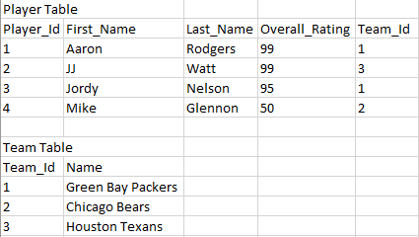
Primary Key & Foreign Key Example

Slide 10
Prime Attribute vs. Non-Prime Attribute
Prime attribute: all the attributes (columns) that are part of candidate keys
Non-prime attribute: all the attributes (columns) that are NOT part of candidate keys

Slide 11
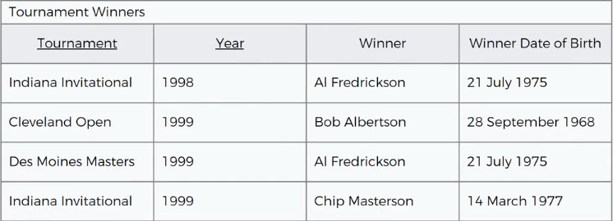
Candidate Key Example
Tournament column is NOT a candidate key because tournament values repeat as the years go on
Year column is NOT a candidate key because in one year you can have several tournaments
Winner column is NOT a candidate key because a person can be a winner in multiple tournaments and multiple years
Winner Date of Birth is NOT a candidate key for same reason winner isn’t
Notes:
Candidate key: column or group of columns that uniquely identifies the rows in a data set

Slide 12
Candidate Key Example Continued
We must now look at combinations to find candidate key
Best way is to look for the purpose of the table. In this case, the purpose is to show tournament winners
A good candidate key is to combine Tournament and Year due to its uniqueness

Slide 13
Indexes
Special lookup tables that the database search engine can use to speed up data retrieval.
Indexes are created on tables and are used by queries to find data from tables quickly.
An index is a pointer to data in a table that is used to speed up searching in a database.

Slide 14
Indexes
Think of an index in a database as an index in the back of a book
In a book, you can use the index to quickly find a topic and the page(s) it is on.
Without an index, you would have to search for a topic page by page.
An index will speed up the performance of queries by reducing the number of database data pages that have to be visited.

Slide 15
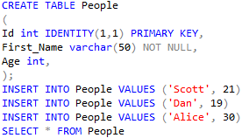
Create Table/Insert Values Example
Id | First_Name | Age
1 | Scott | 21
2 | Dan | 19
3 | Alice | 30

Slide 16

Index Example
When a query is run on the First_Name column, the database will check to see if an index is on the column. In this case, there is.
The database then decides if it makes sense to use the index to find the values being queried.
The index in our example will improve performance of the First_Name column on the People table

Slide 17
Indexes
Single-column indexes: index that is created based on only one column in a table
Composite indexes: index that is created based on two or more columns in a table
Indexes can be created or dropped with no effect on the data.
Don’t use indexes on small tables or on a table that have columns that have many null values
Indexes should be created on columns that get queried frequently

Slide 18
Disadvantages of Indexes
Takes up space → larger the table means larger the index
Every time CRUD (add, insert, delete) operations are performed on a table, the same has to occur on the index. This is because the index must be up to date with the table data in order to be effective.

Slide 19
Entity Relationship Diagram (ERD)
ER diagrams show the logical structure of a relational database
It illustrates how entities (people, objects, etc.) relate to each other within a system
ER diagrams use symbols and connecting lines to show how entities connect, the relationships, and their attributes.
Notes:
Great resource: https://www.smartdraw.com/entity-relationship-diagram/

Slide 20
Relationships
One-to-One
One Person has one Social Security Number
One-to-Many
Team has many Players (players on the roster)
Many-to-Many
Students take many Courses and Courses will be studied by many Students

Slide 21
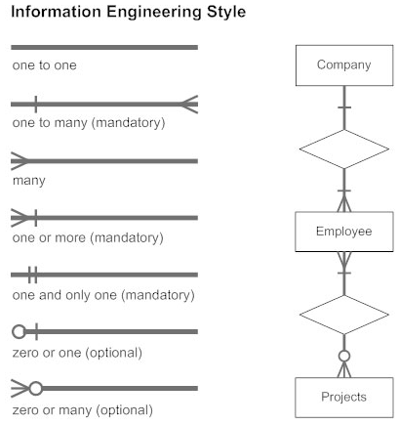
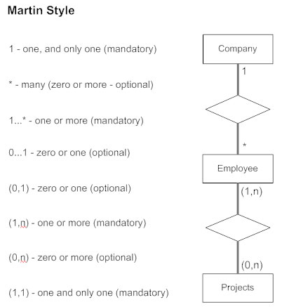
ERD Relationships

Slide 22
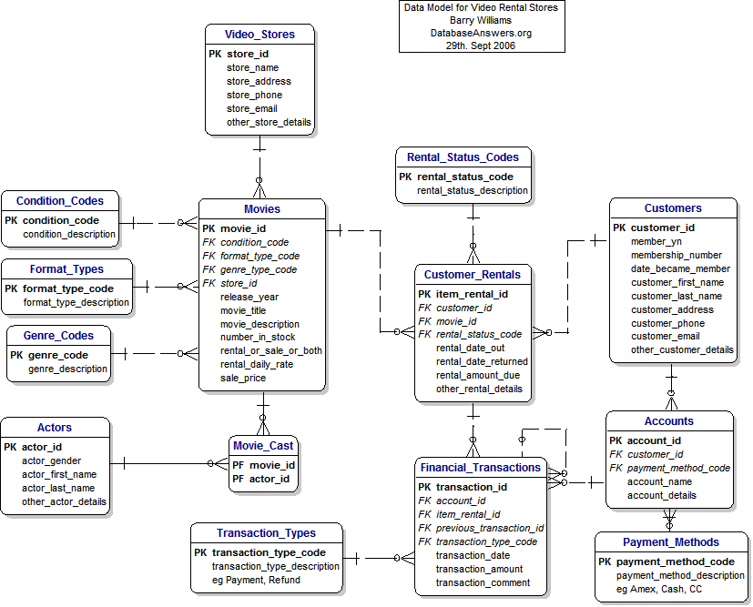
ER Diagram Physical Model Example

Slide 23
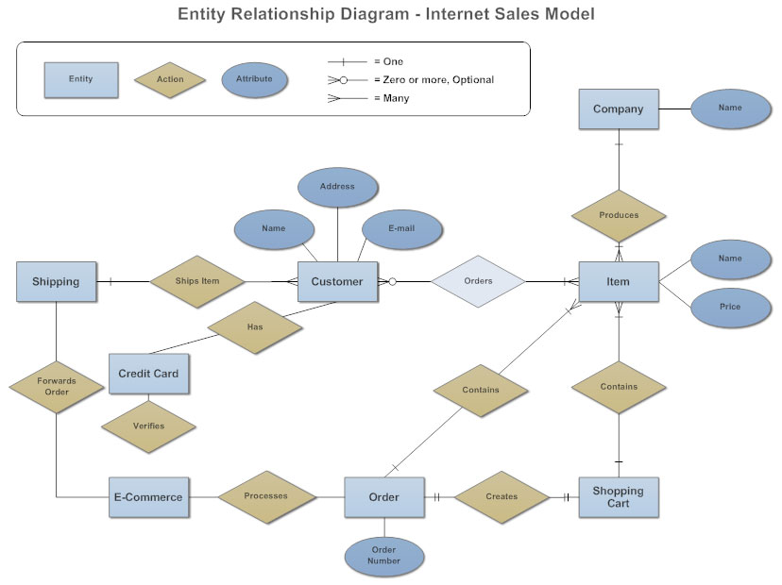
ER Diagram Conceptual Model Example

Slide 24
Object Relation Mapping (ORM)
ORM translates database data to classes/objects in some programming language.
A way to move data from database to application, or vice versa, under the hood
Good example of ORM is Entity Framework

