Slide 1

Database Normalization

Slide 2
Candidate Key
Column or group of columns that uniquely identifies the rows in a data set
Primary key and foreign key are types of candidate key

Slide 3
Prime Attribute vs. Non-Prime Attribute
Prime attribute: all the attributes (columns) that are part of candidate keys
Non-prime attribute: all the attributes (columns) that are NOT part of candidate keys

Slide 4
Functional Dependency
A functional dependency occurs when one attribute in a relationship uniquely determines another attribute.
As far as databases are concerned, it is a constraint between columns on your database.
A → B. Two ways to state this are:
"B is functionally dependent upon A"
"A functionally determines B"

Slide 5
Functional Dependency Example
Movie(title, year, length, film_type, studio_name)
Functional dependencies:
title year → length film_type studio_name
A movie’s title and year functionally determines a unique length, film_type, and studio.

Slide 6
Database Denormalization
Increase performance of database by adding redundant data where it will help the most
Way to do this is to add extra columns in existing tables or add new tables
Goal is to decrease the running time of select queries by making data more accessible
Important to make sure the possible good from denormalization outweighs any harm your database might face
Notes:
Trade off: organization, introduce redundencies

Slide 7
Database Denormalization – When/Why
Maintain history of database
Records can change frequently (person’s age, last name, etc.). Adding a table to maintain history can have complicated queries
Improve query performance
Faster retrieval of data. Queries that require joining multiple tables together can get costly, especially if any of the tables contain large amounts of data.
Speed up reporting
Creating statistics from live data can have an affect on the performance of a database. Depending on the data involved, it can slow the database down. Fewer tables leads to faster searches.
Notes:
By denormalizing, you are making a shitty database in exchange for speed.

Slide 8
Database Denormalization Disadvantages
Disk space
More duplicated data means more disk space being used
Data anomalies
When data can get changed in more than one place, everything must stay consistent. This leads to the potential of more user error.
Code can become more complex because of the redundancy in the table.
If need to denormalize an existing database, it will require writing/modifying many select queries
Notes:
Do you have duplicate data? If I changed my name from “Mike” to something else, would all other “Mike”s names change too?

Slide 9
Database Normalization
Technique of organizing data in a database to achieve following goals:
Eliminate data redundancies (duplicated data)
Simplify queries
Ensure data is logically stored
Improve data integrity
Break up attributes into smaller relations
Don’t have to restructure database when data is added in the future

Slide 10
Database Normalization
Tables should be about a specific topic
Columns on that table should support that topic
Tables (entities) can have relationships with other tables (entities). These entity relationships are shown through primary and foreign keys
For example, a Customer table can have a foreign key to an Address table

Slide 11
Normal Forms
Normalization can be organized even further into normal forms, with First Normal Form, Second Normal Form, and Third Normal Form being the most common
Tables become less prone to database modification anomalies and remain focused on a sole purpose the more organized they become.
Minimizing or completely eliminating modification anomalies is one of the main reasons to normalize

Slide 12
IMPORTANT TO REMEMBER
Database denormalization:
Increase performance of database with faster data retrieval
Reduces number of foreign keys and indexes
Reduces number of tables in a database

Slide 13
IMPORTANT TO REMEMBER
Database normalization:
Technique of organizing data in a database
Eliminate data redundancies (duplicated data)
Ensure data is logically stored
Ensure data integrity

Slide 14
Which one should I choose?
Normalization is the cleaner, more manageable approach. It ensures data integrity, removes data redundancies, and improves disk space.
Denormalization is better for performance. If you are going to do data mining or reporting, you should denormalize your database.
Final thought:
Go with normalization unless you are going for speed – with speed only being done when necessary.

Slide 15
Relationships
One-to-One
One Person has one Social Security Number
One-to-Many
Team has many Players (players on the roster)
Many-to-Many
Students take many Courses and Courses will be studied by many Students

Slide 16
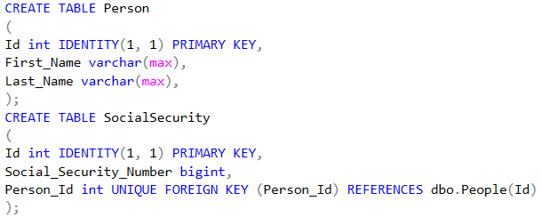
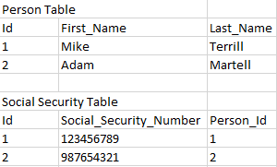
How to Handle One-to-One
Notes:
UNIQUE keyword will prevent duplicates of the given column. In this case, it means that the Social Security table’s Person_Id column will never contain a duplicate among different rows, ensuring the one-to-one relationship.

Slide 17
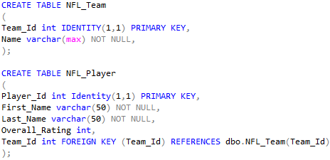
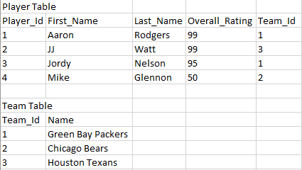
How to Handle One-to-Many

Slide 18
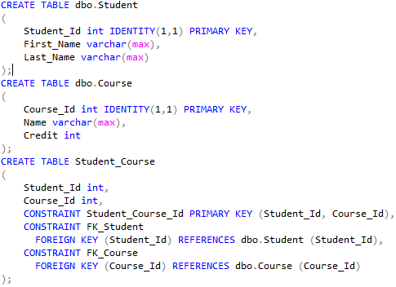
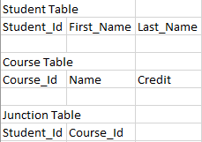
Junction Table to Handle Many-to-Many

