Slide 1

C# Functional Programming

Slide 2
Functional Programming
Functional programming is a programming paradigm that is more focused on functions (methods) than it is dealing with objects, although functional programming and OOP do work very well together.
Using anonymous types, delegates, Lambda Expressions, and LINQ, you will specify what you want to do (functions/methods) opposed to how you will do it.
There are “better” programming languages for functional programming (i.e. JavaScript). With that said, this is how we can use a great OOP language while also using functional programming concepts.

Slide 3
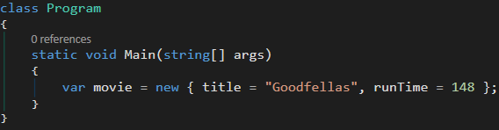
Anonymous Types
Anonymous types are types that don’t have a name. We are able to create an object with the new keyword without explicitly stating the name of the class
The ‘var’ keyword comes into play. This implicitly typed variable holds a reference of the anonymous type
Anonymous type properties are read-only, and the compiler will apply the appropriate data type to each property based on the value expression.
Anonymous type is an object that is used once locally. This becomes useful when doing a LINQ query

Slide 4
Delegates
A delegate is a reference or pointer to a method(s) with the same method signature
Think of it as a placeholder for methods
Essentially, we can assign any method that matches the signature to the delegate and it is called when the delegate is called
A delegate makes it easier to pass methods around as arguments to other methods
Delegates are used for designing extensible and flexible applications
Notes:
With delegates, there are no interfaces, no object instantiations, and no other methods for evaluation to worry about.
The point of delegates is to be used for simple method-pointer usage for a simple task
Delegates type check the inputted function
Think of delegates as interfaces

Slide 5
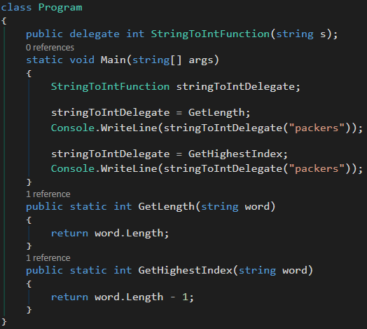
Delegate: Creating Our Own
//Output
7
6
Notes:
By defining a delegate, you are saying to the user of your class, "Please feel free to assign, any method that matches this signature, to the delegate and it will be called each time my delegate is called".
Think of delegates as interfaces

Slide 6
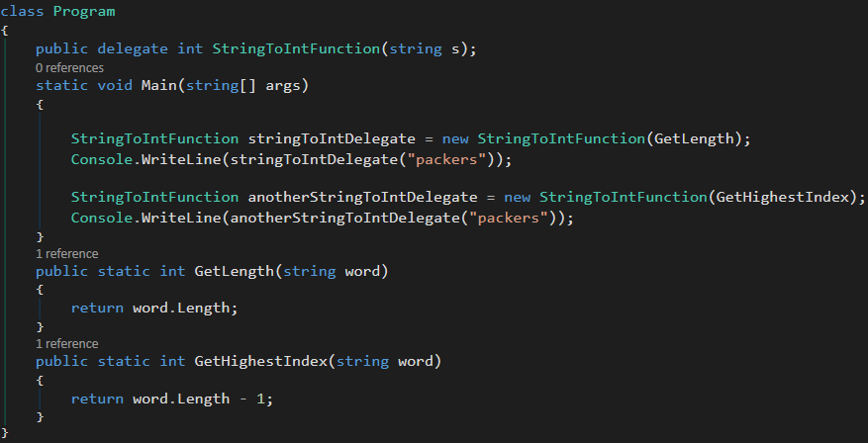
Delegate: Creating Our Own
Notes:
Both ways are instantiating the delegate, with the first way being less code
Under the hood, the compiler does it the second way
stringToIntDelegate is a reference to the method that is passed to the delegate constructor
When a method gets passed into a constructor or another method, we are used to seeing it get invoked (that’s what the parentheses do). Under the hood, the delegate reference is still being invoked, even if we aren’t explicit about it.

Slide 7
Why Use Delegates
Allow us to parameterize code
With delegates, we can pass a reference to some code as an argument to other methods
This includes passing a delegate as an argument to a method
It allows us to generalize code and get rid of duplicated code!

Slide 8
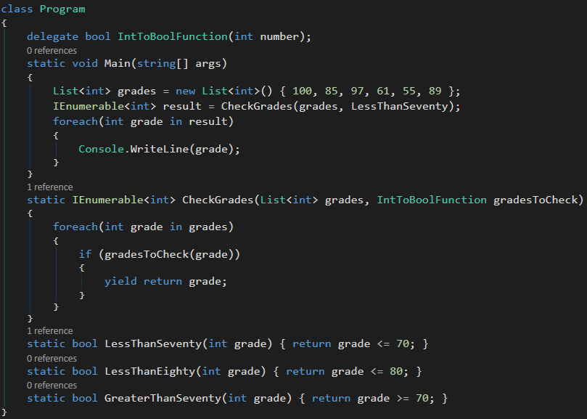
Why Use Delegates
Notes:
We can just pass the int into the method, but delegates are necessary to pass the int as well as pass the complicated expression
Delegates provide flexibility → Think of it as creating one bigger, general function that helps you avoid rewriting the same code over and over
Use a delegate over an interface when the caller doesn’t need to access other properties or methods on the object implementing the method
If we did need to access other properties or methods, then an interface is needed

Slide 9
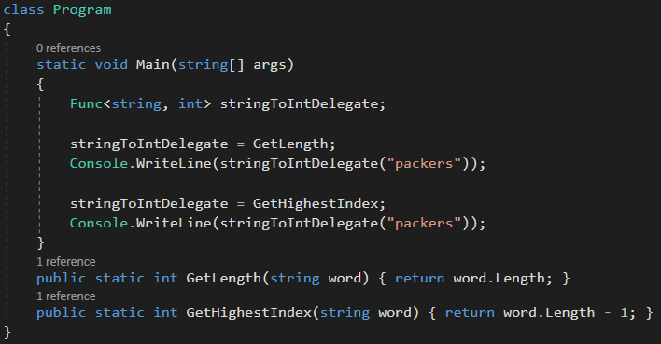
Delegate: Func
A built-in delegate that points to a method that returns a value
Last input parameter is always the output return type of the method

Slide 10
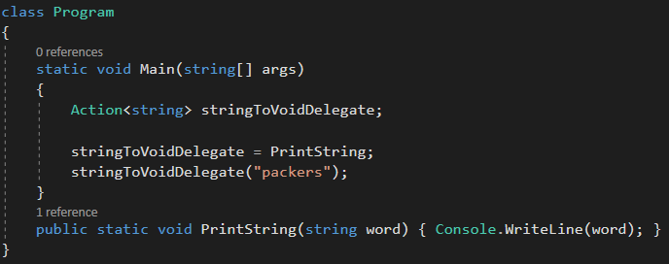
Delegate: Action
A built-in delegate that points to a method that returns void

Slide 11
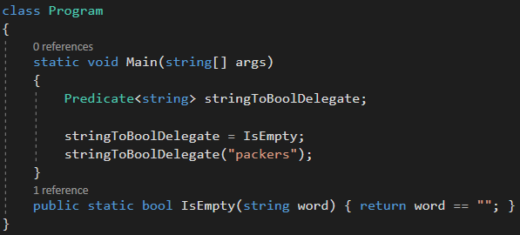
Delegate: Predicate
A built-in delegate that points to a method that returns a Boolean value
Predicate pre-dates Func and Action, which is why Func and Action are seen more frequently when it comes to delegates

Slide 12
Lambda Expression
A lambda expression is an anonymous method
No access modifier
No method name
No return statement
We use lambda expressions for the convenience of writing less code to achieve the same thing, as well as, code readability.
Lambda expressions are commonly used with delegates
Lambda expressions are used to write LINQ query expressions

Slide 13
Lambda Expression
Three parts to a lambda expression:
Parameters or arguments (can be parameter-less)
=> (goes to operator)
Method body made up of an expression or statement
Parameters => expression or statement

Slide 14

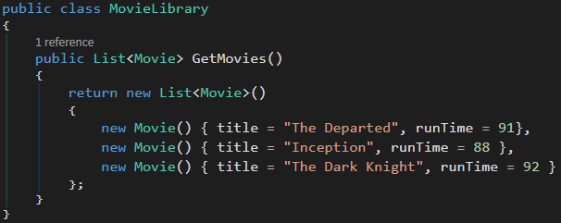
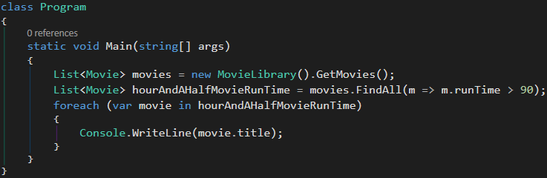

Lambda Expression Example
Lambda Expression

Slide 15
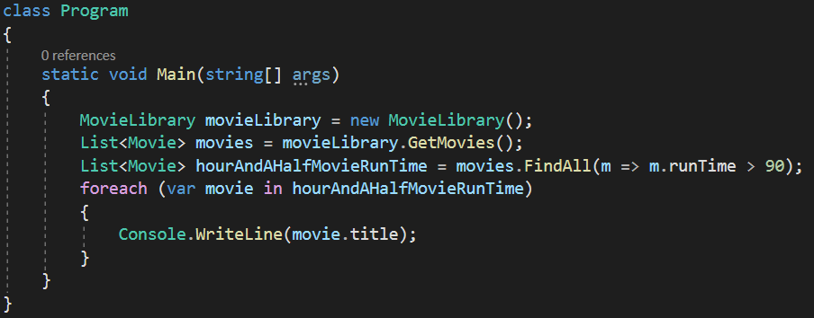
Lambda Expression Example
//Output
The Departed
The Dark Knight
Lambda Expression

