Slide 1

LINQ

Slide 2
LINQ
Language Integrated Query (LINQ)
Gives the capability to query objects in C#

Slide 3
LINQ
We use LINQ to query the following:
Objects in memory, i.e. collections (LINQ to Objects)
SQL Server Databases (LINQ to Entities (Entity Framework))
XML documents (LINQ to XML)
ADO.NET Data Sets (LINQ to Data Sets)
Notes:
XML: eXtensible Markup Language that is designed to store and transport data (markup language like HTML)
ADO.NET: ActiveX Data Objects; software components that can be used to access data and data services from a database

Slide 4

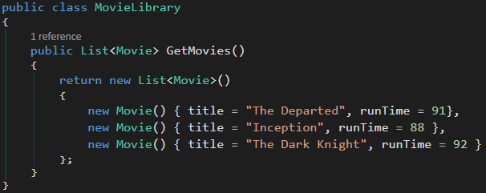
Classes for code examples

Slide 5
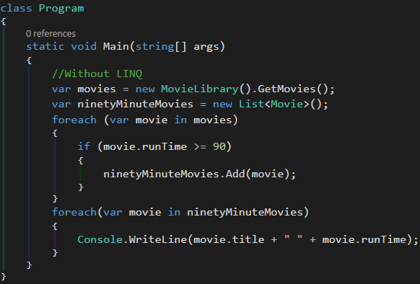
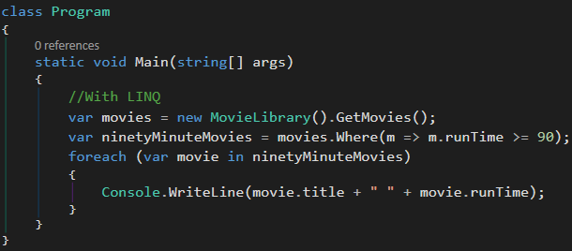
LINQ Extension Methods
LINQ extension methods are built-in methods that we can use to query

Slide 6
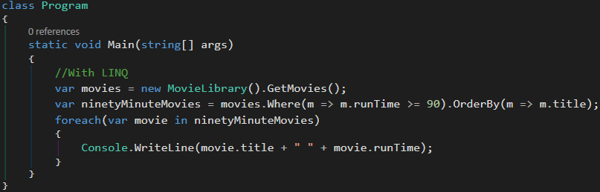
LINQ Extension Methods: Chaining LINQ Methods
It is possible to chain multiple LINQ methods together
//Output The Dark Knight 92 The Departed 91

Slide 7
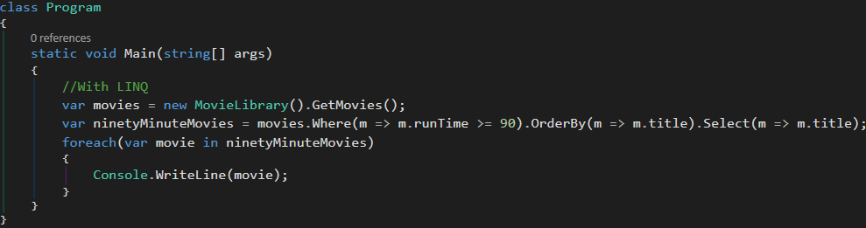
LINQ Extension Methods: Using Select
Using Select, we can iterate over the movies and convert them to another object or select a movie property as a string
In our example, what started out as a collection of type Movie is now treated as a collection of type string
In our example, we are filtering (Where), sorting (OrderBy), and selecting (Select) a property

Slide 8
Coming Full Circle With Delegates
From the previous example:
.Where(Func<Movie, bool>)
.OrderBy(Func<Movie, TKey>)
.Select(Func<Movie, TResult>)
Notes:
Func<>: Last input parameter is always the output return type of the method

Slide 9
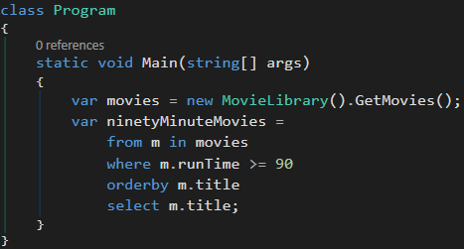
LINQ Query Operators
LINQ query operators looks similar to writing SQL code
LINQ query operators always start with ‘from’ and end with ‘select;

Slide 10
Which Should You Use?
It comes down to personal preference whether to use LINQ extension methods or LINQ query operators
With that said, LINQ extension methods are more powerful and flexible because:
All of the query operator keywords translate to extension methods under the hood
There are more LINQ extension methods than LINQ query operators.

