Slide 1

Null Operators

Slide 2
Nullable Types (?)
Value types that can take null as a value.
The ability to assign null to numeric and Boolean types becomes especially useful when dealing with databases as well as data types that contain elements that may not be assigned a value.

Slide 3
Nullable Type (?) Example
int? number = null;
Console.WriteLine(number.HasValue); Output: False

Slide 4
Nullable Type (?) Example
public class Money { public int? GetMoney() { return null; } }
Since GetMoney() is designed to get money from someone who owes money, there is a chance we have not got it yet. Instead of having the value set to 0, it is more appropriate for the value to be null, or nothing.

Slide 5
Null-Coalescing (??)
Returns the left-hand operand if the operand is not null; otherwise it returns the right-hand operand

Slide 6
Null-Coalescing (??) Example
int? number = null;
int age = number ?? 10;
This will set age to the value of number if number is not null. However, if number is null, set age to 10.

Slide 7
Null-Conditional (?.)
Test for null before performing a member access (?.) or index (?[). Allows you to write less code to handle null checks.

Slide 8
Null-Conditional (?.) Example
int? queue = students?.Count;
If students is not null, check its Count property
If students is null, it will set variable to null instead of throwing NullReferenceException
Student firstInLine = students?[0];
If students is not null, check what is stored at index.
If students is null, it will set variable to null instead of throwing NullReferenceException

Slide 9
Ternary (?:)
Returns one of two values depending on the value of a Boolean expression.
Can be used as a shortcut for an if/else statement. It is typically used when a written-out if/else statement appears to be too much for the given scenario.
Ternary operator must return a value

Slide 10
Ternary (?:) Example
bool mikeIsAwesome = true; mikeIsAwesome ? firstExpression : secondExpression
firstExpression will be returned if mikeIsAwesome is true
secondExpression will be returned if mikeIsAwesome is false

Slide 11
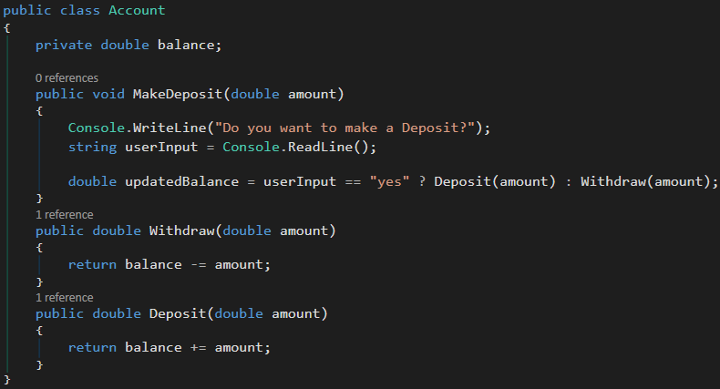
Ternary (?:) Code Example

