Slide 1

MVC Design Pattern

Slide 2
Model View Controller (MVC)
A design pattern that has been around for nearly 50 years
Made popular by Microsoft’s ASP.NET MVC web application framework
Can also be used in frameworks such as Ruby on Rails and Apple iOS development
MVC is designed to create a separation of concerns on the server side between the model and view
Coding, maintaining, and testing of app made easy due to Model and Controller logic being separate from the View

Slide 3
MVC: Model
The data source that communicates with the database
Model classes explain the business logic via data access operations (business model)
Defines the rules for data
This refers to defining how data can be manipulated

Slide 4
MVC: View
The part the user sees and interacts with
It represents the user interface components
Displays the data that is received from the controller
Able to pass a Model or ViewModel object to the View from the Controller to be manipulated and sent back to Controller.

Slide 5
MVC: Controller
Code that marries the View to the Model
Handles the business logic and processes incoming requests
Gets input from users (View), processes the data through the Model, and then passes back the results to the View.
Example: If you clicked the “Delete” button on the View, it checks to make sure you are the authorized person to delete, if the record can be deleted, etc.

Slide 6
View Model
View Models are a way to pass data from the Controller to the View, as well as, bind data in the View and pass back to the Controller.
View Models are useful for when we want to pass multiple models to the View

Slide 7
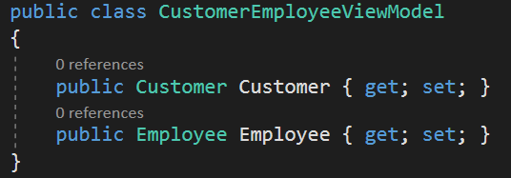
View Model
Customer Model and Employee Model are passed to the View as one (CustomerEmployeeViewModel)

