Slide 1

Classes & Objects

Slide 2
Object-Oriented Programming (OOP)
OOP is a programming paradigm organized around objects rather than actions.
These objects interact with each other
Objects have attributes (member variables, fields)
Objects have actions (member methods)

Slide 3
What is a class?
Class is a template of an object, and we can create instances of that object based on that class
Think of a class as a blueprint to what an object is

Slide 4
What is an object?
An object is an instance of a class
Objects are created from templates known as classes
A class does not become an object until it is instantiated

Slide 5
Class & Object Example
Consider an object in the real world. A soda can is a good example of this.
The can has attributes that describe it. These are the can’s variables.
Color, contents, status of the can (open/close)
The can has actions it can do. These are the can’s methods.
Open the can, pour contents out of the can, crush the can

Slide 6
Member variables
Member variables (fields) are the variables defined inside a class.
Think of member variables as the attributes of an object
Car is the object. Color and engine size are member variables of that object
Member variables also keep track of an object’s status
Local variable: variables defined inside scope of a function

Slide 7
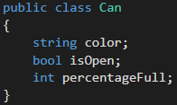
Member variables
In our example of a can, these are what the member variables of the Can class will look like:

Slide 8
Member methods
Just like member variables, we can create as many methods for our class as we want.
The methods inside the class, or member methods, give functionality to the object.
These methods are the actions of the class.

Slide 9
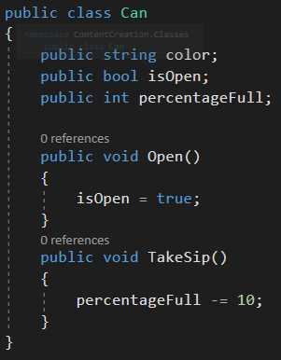

Member methods
Methods added

Slide 10
Constructor
A constructor is a special type of method.
The constructor is called every time a new instance of a class is created
We know a method is a constructor because it will have the same name as the class and it does not have a return type.

Slide 11
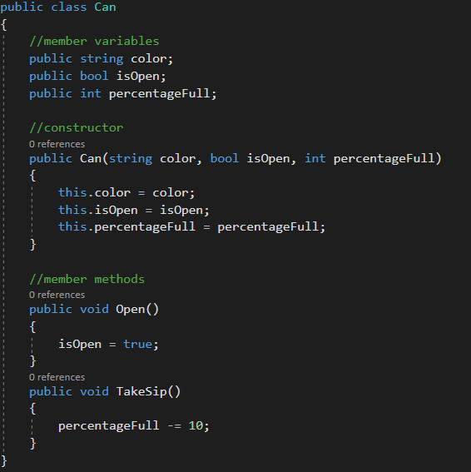
Constructor example
Constructor added

Slide 12
Constructor
We can pass values into the constructor just as we can with a method
These values typically are set equal to the member variables of the class
This allows for each object that is instantiated from the same class to have unique member variable values, if desired

Slide 13

Instantiation
Instantiation is creating an instance of a class (creating an object)
To create an instance of a class (creating an object), we must use the “new” keyword.
After creating an instance, we use that object to access the class variables and methods

Slide 14
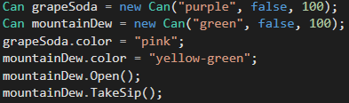
Dot notation ( . )
To access an object’s variables and methods, we use dot notation.

Slide 15
Review Questions
What is a class? What is an object?
What is instantiation?
What are member variables? Member methods?
What is a constructor?
What is dot notation?

Slide 16
Assignment
Create a ClockRadio class
Your clock radio should keep track of the time, current state of the alarm (on/off), and current radio station
Your clock radio should be able to set an alarm and change to a new radio station
Add as many other member variables and member methods as appropriate

