Slide 1

C# Loops

Slide 2
What is a loop?
A developer will use a loop when it is necessary to execute a block of code over and over again.

Slide 3
While Loop
A while loop allows code to be executed repeatedly based on a given Boolean condition.

Slide 4
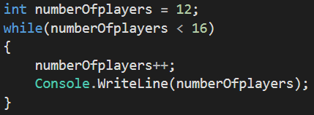
What a while loop looks like:
//Output:
13
14
15
16

Slide 5
For Loop
A for loop is used when the number of cycles to be executed is known before the loop begins its iterations.

Slide 6
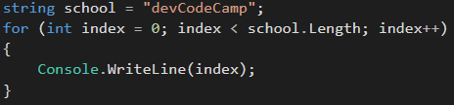
What a for loop looks like:
//Output: 0 1 2 3 4 5 6 7 8 9 10

Slide 7
Foreach Loop
The foreach loop does not care about the number of cycles to be executed. Instead, it is used to iterate through a collection of data.
If there is a list of players on a team (roster), the foreach loop can be used to print each player contained in the list.

Slide 8
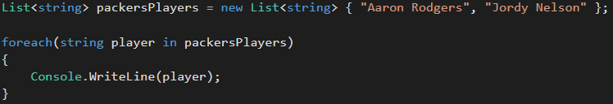
What a foreach loop looks like:
//Output: Aaron Rodgers Jordy Nelson

Slide 9
Do-While Loop
Similar to a while loop
The difference is it will test the condition at the end of the loop body, instead of testing the condition before executing the loop body.
Practical examples:
Command line interpreter
Read data from a file
Shipping applications

Slide 10
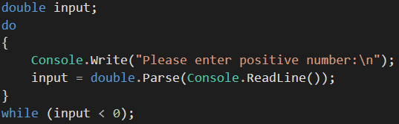
What a do-while loop looks like:

Slide 11
Nested Loops
It is possible to use one or more loops inside each other.

Slide 12
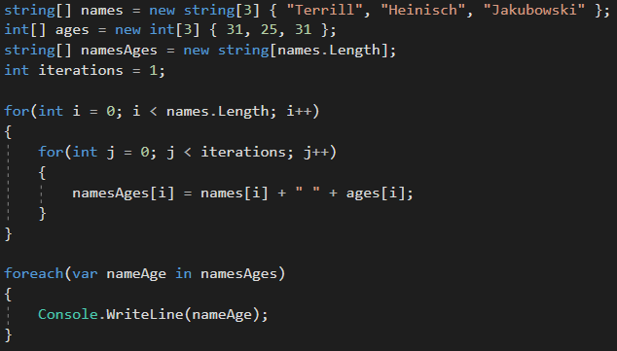

What a nested loop looks like:

Slide 13
Continue
Instead of breaking out of a while loop or for loop, the continue key word will skip a part of the loop and continue on with the next iteration of the loop.
Essentially, the continue keyword will skip the current iteration in the loop.

Slide 14
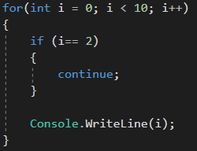
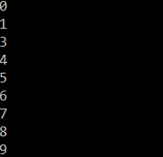
What the continue keyword looks like:
Output:

Slide 15
Review Questions
What is a while loop? Give an example.
What is a for loop? Give an example.
What is a foreach loop? Give an example.
Why would you use a while loop instead of a for loop or foreach loop?
When is it appropriate to use a do…while loop?
When is it appropriate to use the continue keyword?

Slide 16
Assignment
Fizzbuzz
Write a program that prints every number from 0 to 100 to the console If a number is divisible by 3, print ‘fizz’ instead of the number If a number is divisible by 5, print ‘buzz’ instead of the number
If a number is divisible by 3 AND 5, print ‘fizzbuzz’ instead of the number

