Slide 1

Inheritance

Slide 2
What is inheritance?
Process where one class acquires the member variables and methods of another class
The derived class (child class, subclass) inherits all of the members (variables and methods) from its base class (parent class, superclass).

Slide 3
Why use inheritance?
Gives us the ability to define a class in terms of another class. This makes it easier to maintain an application.
Inheritance also makes it easier to reuse code, which speeds up the coding process.
For instance, don’t have to constantly write the same member variables and methods over and over again.

Slide 4
“Is A” versus “Has A” relationship
Inheritance is an “Is-A” relationship
Example: Dog is an Animal
Member variables are a “Has-A” relationship
Example: Dog has a Bone

Slide 5
Inheritance
When inheriting, make sure the child class is going to use everything in the parent class.
It is not appropriate to inherit from a class, unless everything in the parent class fits into the child class.

Slide 6
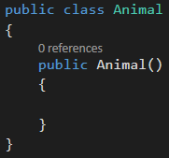
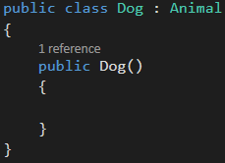
How to inherit from a base class
Use a colon ( : ) to inherit one class from another
Base Class
Derived Class

Slide 7
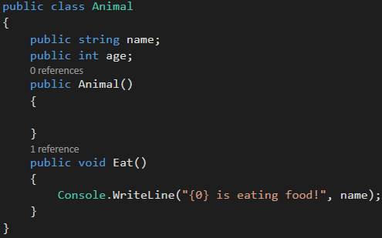
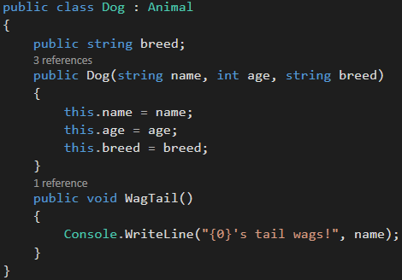
Inheritance Example

Slide 8
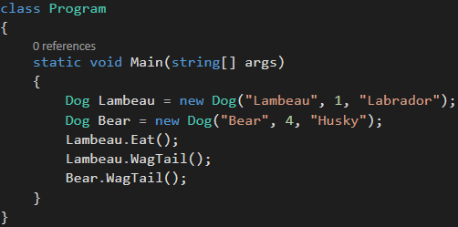

Inheritance Example

Slide 9
Base Keyword
The base keyword is used to access members of the base class (parent) from within a derived class (child)
When instantiating a derived class, the base keyword is used to specify which constructor in the base class should be called.
Hint: Classes can have more than one constructor

Slide 10
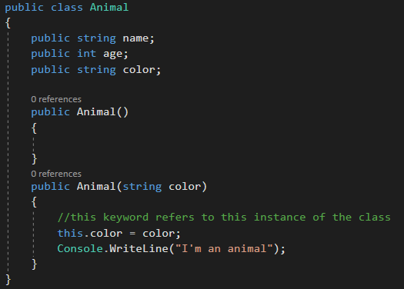
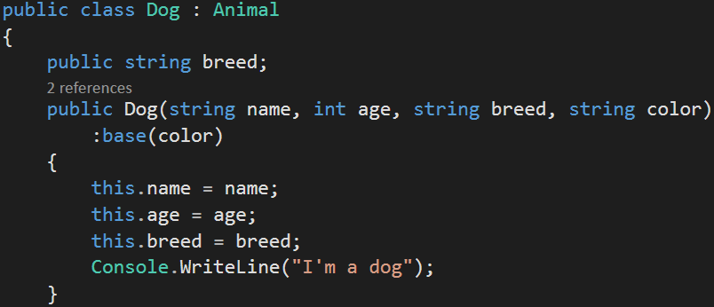
Base

Slide 11
Method Override
Overriding allows the ability to change the functionality of a method in a derived class
A method in a derived class can have different logic than the method with the same name in the base class

Slide 12
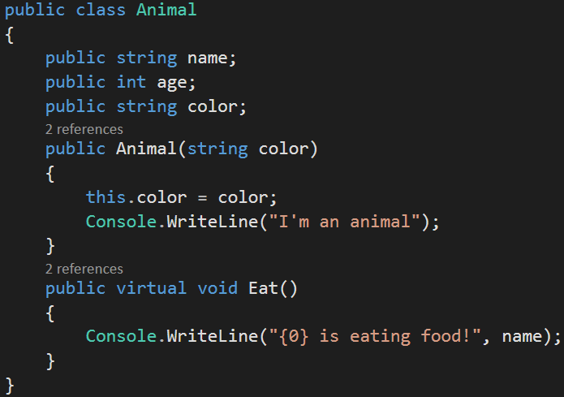
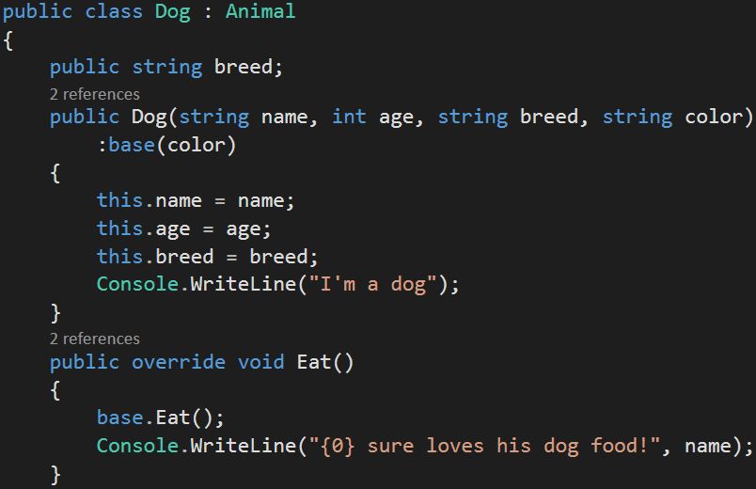
Method Override Example

Slide 13
Base
The base keyword can be used with methods.

Slide 14
Abstract Class
Abstract class cannot be instantiated. Therefore, it makes for an ideal parent class.
Unlike interfaces which do not contain any code, an abstract class can contain the implementation of methods, fields, constructors, etc.
However, abstract classes are not required to provide implementation details.
Any class that inherits an abstract class must utilize any implemented or unimplemented methods contained in the abstract class.

Slide 15
Abstract Class
Some of the methods may contain an implementation, while others may only be methods with a method signature.
If a class contains an abstract method then the class must also be abstract
Use the override keyword to redefine the abstract method on the derived class

Slide 16
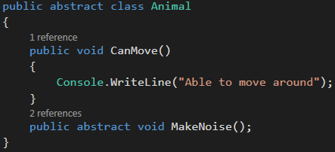
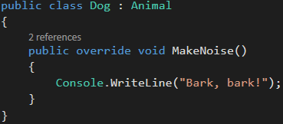
Abstract Class Example

Slide 17
Review Questions
What is inheritance?
Why use inheritance?
What are other terms for the parent class? Child class?
How does a class inherit from another class?
What is an abstract class?

