Slide 1

SOLID Principles

Slide 2
Single Responsibility Principle
Single Responsibility Principle states that every class, function, etc. should have a single responsibility
Essentially, each class, function, etc. should do one thing and one thing well, and bigger applications should be built off smaller parts

Slide 3
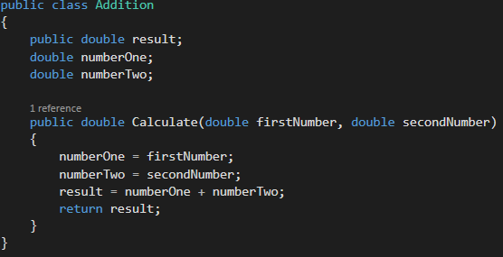
Single Responsibility Example

Slide 4
Open/Closed Principle
Functionality in code should be open to extension and closed to modification
Don’t ever want to change the existing source code but can extend the existing code to add new functionality
Code in a way that will allow rising requirements to be met without changing the functionality of the existing code

Slide 5
Open/Closed Example
Let’s say there is a class AreaCalculator with a method that calculates the area of a rectangle. If we want to add the ability to calculate the area of a circle, we would need to add an if statement in the method.
However, there is a far better way to extend the functionality of the code without modifying the existing functionality of calculating the area of a shape

Slide 6

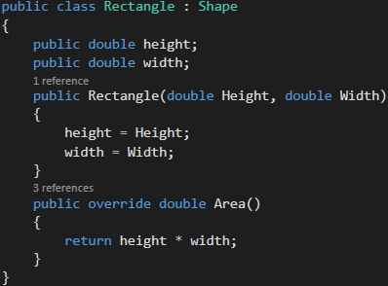
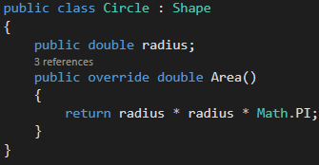
Open/Closed Example

Slide 7
Liskov Substitution Principle
Any time you create a child class off of a parent class, it should be designed in a way so that the child class can be used in the exact same way as the parent class
If a child class is substituted for a parent class, the two classes should still logically do the same thing without any surprises.

Slide 8
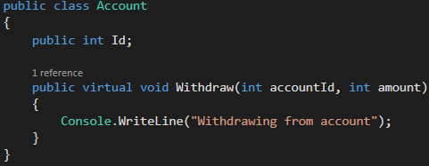
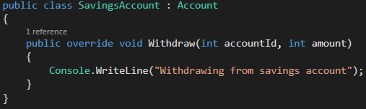
Liskov Substitution Example

Slide 9
Interface Segregation Principle
No class should be forced to implement methods which it does not use
Make interfaces as narrowly defined as possible. Instead of one big interface, it should be broken down into smaller interfaces with each one having a specific purpose.
Don’t make a thing doer!

Slide 10
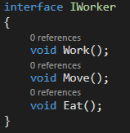
Interface Segregation Example
Instead of having one interface called IWorker that has multiple methods…

Slide 11
Interface Segregation Example
It makes more sense to break out the methods into three separate interfaces. That way classes do not have to implement all three methods.
For example, a Robot would not need to implement an eat method while implementing a work and move method.
Remember, forcing classes to use methods that do not fit is never a good idea.

Slide 12
Dependency Inversion Principle
Want to break/reduce dependencies as much as possible
General design of code should support a wide range of functionality, opposed to coding to exactly what a functionality might do.
A good way to reduce dependencies is to have lower-level components dependent on the interfaces owned by the higher-level components (components that need external dependencies).
The interface is an added abstract layer to help with decoupling
Notes:
Decoupling: Separate something from something else

Slide 13
Dependency Inversion Principle
Making changes to code can seem scary when there are too many dependencies.
i.e. Developer stays away from objects with numerous dependencies like it’s the plague
Dependencies based on interfaces creates greater stability in your code

Slide 14
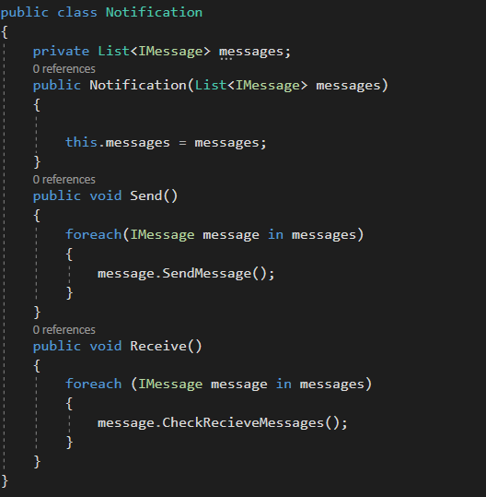
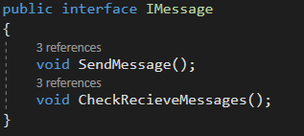
Dependency Inversion Principle

Slide 15
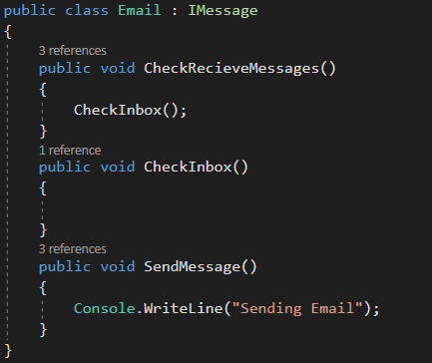
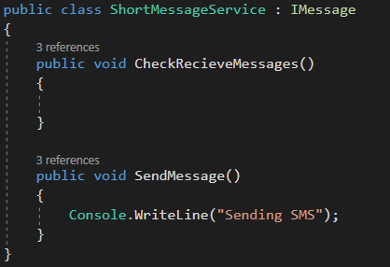
Dependency Inversion Principle

