Slide 1

Error Handling

Slide 2
What is error handling?
Gracefully dealing with runtime errors in your code.
No matter how hard you try, situations will occur that cause errors:
Files already being open or not existing
Users entering unexpected input

Slide 3
When should I use error handling?
Anytime that legal use of your code might cause an exception
This includes unexpected or unconventional uses of your code
Common uses are:
Converting user input from a string to a number
Reading, opening, writing to files
Receiving unexpected data, or a time out from a remote resource

Slide 4
Exceptions
When you first encounter them, exceptions seem like bad things
The truth is, unhandled exceptions are bad things
Handled exceptions are good things

Slide 5
Throwing Exceptions
Exceptions happen because a developer chose to “throw” an exception when a predictable problem happened with their code
For example, if the developer was creating a file reader
It is predictable that someone may try to open a file that doesn’t exist
Throwing a FileNotFoundException() lets the calling function know there is a problem

Slide 6
Try-Catch
We have a method to catch and gracefully handle exceptions
The try-catch block lets us attempt to execute the code in the try block
If no exception is thrown, everything works as expected
If an exception is thrown, the code will skip to the catch block

Slide 7
Try
Code in a try block will execute line by line like you would expect
If an exception is encountered nothing after it in the try block will be executed
Execution will skip to the beginning of the Catch block

Slide 8
Catch
The purpose of the catch block is to log the error and gracefully handle the problem that the exception represents
For example you may give the user an error message explaining that the file doesn’t exist and that they should pick a new one, then call or return the function again.

Slide 9
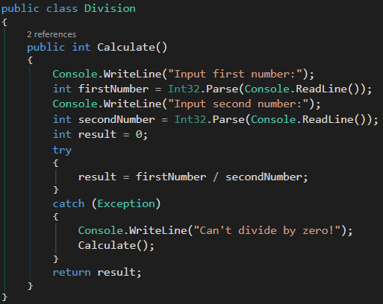
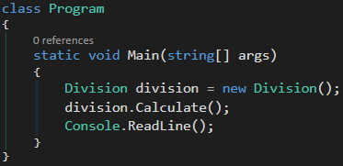

Try-Catch Example

Slide 10
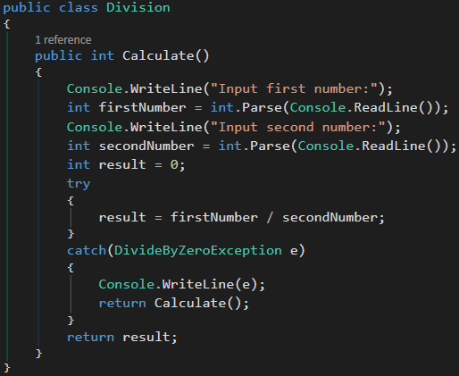
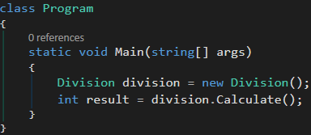

Try-Catch Example With Known Exception

Slide 11
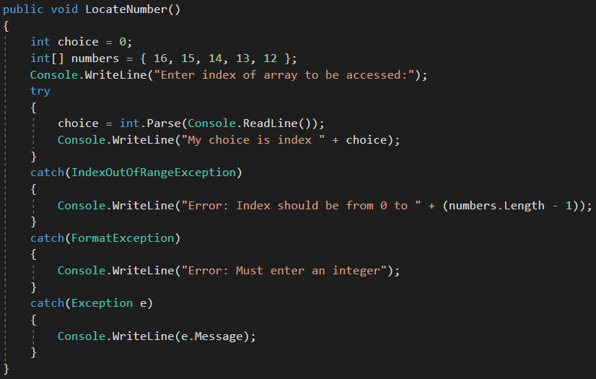
Try-Catch Example

Slide 12
Finally
The finally block will always run, regardless of whether an exception was encountered
Finally is for cleaning up
Because execution of a try block stops if an exception is encountered we may not have the chance to close files or connections gracefully in the try block
By cleaning up after ourselves in the Finally block we can ensure that everything is gracefully taken care of

Slide 13
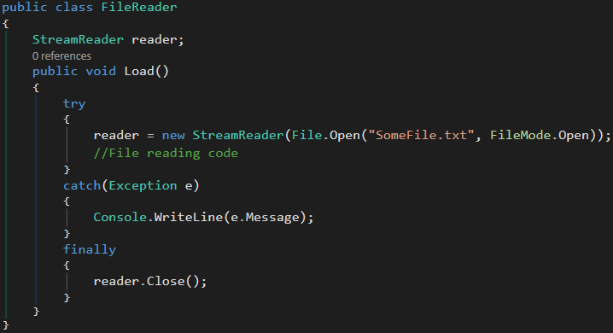
Try-Catch-Finally Example

