Slide 1

JavaScript in Action

Slide 2
C# vs JS
Similarities
Loops (for, while, etc.)
Conditionals (if/else, switch case)
Arithmetic Operators (+, -, %)
Logical Operators (&&, ||, !)
Assignment Operators (=, +=, ++, etc.)
Differences
No explicit datatypes in JS
camelCase variables
Curly brace conventions
=== & !==
Functions instead of Methods
No classes or instantiation **

Slide 3
Dynamically Typed Language
JavaScript is a dynamically typed language
This means that data types aren’t determined until run-time
This is why we declare variables with ‘let’ or ‘var’ regardless of the type
Other languages like C# are statically typed
This means that data types are determined at compile time

Slide 4

Declaring a Variable in JavaScript
A variable is declared with either the ‘let’ or ‘var’ keywords (we prefer ‘let’)
Difference between ‘let’ and ‘var’:
Scoping
var is scoped to nearest function block
let is scoped to the nearest enclosing block (can’t be seen outside of the enclosing block it is declared in)
Notes:
https://developer.mozilla.org/en-US/docs/Web/JavaScript/Reference/Statements/let

Slide 5
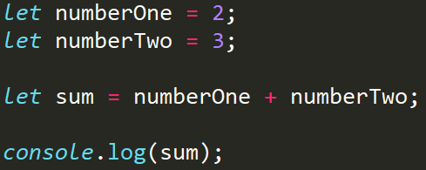
Numbers in JavaScript

Slide 6
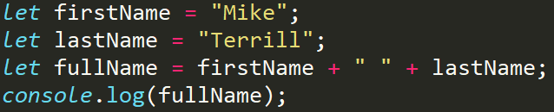

Strings & Booleans in JavaScript

Slide 7
Comparison Operators
Operator Description
=== equal value and equal type
!== unequal value and unequal type
== equal value
!= unequal value
> greater than
< less than
>= greater than or equal to
<= less than or equal to

Slide 8
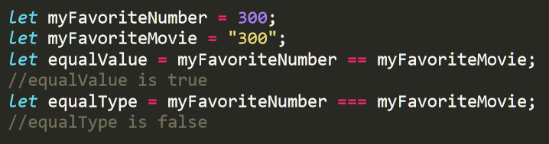
Comparison Operators
Comparison operators are used to compare two values to each other
A comparison expression will always result in a boolean
Notes:
False
True

Slide 9
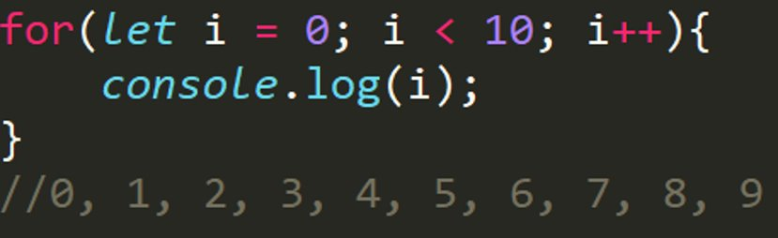
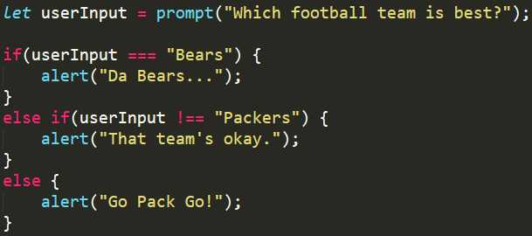
Loops & Conditionals

Slide 10
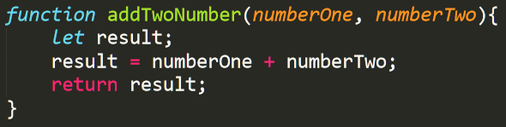
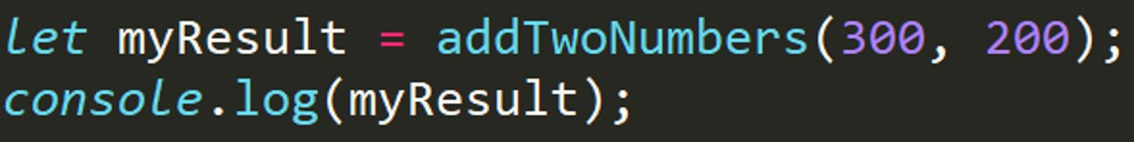
Functions
No datatypes on parameters!
Now call the function!

Slide 11
Pure Functions
In JavaScript, a pure function doesn’t depend on and doesn’t modify the states of variables outside of its scope.
In most cases, and especially in JavaScript, we should aim to create pure functions
Functions are pure if the returned value ONLY depends on the input value(s)

Slide 12
Pure Functions
A pure function only receives data though the parameters
A pure function only sends data out of the function using the return keyword
A pure function does not have any effect outside of itself
Given the same inputs, a pure function will always return the same output
Pure functions are a pillar of functional programming

