Slide 1

Test Driven Development

Slide 2
Test Driven Development (TDD)
Design
Use analysis to figure out what your project needs to achieve success.
Test
Write tests to express the design. These tests are expected to fail because there is no code written yet.
Implement
Write code that will satisfy the expected result.
Test
Test to ensure the code passes

Slide 3
Test Driven Development (TDD)
Write a failing test
Write code to make the test pass
Clean up to improve code and tests

Slide 4
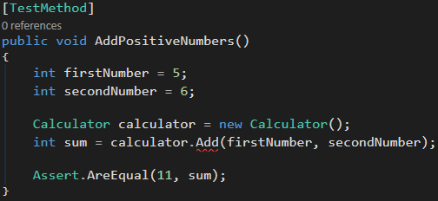
TDD – Write a failing test
This test will currently fail because there is no Add method on the Calculator class

Slide 5
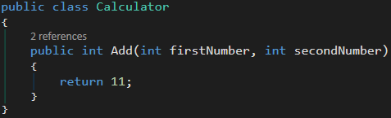
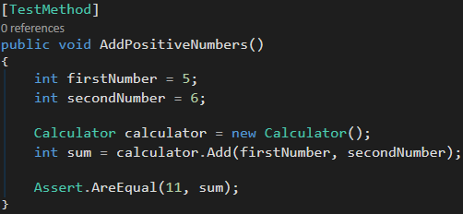
TDD – Write code to make it pass
Test can now pass because there is a method called Add in the Calculator class

Slide 6
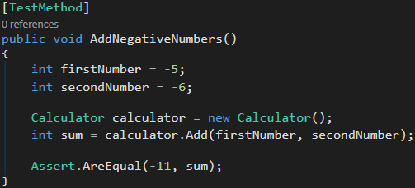
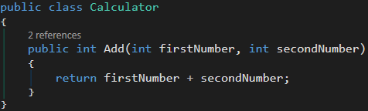
TDD – Clean up code
Our previous Add method will fail when adding two negative numbers, because currently it only returns integer 11.
Therefore, we can clean up our code to get the sum of two integers that are passed into the method.

