Slide 1

C# Concurrency

Slide 2
Synchronous Programming
In Synchronous Programming, a function call must complete before returning to the caller.
private void DoMorningRoutine() {
Coffee coffee = MakeCoffee(); //Takes forever
DrinkCoffee(coffee);
GetReady(); //Bathroom isn’t free
EatCereal();
Read();
GoToWork(); //You’re late
}

Slide 3
Asynchronous Programming
Asynchronous programming is doing multiple tasks at once
Asynchronous Programming: When a function is called, program execution continues to the next line without waiting for the function to complete.
Task represents an asynchronous operation
Notes:
Use asynchronous when there is a block in operation (accessing resources)

Slide 4
Asynchronous Programming
async and await is how we can handle multiple tasks using the Task Parallel Library without interacting with threads
Task Parallel Library: simplifies process of adding concurrency to applications. It is a set of APIs for running tasks asynchronously and in parallel
Notes:
Task Parallel Library: simplifies process of adding concurrency to applications
Use Task when method is void
Use Task<T> when you know the type you are returning

Slide 5
Async
async keyword is used to declare an asynchronous method that returns a Task object. It informs the compiler we want to use the asynchronous features inside the method.
Use Task when method is void
Use Task<T> when you know the type you are returning
async only states that we intend to use the await keyword
async methods run synchronously until it encounters the await keyword
There are many built-in methods with an async version.

Slide 6
Await
await does not wait for program execution to complete
await is a marker for the compiler. Essentially, it is informing the compiler that the operation is expected to take additional time.
When the compiler sees the await keyword, it doesn’t block the thread. It instead returns the control to the caller of the method. From there, that method continues doing its thing.
Meanwhile, the method marked with the await keyword takes it time to complete, and the run time is aware of this. When this method is completed, run time goes back and executes the rest of the method.

Slide 7
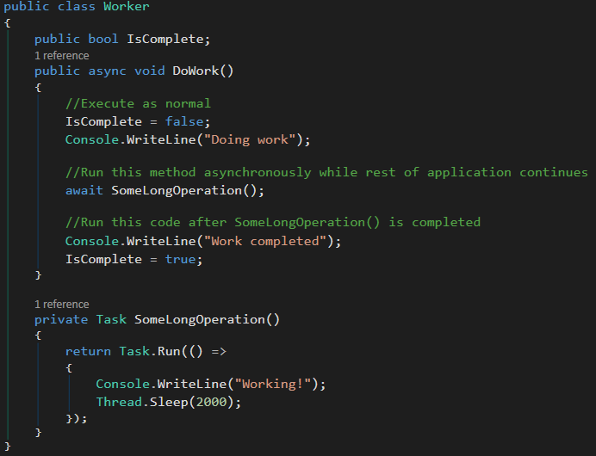
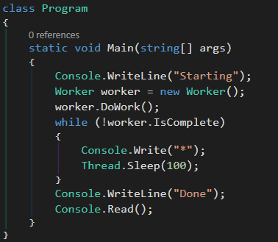
Asynchronous Programming
Notes:
() => is a empty parameter list and a Lambda expression
Task.Run() queues the specified action to run on the thread pool and returns a Task object

Slide 8
Threads
By default, an application uses one thread for all of the processing. This means making object calls, calls to the database, web service calls, and various other actions. As you can imagine, this can take some time.
By creating additional threads, the application can perform additional processing, which increases the overall efficiency.

Slide 9
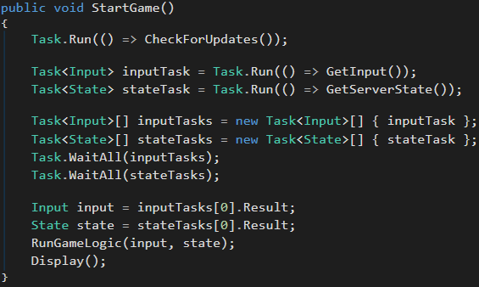
Threads
() => is a empty parameter list and a Lambda expression
Task.Run() queues the specified action to run on the thread pool and returns a Task object
Task.WaitAll(Task[]) waits for all of the provided Task objects to complete execution
RunGameLogic(input, state) is now running on threads, which allows getting input and monitoring the state of the server.
Notes:
Lambda expression: anonymous function that you can use to create delegates. It can be shorthand for specifying a method
Example: public int Method(int x){ return x *2; } This can be used as x=>x*2
Another Example:
(Person person) => person.FirstName == “John”

Slide 10
Difference Between Task & Thread
A task is something you want done, whereas a thread is a possible worker to perform the given task.
As mentioned, a task is an asynchronous operation. Tasks are used to complete the asynchronous operations by breaking up the work and assigning it to different threads.
Not every task needs a new thread, but rather, it is possible to use existing threads.

Slide 11
Processes
private void RunAllTheThings() {
try {
Process.Start(“C:\\HaxLogs.txt”);
Process.Start(“C:\\Python35\\python.exe”);
}
catch (Exception e) {
Console.WriteLine(e.Message);
}
}
Process.Start(string) starts the process resource of the application file. The resource becomes a new process component

Slide 12
Lock
Restricts code from being executed by more than one thread at a time.
Ensures one thread doesn’t enter a critical section while another thread is in the critical section

Slide 13
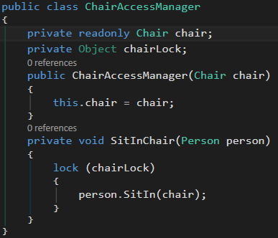

Lock
Only one thread can get into person.SitIn(chair) at one time. We don’t want to have a thread with person.SitIn(chair) happening before the first thread sits up.
Notes:
Readonly: prevents field from being change, can only be initialized at run time

Slide 14
Semaphore
Semaphore limits the number of threads that can access a resource or pool of resources concurrently.
Think of it as a bouncer at a nightclub. There are a dedicated number of people allowed in the club at once. If the club is full, no one can enter until a person leaves.
A semaphore will prevent a task or thread to enter until another task or thread gets released

Slide 15
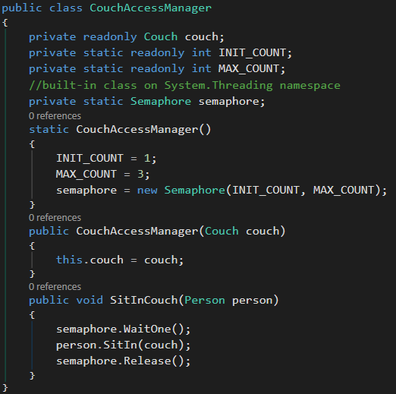
Semaphore
Semaphore(int, int) specifies the initial number of entries and the max number of concurrent entries
semaphore.WaitOne() threads enter critical section using this method. Calling thread enters only if current count member variable on Semaphore is greater than 0.
semaphore.Release() exits the semaphore and returns the previous count, which allows threads to enter the critical section
In our example, a limit of 3 can sit on the couch but no more than that.
Notes:
Readonly prevents fields from being changed. Readonly fields can be initialized at runtime. Attempts to change them later are disallowed.

Slide 16
When to Use Synchronous Methods – ASP.NET
The operations are simple or short-running.
Simplicity is more important than efficiency.
The operations are primarily CPU operations instead of operations that involve extensive disk or network overhead. Using asynchronous action methods on CPU-bound operations provides no benefits and results in more overhead.
Source: docs.microsoft.com

Slide 17
When to Use Asynchronous Methods – ASP.NET
You're calling services that can be consumed through asynchronous methods, and you're using .NET 4.5 or higher.
The operations are network-bound or I/O-bound instead of CPU-bound.
Parallelism is more important than simplicity of code.
You want to provide a mechanism that lets users cancel a long-running request.
When the benefit of switching threads outweighs the cost of the context switch. In general, you should make a method asynchronous if the synchronous method waits on the ASP.NET request thread while doing no work. By making the call asynchronous, the ASP.NET request thread is not stalled doing no work while it waits for the web service request to complete.
Source: docs.microsoft.com

