Slide 1

Repository Pattern

Slide 2
What is Repository Pattern?
Creates an abstraction layer between the data access and the business logic layer of an application.
Data access logic is in a separate class, or sets of classes called a repository, with the responsibility of persisting the applications business model.
Communication between the data access logic and the business logic is done through interfaces

Slide 3
Why use the Repository Pattern?
Centralizing the data access logic makes code easier to maintain
Business and data access logic can be tested separately
Easier to reuse code
Less chance of making programming errors

Slide 4
Why Continued
Allows business logic to access the data object without having knowledge of the underlying data access architecture
Business logic doesn’t care where or how the data is coming from, but can always access it the same way
Can change where the data is coming from without having to change the business logic

Slide 5
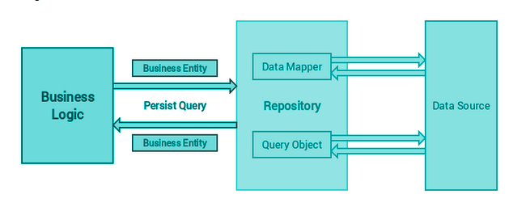
Repository Pattern

