Slide 1

ASP.NET Core Services

Slide 2
What is a service?
A service are classes that are managed by an IOC container
Services are used heavily in dependency injection
Used to pass in instantiations of dependent classes to a constructor of another class
Services must be registered inside of the ConfigureServices() located in the Startup.cs class
Services can be thought of as a waiter, as in it can preform actions on our behalf upon request

Slide 3
Why use a service?
Services are great for maximum code re-usability
Control over how a class is shared between requests
Can be used with interfaces
Used to implement dependency injection

Slide 4
Types of Services in Core
Two types of services in ASP.NET Core
Framework Services
IApplicationBuilder, IHostingEnvironment, ILoggerFactory, etc…
Application Services
Custom services (types or classes) created for the application

Slide 5
IServiceCollection
IServiceCollection is an IOC container (Inversion of Control)
Adding application services to this container will make them available for dependency injection
Once an application service is registered in the IServiceCollection, we can inject those services anywhere in our application

Slide 6
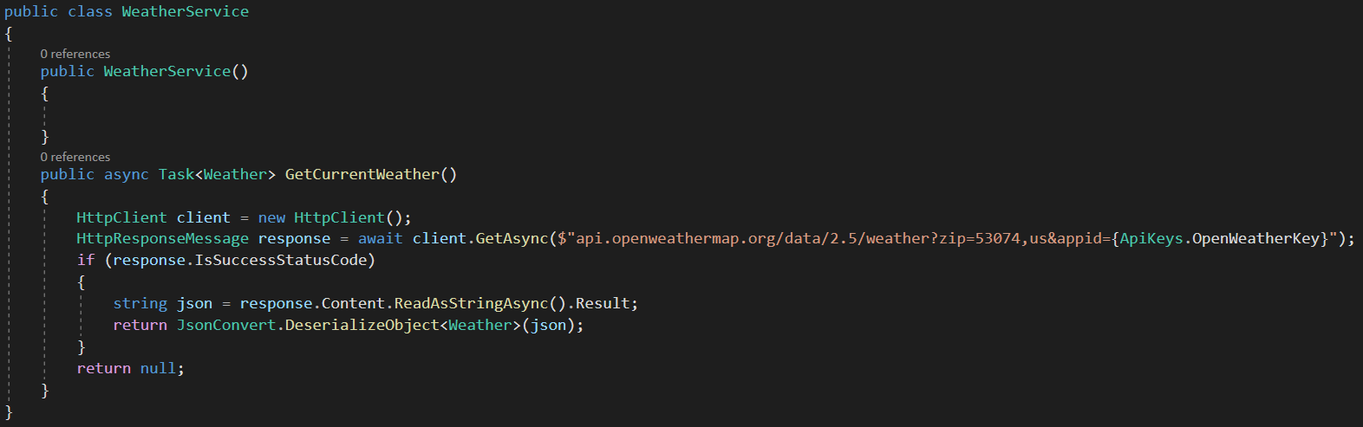
Creating Service Class

Slide 7
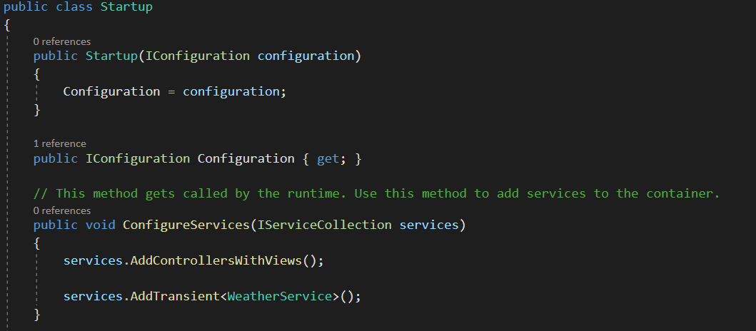
Register Service

Slide 8
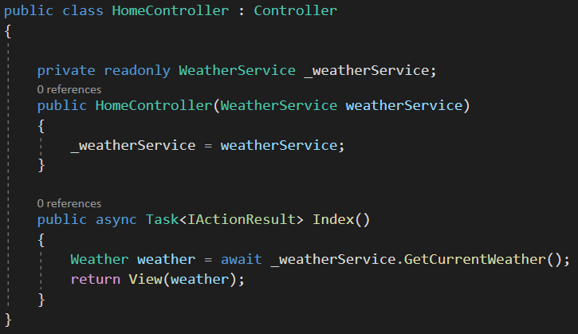
Services Constructor Injection

Slide 9
Service Lifetime
Singleton: IoC container will create and share a single instance of a service throughout the application’s lifetime
Transient: The IoC container will create a new instance of the specified service type every time you ask for it
Scoped: IoC container will create an instance of the specified service type once per request and will be shared in a single request

Slide 10
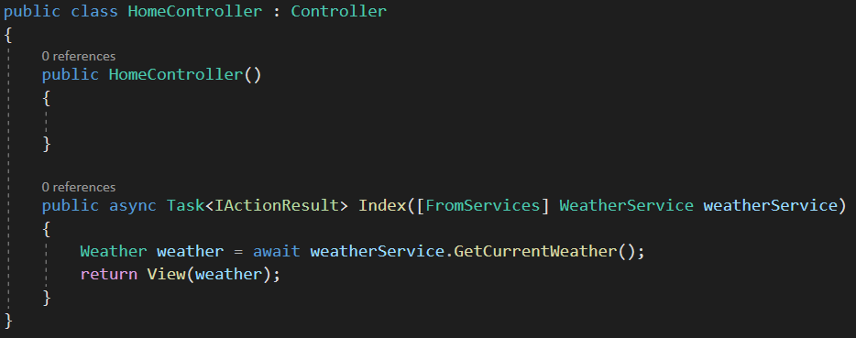
Services Method Injection
Using the [FromServices] attribute, we can request services for methods

Slide 11
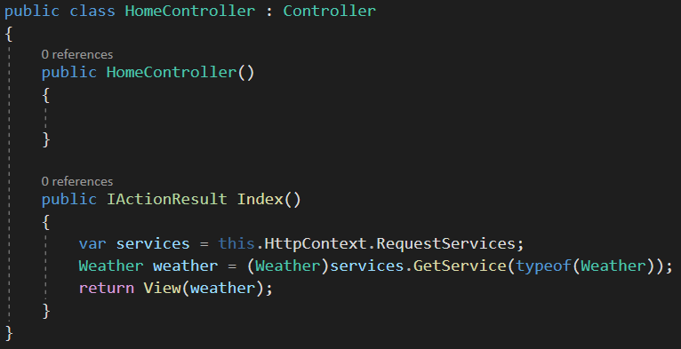
Get Services Manually

Slide 12
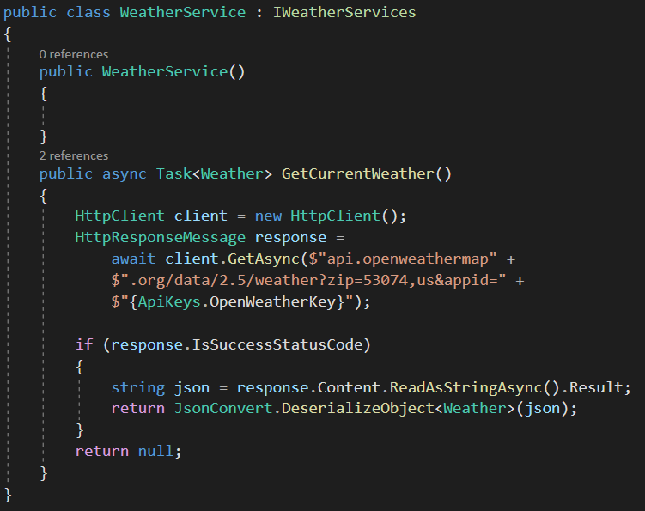
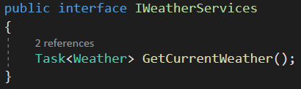
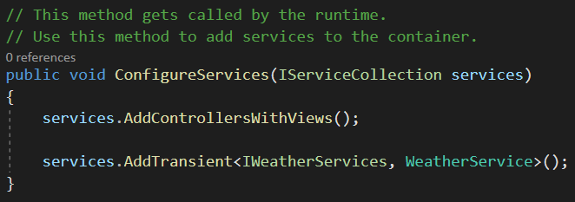
Example Using Interface

Slide 13
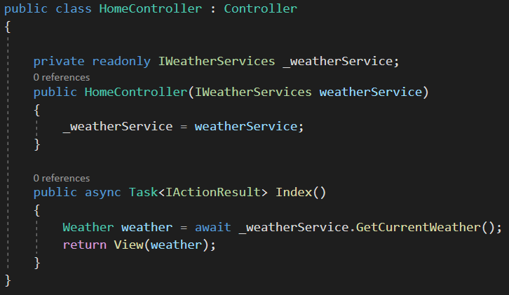
Example Using Interface

Slide 14
Conclusion
Control over how a class is shared between requests i.e Transient, Scoped, Singleton
Never have to use the “new” keyword
Allows for quick re-use of code

