Slide 1
Pizza Sales
By Dylan Furtado
UNID: UMIP217949

Slide 2
Introduction
In this project, we are tasked with analysing and visualising sales data of a pizza shop.
We are given various types of data, including numerical types, categorical types, and date types.
Some of these include Order Date, Pizza Name, Pizza Size, Total Price, Unit Price etc.

Slide 3
Problem Statement
Plato's Pizza seeks to leverage its past year's transactional data to identify opportunities for increasing sales and improving operational efficiency.
The goal is to:
Analyze patterns,
Optimize processes, and
Provide data-driven insights to enhance overall performance and profitability.

Slide 4
Techniques Used
To complete this project, we will be using several tools such as MySQL Workbench and Tableau to effectively analyse and visualise the given data
We will be using the following steps:
Define the Scope and Objective
Data Collection
Data Preparation
Load Data into Tableau
Create Initial Visualizations

Slide 5
MySQL
We will use MySQL Workbench to return relevant queries such as
Total Revenue
Average Order Value
Total Pizzas Sold
Total Orders
Most/Least Popular Pizzas
Highest/Lowest Revenue earning Pizzas
Peak Hours
Popular Categories, Sizes.

Slide 6
Tableau
We can better understand the data by creating simple interactive visualisations on Tableau.
Here we can plot graphs to better understand the queries answered on MySQL with regard to Popular Pizzas, Categories, Sizes etc, as well as ascertain the peak periods for sales.
Although we have already had our queries answered on MySQL, the dashboards created on Tableau simply summarises what we already have in the form of easily readable graphs.

Slide 7
Results and Output
Note: Since the Tableau visualisations are graphs based on MySQL queries, we will be only be inserting the output from Tableau in this section.

Slide 8
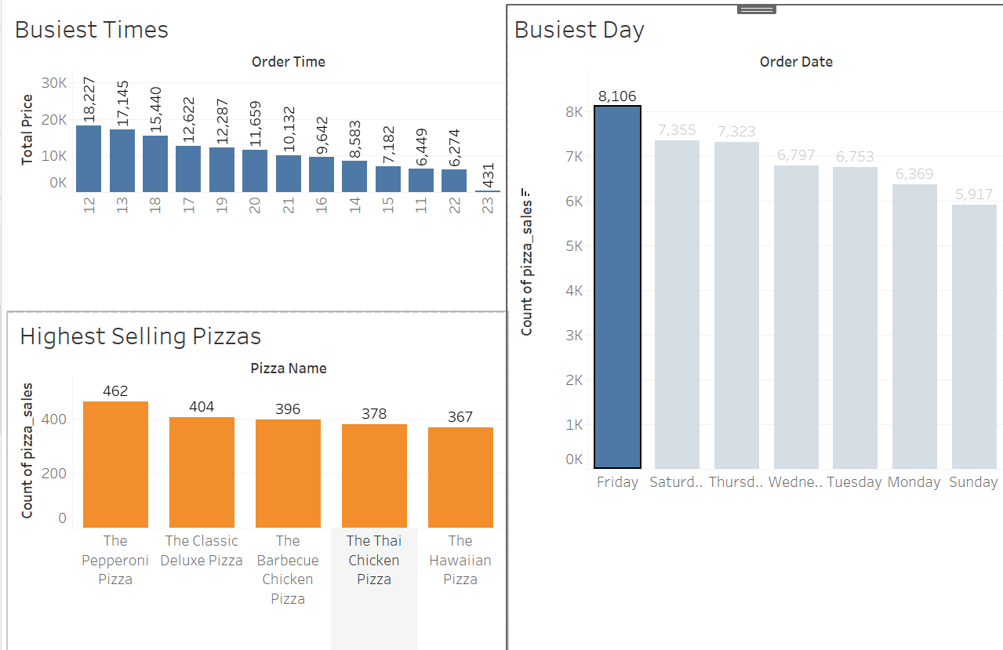
Peak periods
Fridays and Saturdays tend to be the busiest days, with peak hours being around noon or midday. Early evenings also tend to be busy periods. Morning hours are most lax. Pepperoni pizza seems to be most ordered during peak periods

Slide 9
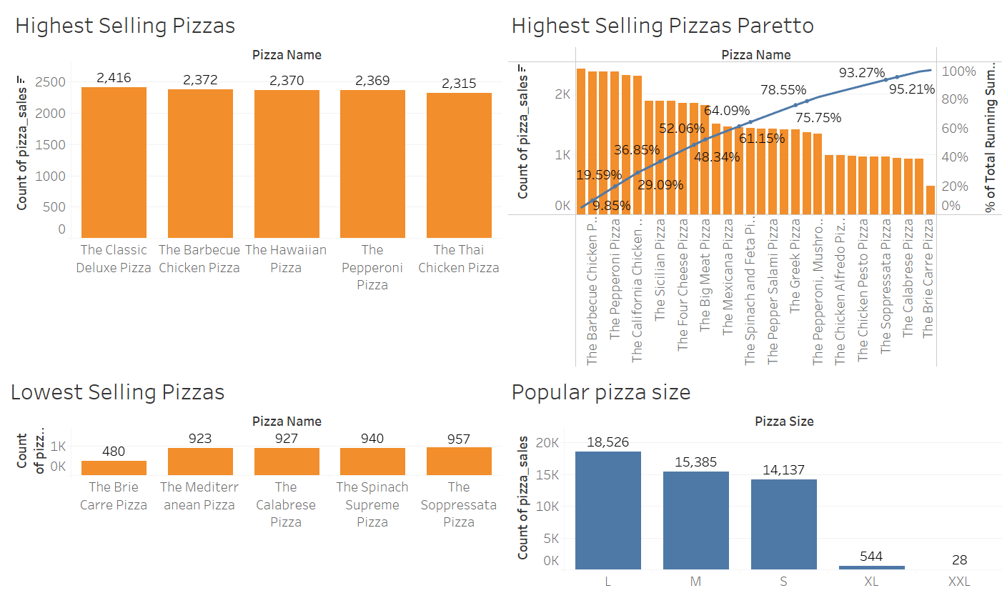
Most ordered
Highest and lowest selling pizzas.
Large pizzas are the most regularly ordered size of pizza.
Extra Large and Extra-Extra Large are the least regularly ordered pizzas.
The top 5 highest selling pizzas contribute to almost a quarter(24.36%) of total sales.

Slide 10
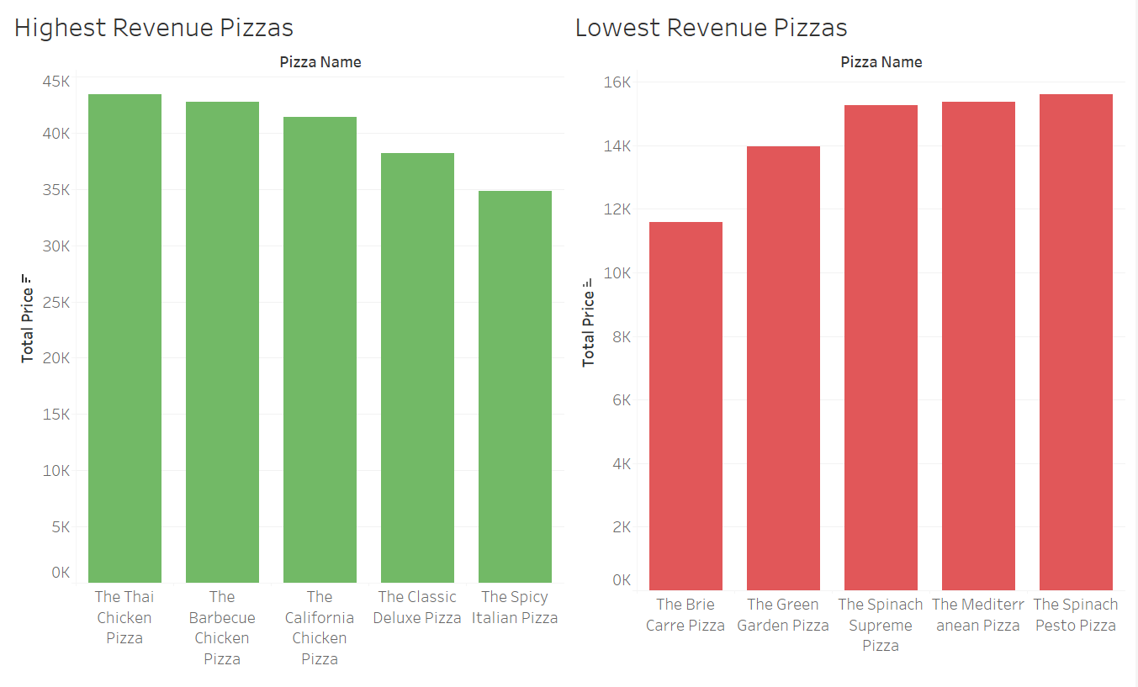
revenue
Although Pepperoni Pizzas are popular, they do not bring in the highest revenue.
The Brie Carre Pizza is not very popular and it also brings in the lowest revenue.

Slide 11
Coffee sales
By Dylan Furtado
UNID: UMIP217949

Slide 12
introduction
In this project, we are tasked with analysing transactional data of a coffee shop.
We are given various types of data, including numerical types, categorical types, and date types.
Some of these include Date, Cash Type, Money, and Coffee Name.

Slide 13
Data overview
These are the following columns given to us:
Date
Datetime: Gives us the time of the order
Cash Type: Method of payment(Cash or Card)
Card: Gives the card number
Money: Amount received per order
Coffee Name: Latte, Hot Chocolate, Americano etc.

Slide 14
Techniques used
We use various libraries available in python such as Pandas, Matplotlib Pyplot and Seaborn
Process:
Load and clean the data
Check for missing values
Prepare Exploratory Data Analysis(EDA) to visualise sales trends
Perform Descriptive analysis
Further analysis of sales trends

Slide 15
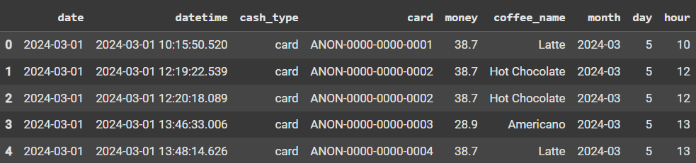
Data Overview
We us df.head() to load the first 5 rows of the dataset.
This gives us an idea of the types of data.

Slide 16
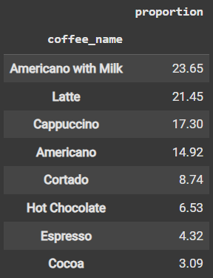
EDA
We check for missing values and duplicate rows. There are neither of the two. Now we can move on to further explore the data using exploratory data analysis.
We can see several patterns such as distribution of coffee types sold, proportion of customers who pay by card and cash.
In the image of the table attached, we can see that Americano with Milk is the highest selling coffee accounting for 23.65% of total sales.

Slide 17
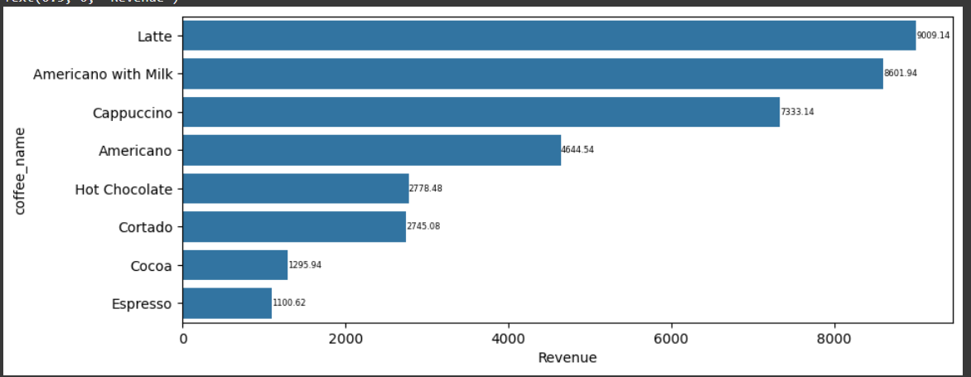
EDA
Revenue Data:
From the bar chart attached, we can see that Latte is the drink which brings in the highest revenue. Americano with Milk also brings in a high revenue.
Espresso and Cocoa brings in the least revenue

Slide 18
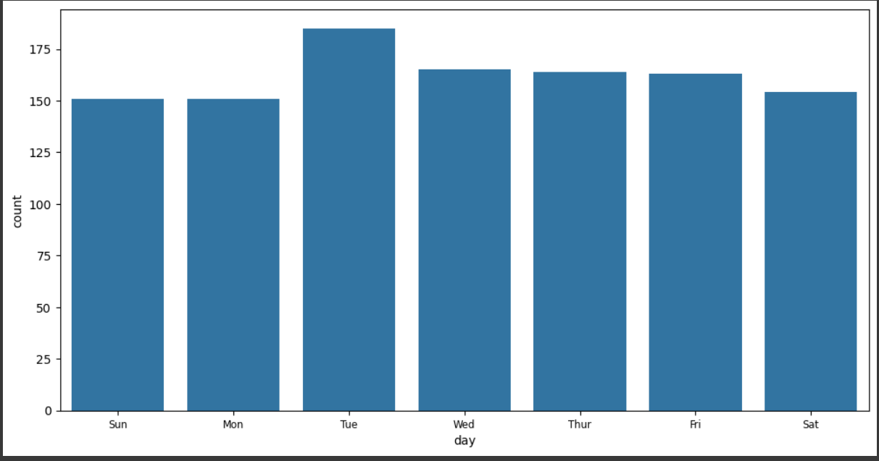
Peak periods
Sales are typically highest on Tuesdays, while the rest of the week shows relatively consistent sales figures.

Slide 19
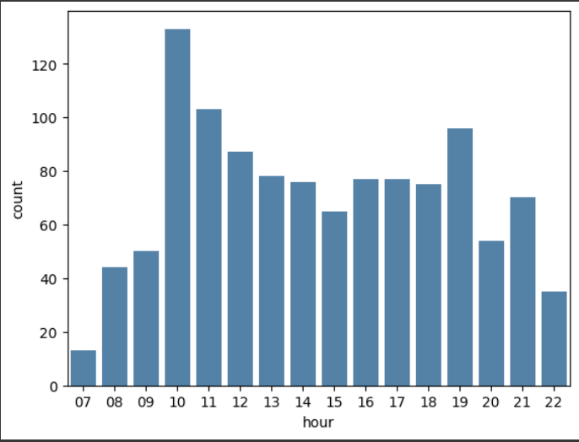
Peak periods
In general, two peak hours are noticeable each day—10:00 AM and 7:00 PM

Slide 20
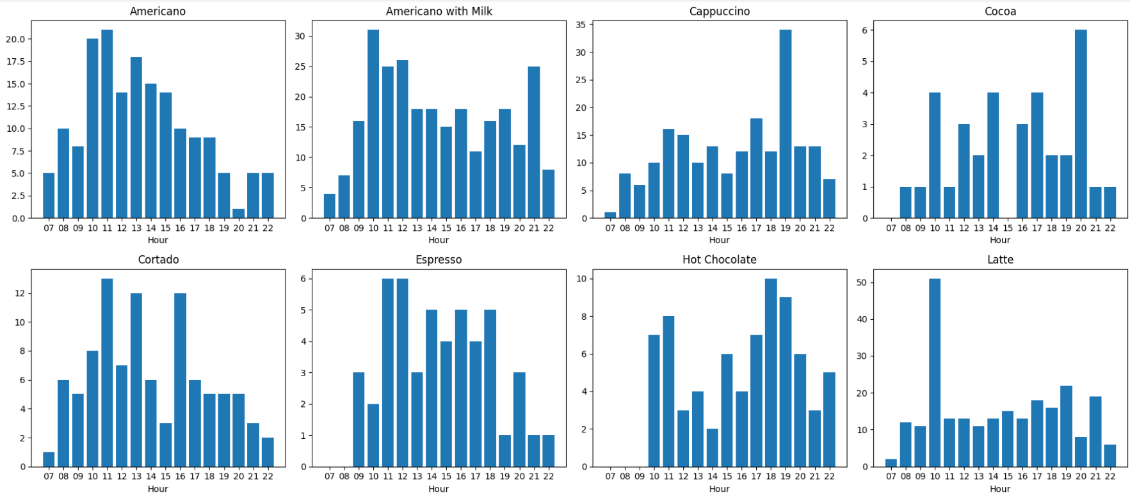
Shopping patterns
The charts above depict the shopping traffic patterns for each product throughout the day. It is evident that all products see a spike in traffic around 10:00 AM, with this trend being most prominent for Latte. Moreover, Cappuccino, Cocoa, and Hot Chocolate show higher popularity during the evening hours, particularly between 6:00 PM and 8:00 PM.

Slide 21


