Slide 1
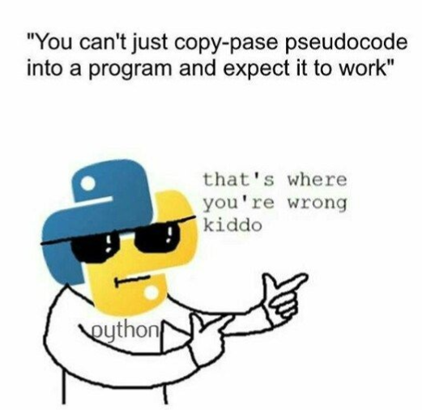
Python
Programming – Intro To Python
Last modified 23/1/10 by Dylan Guidry

Slide 2
Contents
Compiled VS Scripting Programming Languages
What is Python?
Variables
Conditionals
Loops
Classes

Slide 3
Compiled Languages
Up to this point we have been using C++ which is a compiled programming language
Compiled languages require the code base to be recompiled every time a change is made.
We solve this very time consuming problem by using Scripting Languages.
Python, JavaScript, Lua, PHP

Slide 4
Scripting Languages
Run through a virtual machine
A virtual machine is simply compiled code that is able to execute other code
Because of it is not run by the computers processor itself the code does not need to be compiled for specific hardware

Slide 5
Benefits of a Virtual Machine?
Write once run everywhere
Not only do we not need to rewrite and recompile our scripted code for different platforms and hardware but we can manipulate and modify code while the game is running.

Slide 6
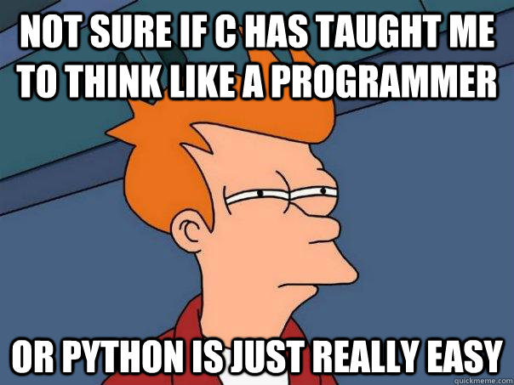
What is Python
Python is very similar in syntax to C/C++ in that we have some common key words:
If, while, else, class, break, for, return, continue
Python also has many other keywords:
And, or, elif, self

Slide 7
White Space
Unlike C/C++ python is white space sensitive
This means you use tabs to define scope instead of curly braces to define scope.
There is also no semi colons at the end of lines.
Some lines do require you to use a colon though
For statements and conditional statements

Slide 8
Dynamic Types
There are no implied data types in python everything is of dynamic types

Slide 9
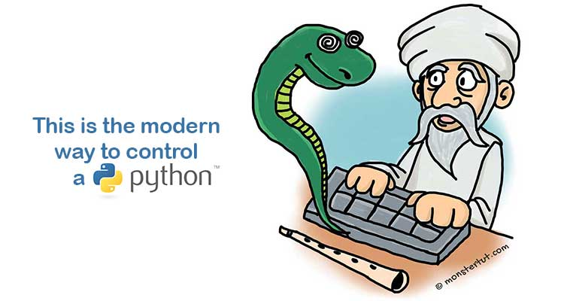
Why use Python?
We use python when we want to get something done fast.
We do this because it is super fast to set up the environment for it and get to work.
All you need to code Python is the language installed and some kind of text editor.

Slide 10
Getting started
You can install Python from the website https://www.python.org/
We will be using Python 2.7
Once you have that we are ready to begin programming
Open up the console and navigate to your install directory for python and Type Python
Now you can begin to code in the console.
This code is not saved how ever you will have to retype it every time .

Slide 11
Hello World
To Print to the console we use the print function followed by the information we want to print
You do not have to use parentheses to use the print function put it will still work if you do.

Slide 12


Variables
As stated before all data types in Python are dynamic types which means we don’t imply a variable has a data type
In the example above I created a new variable called “a” and assigned it the value of 10, then printed the value.
This can be dangerous as you can change data types if you are not careful

Slide 13

Conditionals
In C/C++ when we want to write a condition statement we use keywords like if, else, else if followed by a true or false expression.
In Python we use if, else, elif followed by a true or false expression.
To chain conditional expressions we can use the keywords “and” and “or” just like we would use && and || in C/C++

Slide 14
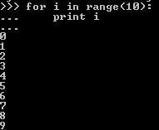
For Loops
You have seen for loops before in C/C++ and the behavior doesn’t change to Python just the syntax
The code snippet above iterates a for loop 10 times printing out the value of “I” each time.
Take note how the line starting the for loop ends with a colon.
This is one of the cases where you have to specify the end of the line
You will also notice the use of to identify the scope of the for loop

Slide 15
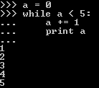
While Loops
While loops in Python are just like while loops in C/C++ where they will continue to execute the code under it as a condition is true.
This loop will continue to run as long as the value of “a” is less that 5.

Slide 16

Classes
Classes declared in Python are denoted by the keyword class
The biggest difference in syntax is the face that you don’t have variable declared in class scope. Instead they are declared in the class initializer function.
The class variables are denoted by having the keyword “self” in front them
This variables will be accessible by all other class functions that have the argument self in them

Slide 17
Summary
Python is very fast to get set up and start programming
No need to declare variable type as all variables are dynamic types

Slide 18
References
Python 2.7.14 Documentation, docs.python.org/2.7/
Zelle, John M. Python Programming: an Introduction to Computer Science. Franklin, Beedle & Associates Inc., 2017.

