Slide 1

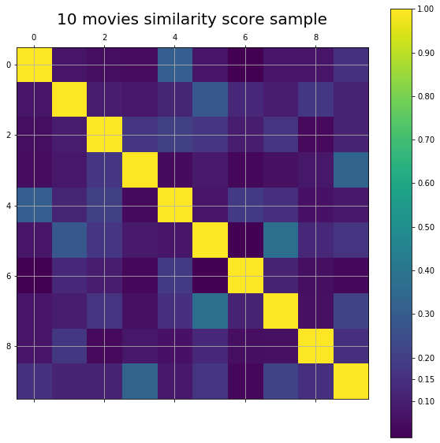
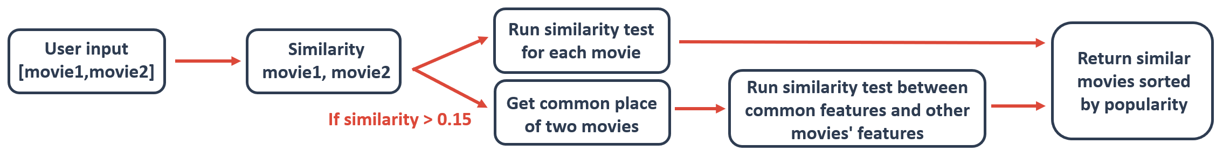
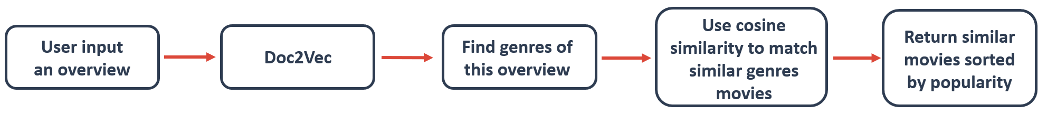
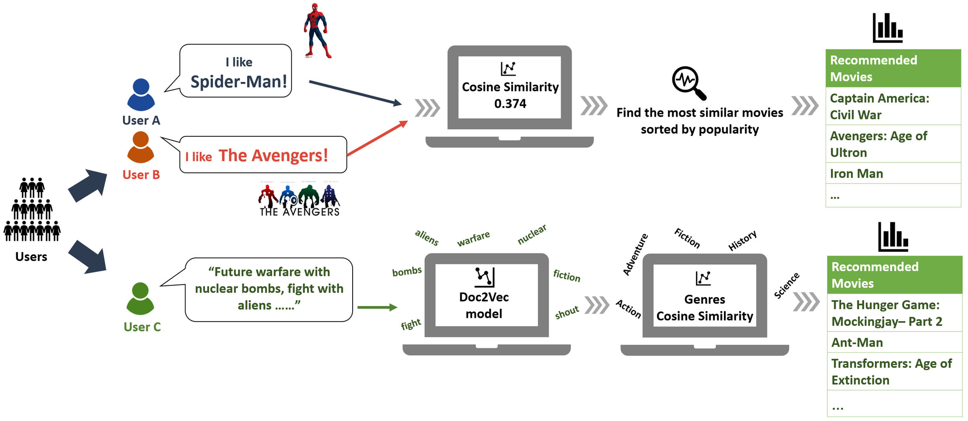
ANLY 580: Natural Language Processing for Data Analytics
Movie Recommendation System
with Cosine Similarity and Topic Modeling
Dongru Jia, Jianhao Ji, Miao Wang, Yuxuan Yao
Keywords
Methodology
Conclusion
Movie recommendation system
Topic modeling
Cosine similarity
Doc2Vec
Genism
The methodology we used in this project consist of two methods; one by applying Cosine Similarity, the other by applying Doc2Vec.
As expected, both methods can generate reasonably similar movies. Cosine Similarity based model performs really well when two input movies are close in terms of cosine or similar. For example, when they are all about superheros. However, when two input movies are very different from each other, the performance of finding similar movies to both inputs dropped, and that why we took another path to return similar movies to each inputs. For the second method which applies Doc2Vec, it sometimes can provide surprisingly precise result, but the performance is not consistent. For example, when “alien” is in the input overview, the program will consider it as genres of “fiction”, “science”, and “thriller” and return movies like “Independence day” and “Star Trek”. Given “alien” is not a tagged genres, the result is surprising.
But of course, there is weakness in our model. For example, since the keywords, the most important feature, is concluded by viewers without a standard, some similar movies might have very different keywords due to the different focus by viewers. As a result, the similarity score between some similar movies could be very low.
For similarity method, the model mainly focus on movies’ features including keywords, production company, generes and title. All of these features would be combined in one single column, called overall features, as our similarity calculation variable.
As Cosine Similarity function applies to the overall features, all movies’ overall features would be compared with each other. As a result, we would get a similarity score matrix. With this matrix, we are able to rank the similar movies of input movies.
Introduction
Our project is designed to solve a familiar dilemma. Consider the following situation. During a regular date night, both you and your partner have favorite movies to watch in mind. However, it is hard to come to a perfect solution. It is either someone is sorry or annoyed, or both. Hence, to prevent such a situation, and let everyone enjoy a date night, our group is motivated to come up with an optimized solution, a movie recommendation application gives movie suggestions that could accommodate both parties, based on two input movies or a short overview of the story both you and your partner would love to watch.
The second method we take is first to apply the Doc2Vec model from Gensim and then feed the output (genres) to Cosine Similarity model. From here, the program will generate movies with similar genres tags. To train Doc2Vec model, we used “overview” column as training feature and “genres” as labels or document tags. To find model that performs the best, we trained three models with different parameters, such as learning rate, vector size, max iteration, etc. And, to evaluate this method, we examined the interpretability of results.
Data Description
Future work
Our dataset are from Kaggle.com, which includes more than 4800 movies from The Movie Database (TMDB). Features include movie title, tagline, genres, overview, keywords, cast, audience ratings, popularity, vote count and etc. Among them, several important variables are listed as below:
Genres: Each movie is labeled as one or a few genres, based on the story.
Keyword: Keywords are the key elements of the story, for example, superhero, marvel, DC, etc.
Overview: It is 1-5 line brief summary of the story.
Production company: Movie’s production company
To prepare our data for analysis, we combine the columns of keywords, genres, production company and title, and generated as a new comprehensive feature for method one. For method two, we simply used overview as training feature and genres as labels or document tags.
For future work, one can overcome the weakness of our current recommendation system. For objective feature bias, we might add more features, for example movie director and main casts, by which the significance of certain feature, in this case keywords, would decrease and the cosine similarity model would have a better performance. We can also feed more data to train Doc2Vec model. For this project, we only used movie overviews, to train our model, but for future work, the whole movie script can be used, and ideally generate better performance.
Example
Reference
1. Yang, C. et al. “A Hybrid Movie Recommendation Method Based on Social Similarity and Item
2. Colucci, L., et al. Evaluating Item-Item Similarity Algorithms for Movies. in Proceedings of the 2016
3. Choi, Sang-Min, Sang-Ki Ko, and Yo-Sub Han. "A movie recommendation algorithm based on genre
Acknowledgements
This project was supported by Prof.Lisa Harper. We thank them for providing insight and expertise that greatly assisted the project.

