Slide 1
Var retail
0407

Slide 2
Outline
Baseline
Penalty structures
Baseline
Penalty control
Updates
Penalty strength (lambda search)

Slide 3
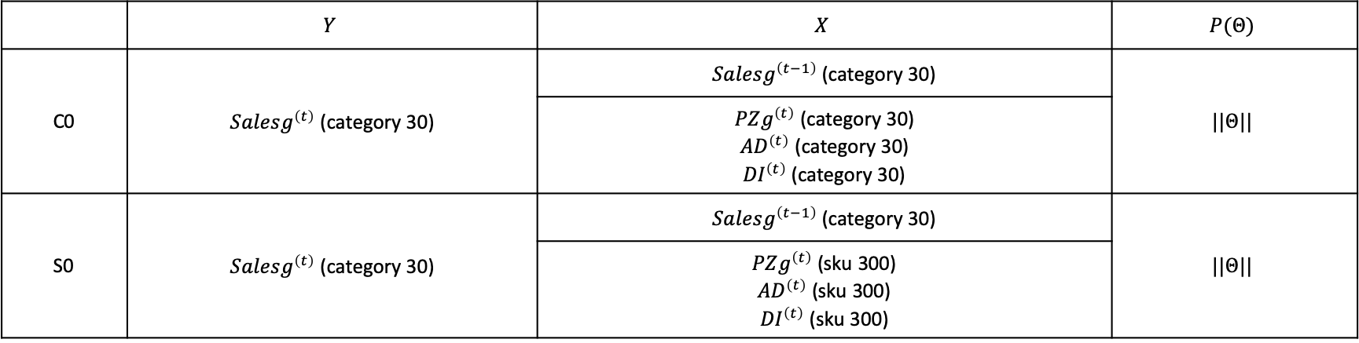
Baseline
 | $$Y$$ | $$X$$ | $$P(Θ)$$
C0 | $Salesg^{\left(t\right)}$ (category 30) | $Salesg^{\left(t−1\right)}$ (category 30) | $$||Θ||$$
 |  | $PZg^{\left(t\right)}$ (category 30) ${AD}^{\left(t\right)}$ (category 30) ${DI}^{\left(t\right)}$ (category 30)
S0 | $Salesg^{\left(t\right)}$ (category 30) | $Salesg^{\left(t−1\right)}$ (category 30) | $$||Θ||$$
 |  | $PZg^{\left(t\right)}$ (sku 300) ${AD}^{\left(t\right)}$ (sku 300) ${DI}^{\left(t\right)}$ (sku 300)

Slide 4
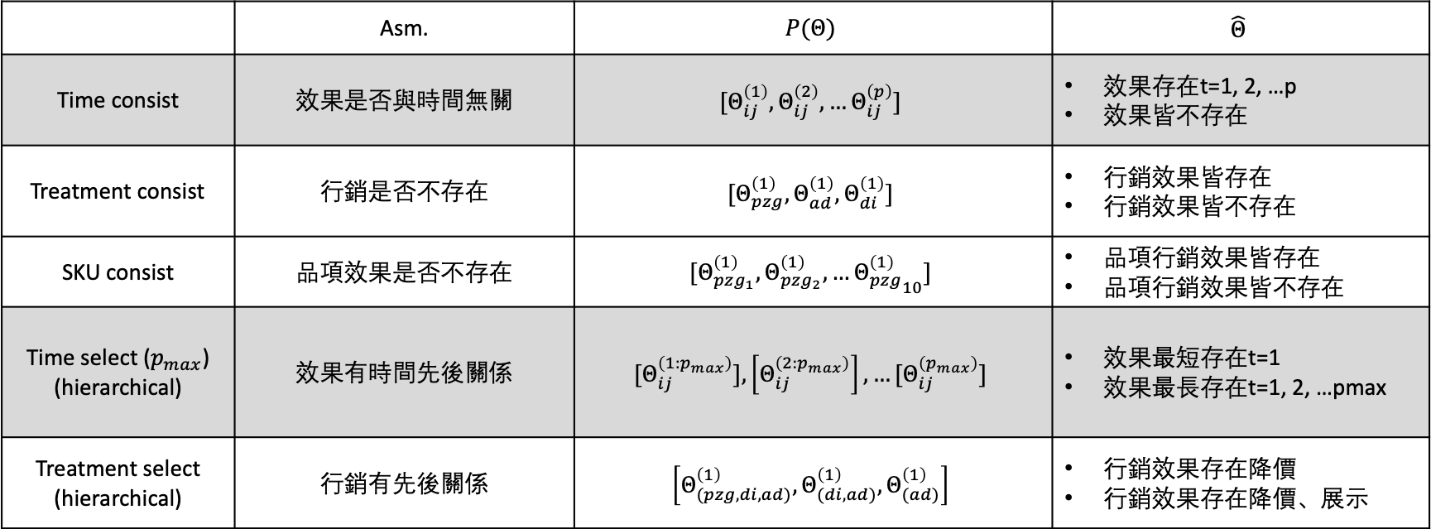
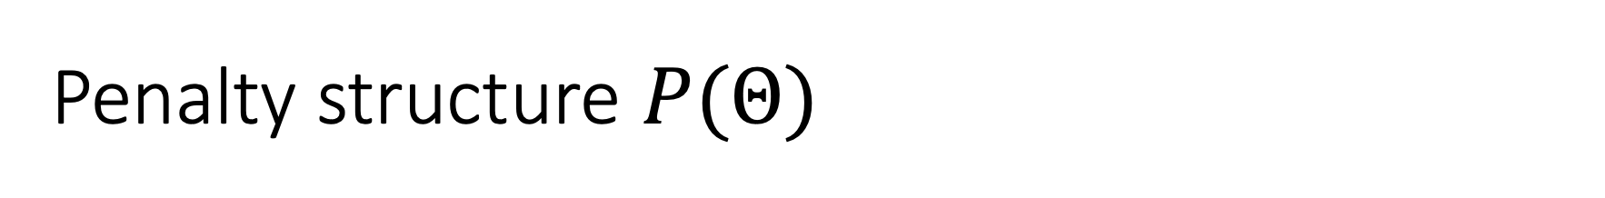
Penalty structure $P(Θ)$
 | Asm. | $$P(Θ)$$ | $$\hat{Θ}$$
Time consist | 效果是否與時間無關 | $${[Θ}_{ij}^{\left(1\right)},Θ_{ij}^{\left(2\right)}, …Θ_{ij}^{\left(p\right)}]$$ | 效果存在t=1, 2, …p 效果皆不存在
Treatment consist | 行銷是否不存在 | $$[Θ_{pzg}^{\left(1\right)}, Θ_{ad}^{\left(1\right)}, Θ_{di}^{\left(1\right)}]$$ | 行銷效果皆存在 行銷效果皆不存在
SKU consist | 品項效果是否不存在 | $$[Θ_{pzg_{1}}^{\left(1\right)}, Θ_{pzg_{2}}^{\left(1\right)},…{Θ_{pzg}^{\left(1\right)}}_{10}]$$ | 品項行銷效果皆存在 品項行銷效果皆不存在
Time select ($p_{max}$) (hierarchical) | 效果有時間先後關係 | $${[Θ}_{ij}^{\left(1:p_{max}\right)}],\left[Θ_{ij}^{\left(2:p_{max}\right)}\right],…[Θ_{ij}^{\left(p_{max}\right)}]$$ | 效果最短存在t=1 效果最長存在t=1, 2, …pmax
Treatment select (hierarchical) | 行銷有先後關係 | $$\left[Θ_{(pzg, di, ad)}^{\left(1\right)}, Θ_{(di, ad)}^{\left(1\right)}, Θ_{(ad)}^{\left(1\right)}\right]$$ | 行銷效果存在降價 行銷效果存在降價、展示

Slide 5
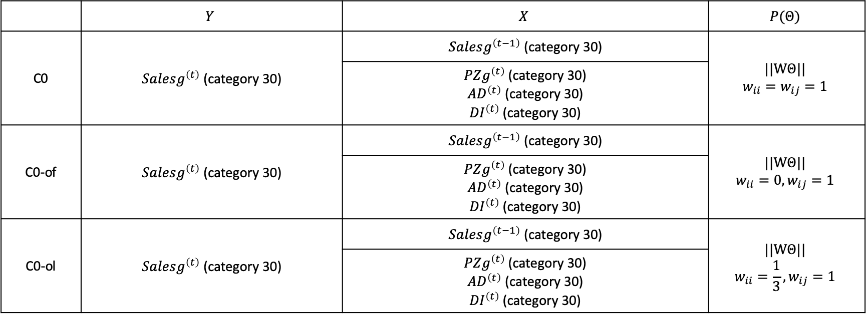
Baseline
 | $$Y$$ | $$X$$ | $$P(Θ)$$
C0 | $Salesg^{\left(t\right)}$ (category 30) | $Salesg^{\left(t−1\right)}$ (category 30) | $$||WΘ||$$ $$w_{ii}=w_{ij}=1$$
 |  | $PZg^{\left(t\right)}$ (category 30) ${AD}^{\left(t\right)}$ (category 30) ${DI}^{\left(t\right)}$ (category 30)
C0-of | $Salesg^{\left(t\right)}$ (category 30) | $Salesg^{\left(t−1\right)}$ (category 30) | $$||WΘ||$$ $$w_{ii}=0, w_{ij}=1$$
 |  | $PZg^{\left(t\right)}$ (category 30) ${AD}^{\left(t\right)}$ (category 30) ${DI}^{\left(t\right)}$ (category 30)
C0-ol | $Salesg^{\left(t\right)}$ (category 30) | $Salesg^{\left(t−1\right)}$ (category 30) | $$||WΘ||$$ $$w_{ii}=\frac{1}{3}, w_{ij}=1$$
 |  | $PZg^{\left(t\right)}$ (category 30) ${AD}^{\left(t\right)}$ (category 30) ${DI}^{\left(t\right)}$ (category 30)

Slide 6
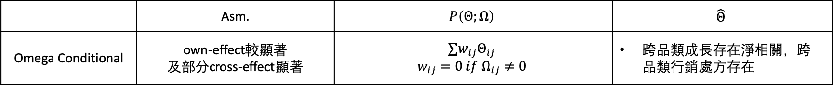
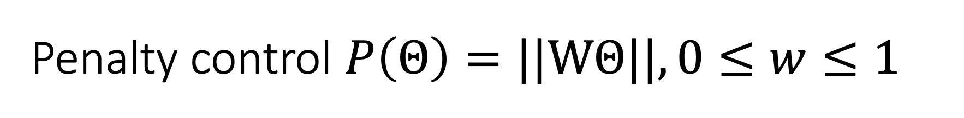
Penalty control $P\left(Θ\right)=||WΘ||, 0≤w≤1$
 | Asm. | $$P\left(Θ;Ω\right)$$ | $$\hat{Θ}$$
Omega Conditional | own-effect較顯著 及部分cross-effect顯著 | $${∑w}_{ij}Θ_{ij}$$ $$w_{ij}=0 if Ω_{ij}≠0$$ | 跨品類成長存在淨相關，跨品類行銷處方存在

Slide 7
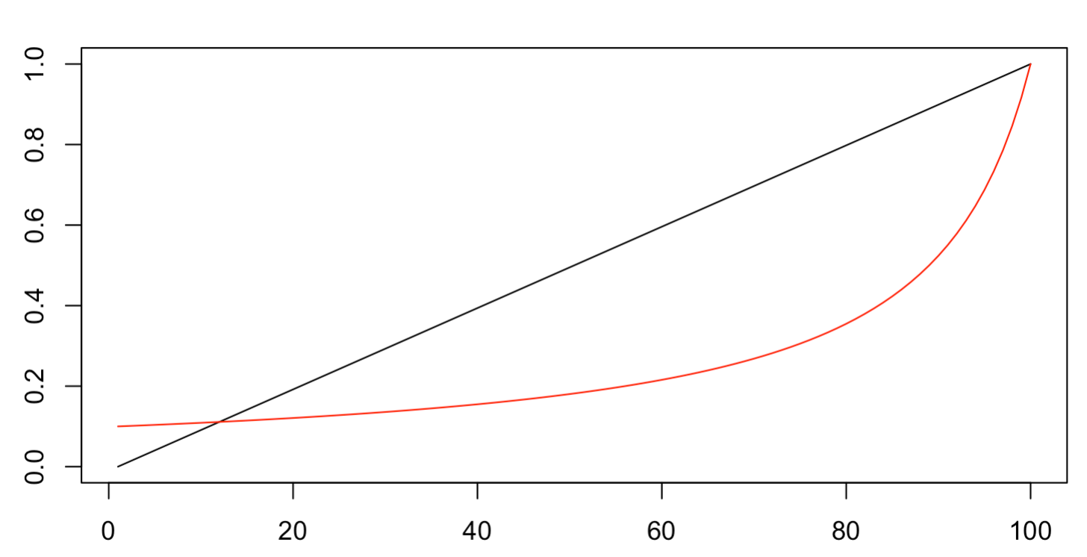
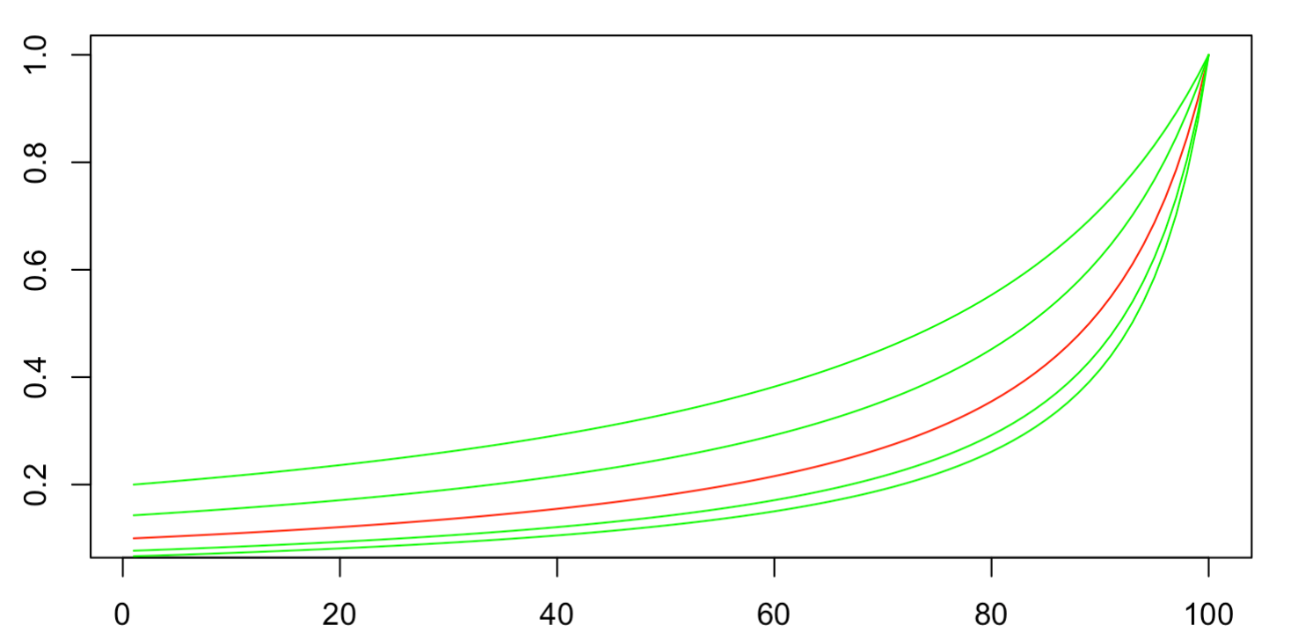
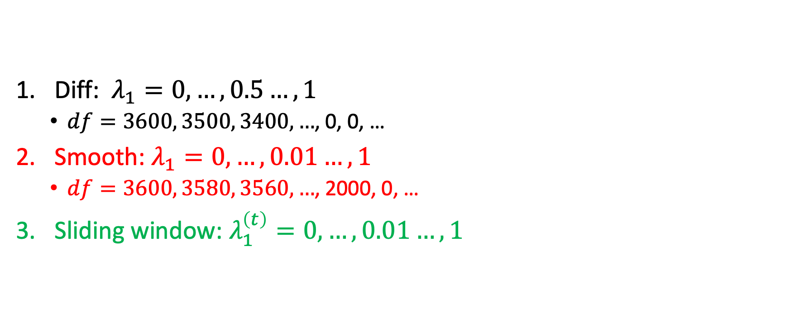
Updates: Penalty strength
Diff: $λ_{1}=0, …,0.5…,1$
$df=3600, 3500, 3400, …$, 0, 0, …
Smooth: $λ_{1}=0, …,0.01…,1$
$df=3600, 3580, 3560, …$, 2000, 0, …
Sliding window: $λ_{1}^{\left(t\right)}=0, …,0.01…,1$

Slide 8
Optimization
CE optimization
Generalized elite
More test observations
標準差固定
Simulation – DGP
Uncorrelated → Correlated noise (to treatments)
Distribution of effect

