Slide 1
Var retail
0414

Slide 2
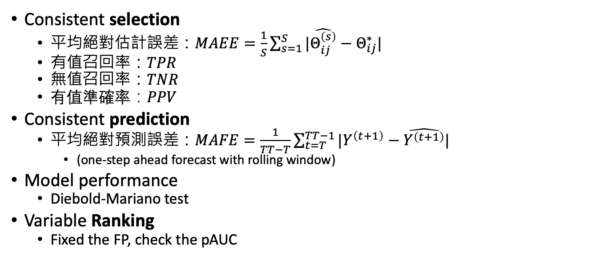
Performance measures
Consistent selection
平均絕對估計誤差：$MAEE=\frac{1}{S}\sum_{s=1}^{S}{|\hat{Θ_{ij}^{\left(s\right)}}−Θ_{ij}^{∗}|}$
有值召回率：$TPR$
無值召回率：$TNR$
有值準確率：$PPV$
Consistent prediction
平均絕對預測誤差：$MAFE=\frac{1}{TT−T}\sum_{t=T}^{TT−1}{|Y^{\left(t+1\right)}−\hat{Y^{\left(t+1\right)}}| }$
(one-step ahead forecast with rolling window)
Model performance
Diebold-Mariano test
Variable Ranking
Fixed the FP, check the pAUC

Slide 3
Before (Regression, fixed scheme): MAE, 平均絕對(回歸)誤差
Rolling window/Expanding window
1 |  |  |  |  |  |  |  |  | T (10) | T+1 (11) |  |  |  |  |  |  |  |  | T+10 (20)
1 |  |  |  |  |  |  |  |  | T (10) | T+1 (11) |  |  |  |  |  |  |  |  | T+10 (20)
 | 2 |  |  |  |  |  |  |  |  | T+1 (11) | T+2 (12) |  |  |  |  |  |  |  | T+10 (20)
…
 |  |  |  |  |  |  |  |  | 10 |  |  |  |  |  |  |  |  |  | T+10 (20)
1 |  |  |  |  |  |  |  |  | T (10) | T+1 (11) |  |  |  |  |  |  |  |  | T+10 (20)
1 |  |  |  |  |  |  |  |  |  | T+1 (11) | T+2 (12) |  |  |  |  |  |  |  | T+10 (20)
…
1 |  |  |  |  |  |  |  |  |  |  |  |  |  |  |  |  |  | T+9 (19) | T+10 (20)

Slide 4
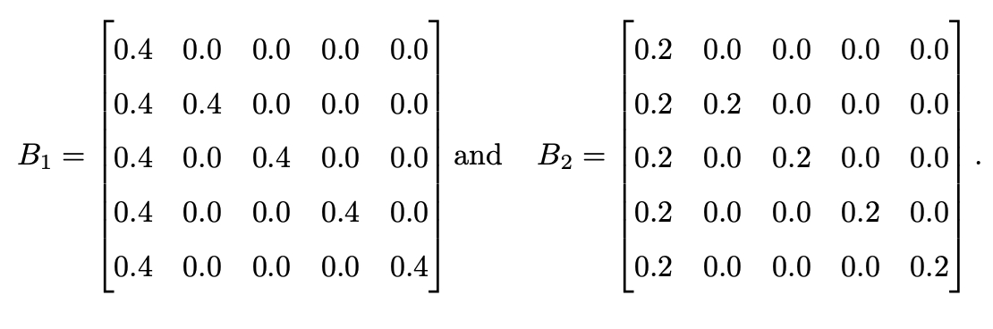
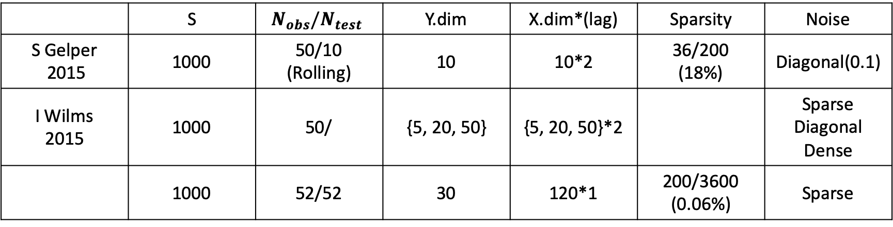
Wlims DGP
 | S | $$N_{obs}/N_{test}$$ | Y.dim | X.dim*(lag) | Sparsity | Noise
S Gelper 2015 | 1000 | 50/10 (Rolling) | 10 | 10*2 | 36/200 (18%) | Diagonal(0.1)
I Wilms 2015 | 1000 | 50/ | {5, 20, 50} | {5, 20, 50}*2 |  | Sparse Diagonal Dense
 | 1000 | 52/52 | 30 | 120*1 | 200/3600 (0.06%) | Sparse

Slide 5
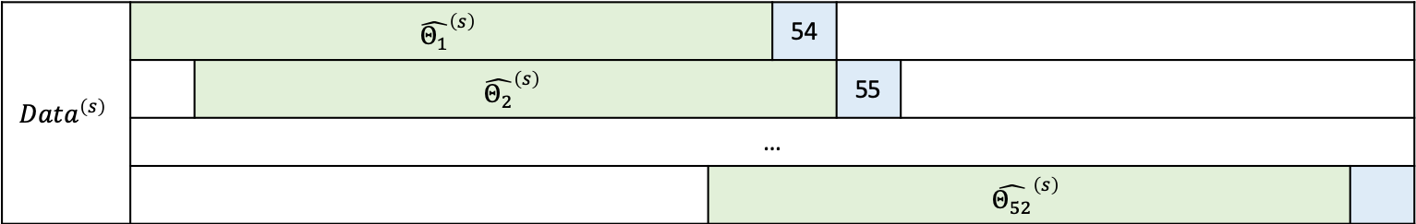
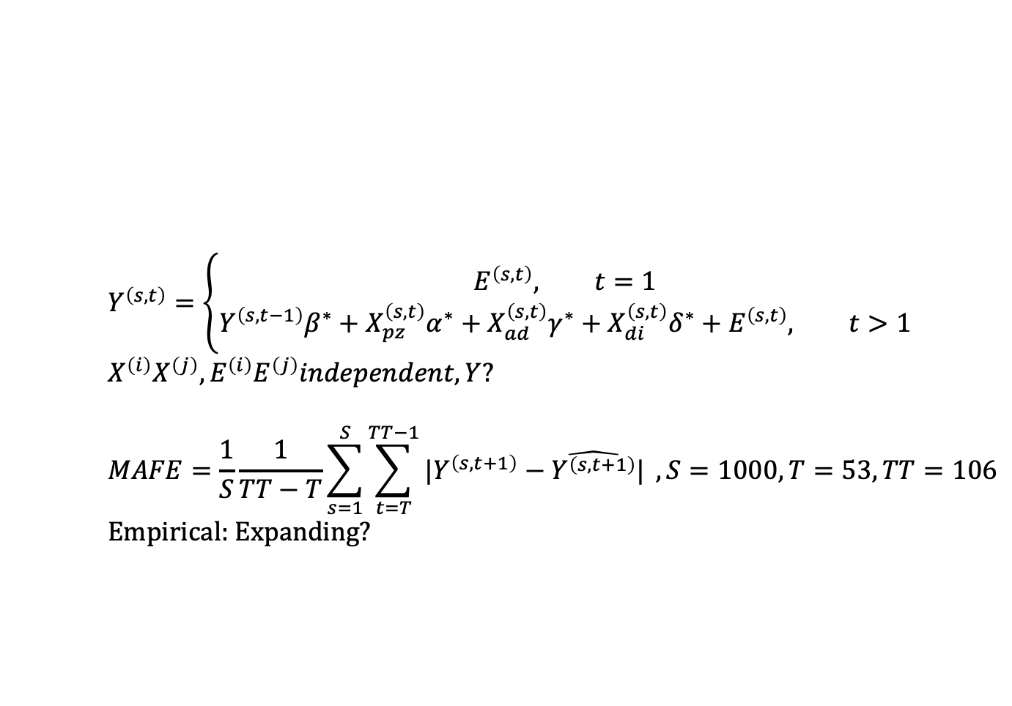
Train/test
$$Data^{\left(s\right)}$$ | $${\hat{Θ_{1}}}^{\left(s\right)}$$ |  |  | 54
 |  | $${\hat{Θ_{2}}}^{\left(s\right)}$$ |  |  | 55
 | …
 |  |  | $${\hat{Θ_{52}}}^{\left(s\right)}$$
$$Y^{\left(s, t\right)}=\left\{\begin{aligned}E^{\left(s, t\right)}, t=1 \\ &Y^{\left(s, t−1\right)}β^{∗}+X_{pz}^{\left(s, t\right)}α^{∗}+X_{ad}^{\left(s, t\right)}γ^{∗}+X_{di}^{\left(s, t\right)}δ^{∗}+E^{\left(s, t\right)}, t>1\end{aligned}\right. \\ X^{\left(i\right)}X^{\left(j\right)},E^{\left(i\right)}E^{\left(j\right)}independent,Y?$$ $$MAFE=\frac{1}{S}\frac{1}{TT−T}\sum_{s=1}^{S}{\sum_{t=T}^{TT−1}{|Y^{\left(s, t+1\right)}−\hat{Y^{\left(s, t+1\right)}}| }},S=1000, T=53, TT=106$$
Empirical: Expanding?

Slide 6
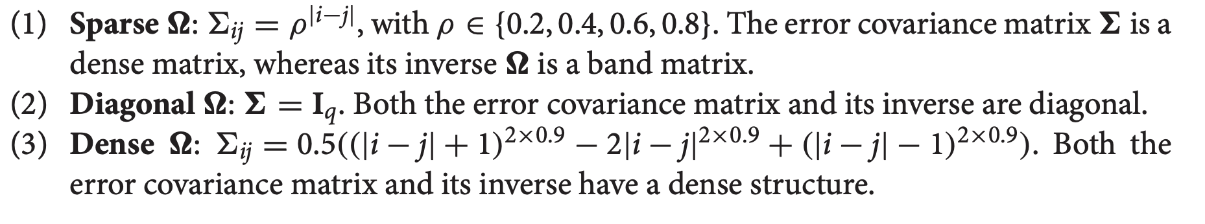
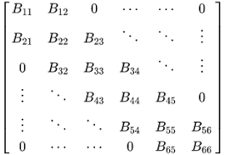
Sigma
(3) Fractional gaussian noise

Slide 7
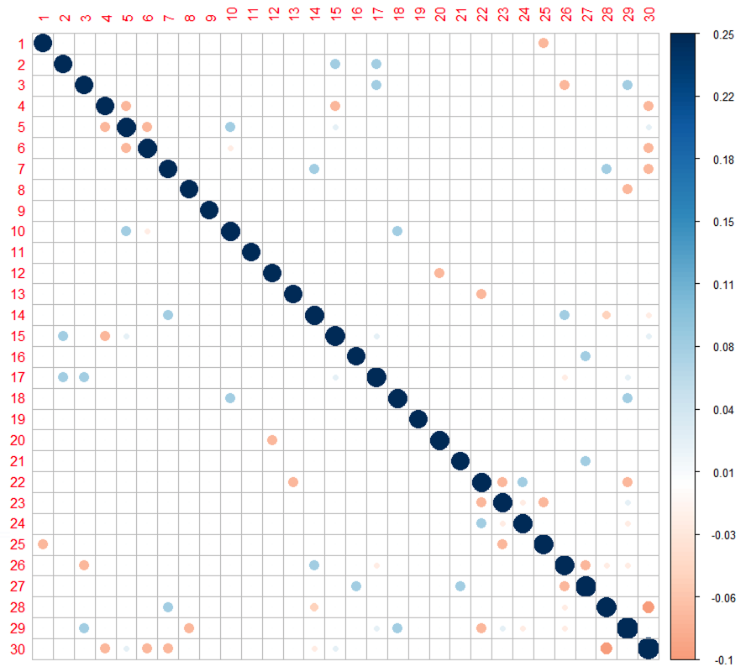
Error covariance matrix
標準差（自身共變異）：
IRI：0.37 (0.18)
稀疏：0.4 (0.17)
密集：0.3 (0.18)
對角：0.42 (0.17)

Slide 8
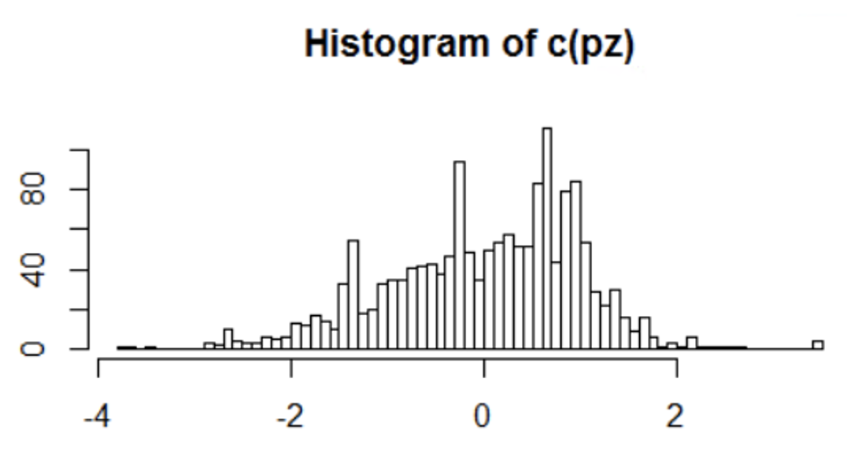
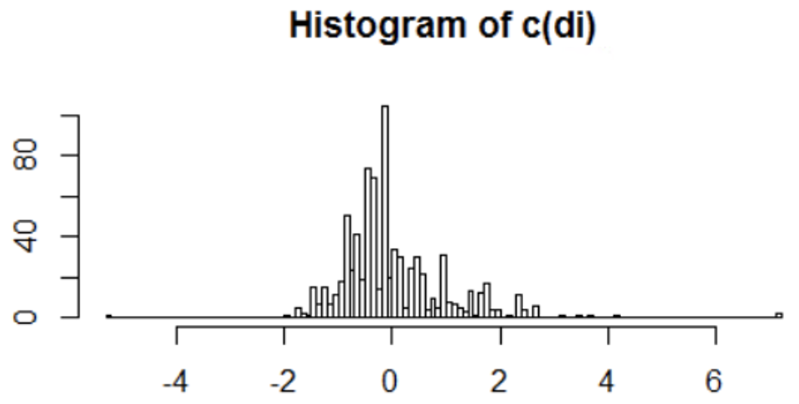
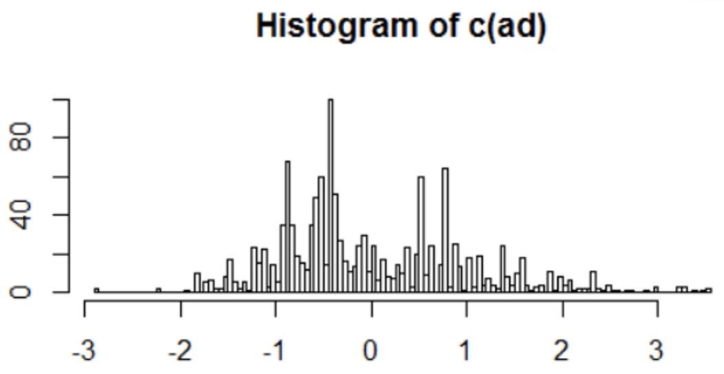
Marketing variables
價格變化：三角形分配，降價長尾。
展示比例：Beta
廣告比例：Beta
- Fitted the IRI’s? F(x)
- 正負：三角形

Slide 9
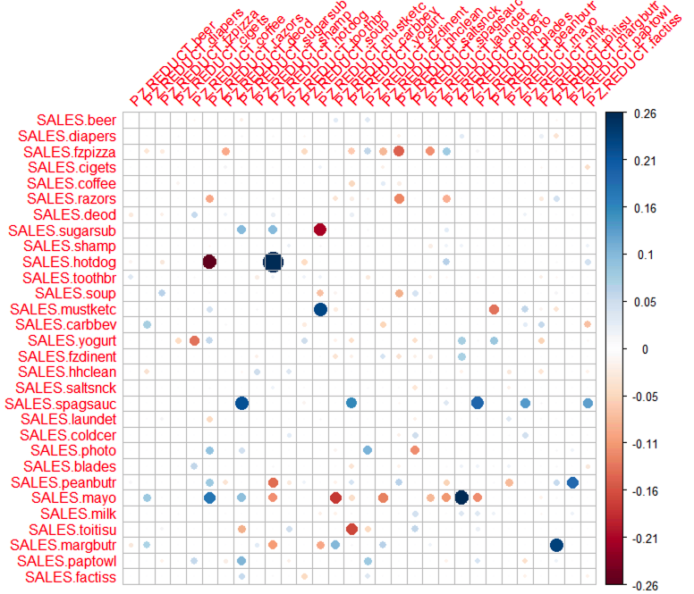
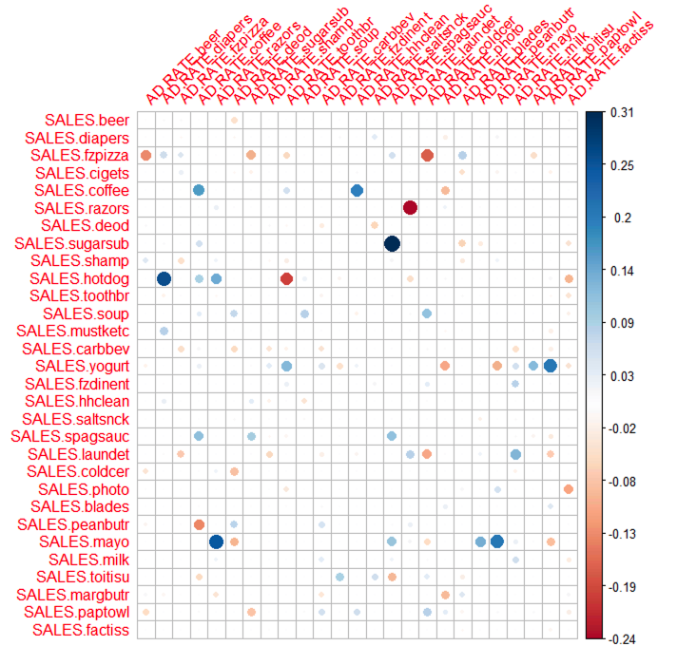
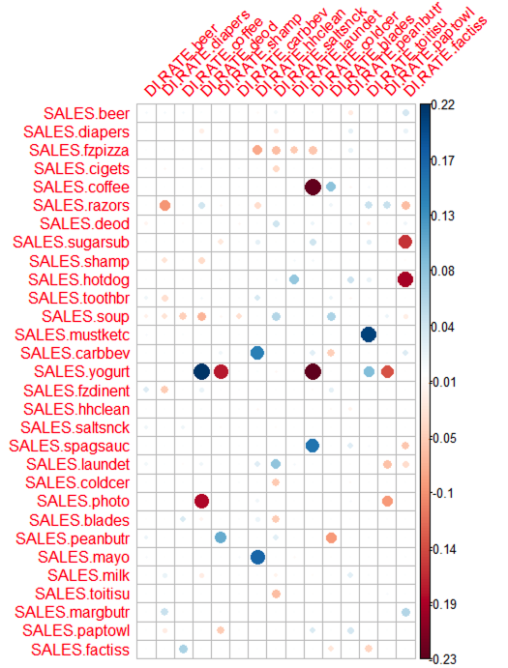

Slide 10
High-dimensional regression in practice: an empirical study of finite-sample prediction, variable selection and ranking
Selection optimal lambda should be larger than prediction consistent.
Prediction optimal lambda include many false positive(0 but predict 1)
Weighted Lasso: Adaptive Lasso/Relaxed Lasso
No overall winner
Statistical significance in high-dimensional linear models
Beta-min assumption /

Slide 11
問題
Training Error << Testing Error
Consist selection and consist prediction depends on lambda
(glmnet)Lambda難決定
(CEoptim)目標式不好訂
最佳化銷售成長非「總銷售額」
模擬有初始bias
ITRI: SKU Sales/SalesG

Slide 12
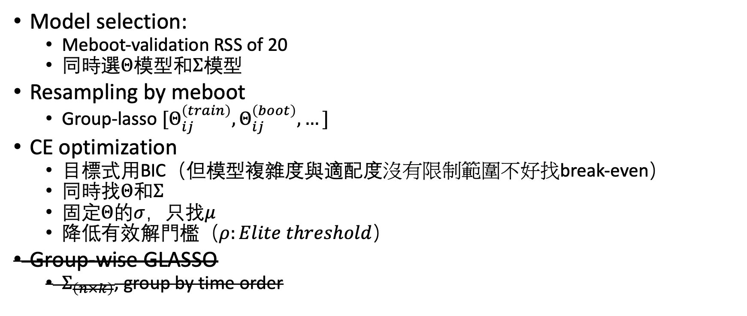
方法
Model selection:
Meboot-validation RSS of 20
同時選$Θ模型和Σ模型$
Resampling by meboot
Group-lasso $[Θ_{ij}^{\left(train\right)}, Θ_{ij}^{\left(boot\right)}, …]$
CE optimization
目標式用BIC（但模型複雜度與適配度沒有限制範圍不好找break-even）
同時找$Θ和Σ$
固定$Θ$的$σ$，只找$μ$
降低有效解門檻（$ρ:Elite threshold$）
Group-wise GLASSO
$Σ_{\left(n×k\right)}$, group by time order

Slide 13
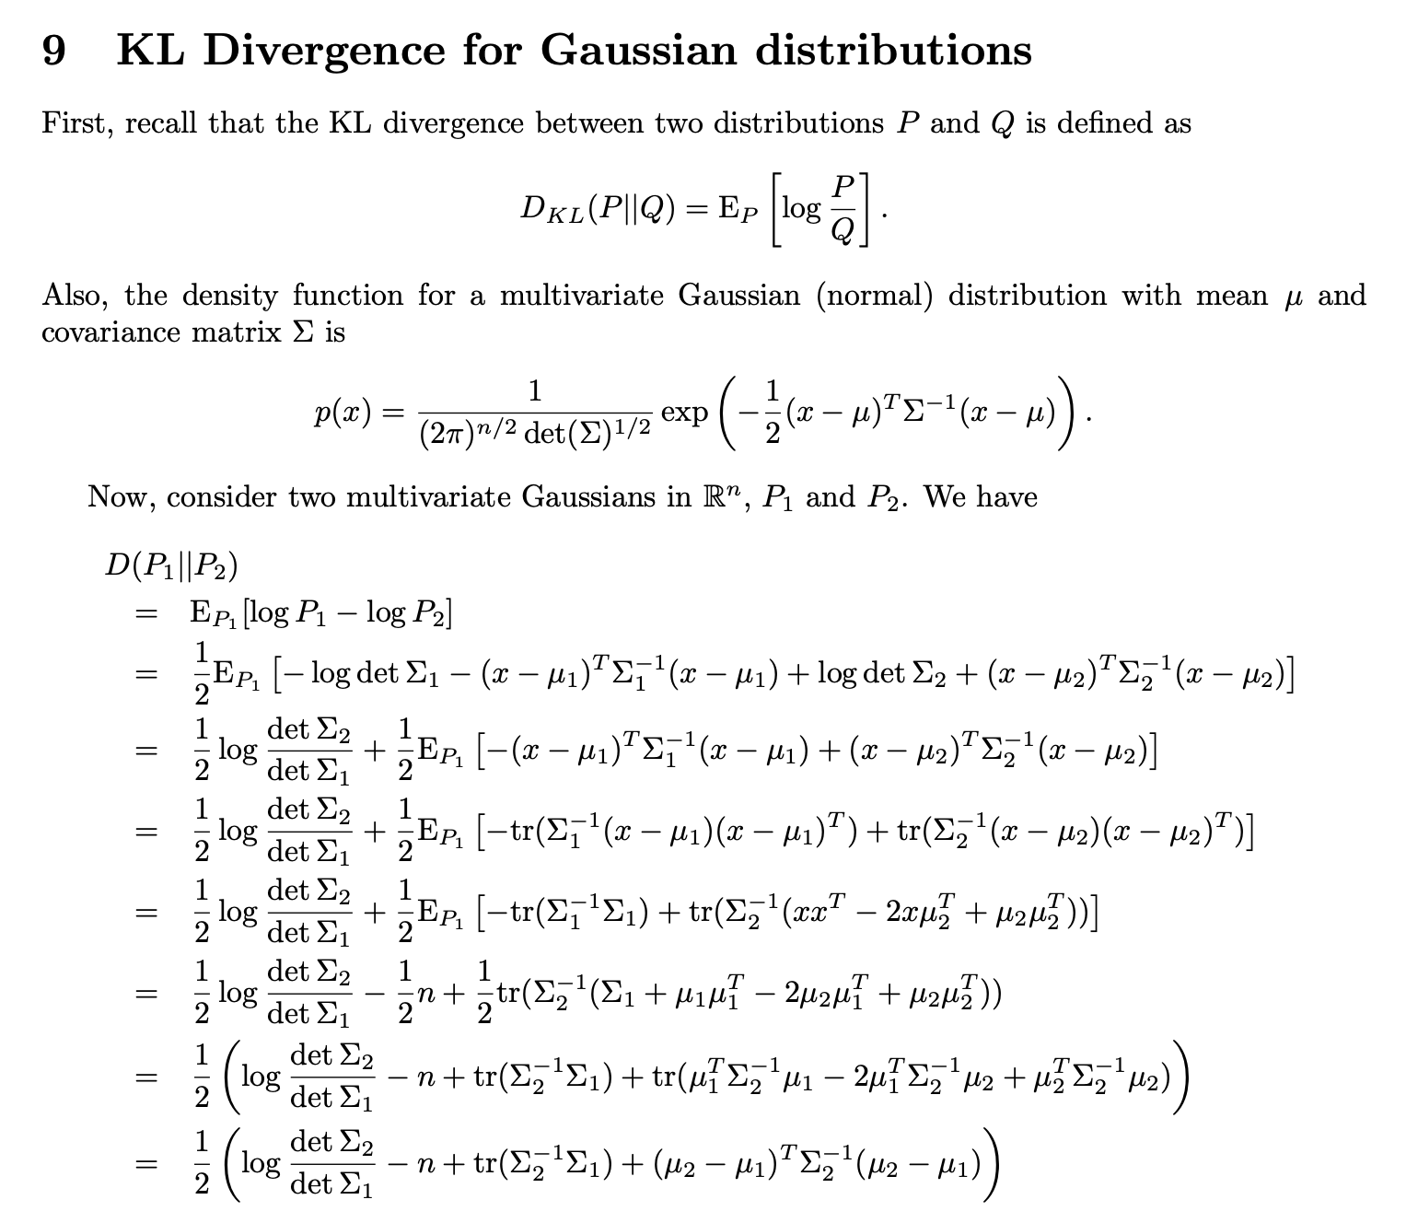
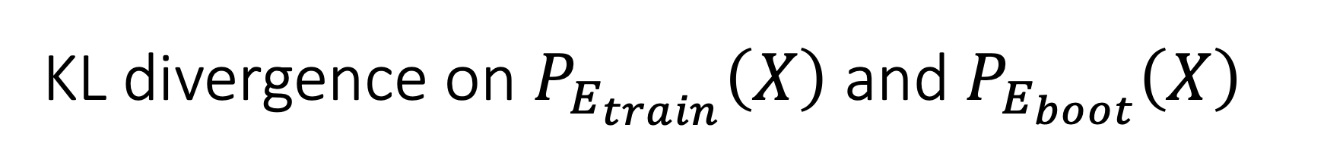
KL divergence on $P_{E_{train}}\left(X\right)$ and $P_{E_{boot}}\left(X\right)$
Select the model which have the shortest sum of the KL distance between bootstrapped and empirical.

