Slide 1
Var.retail
0429

Slide 2
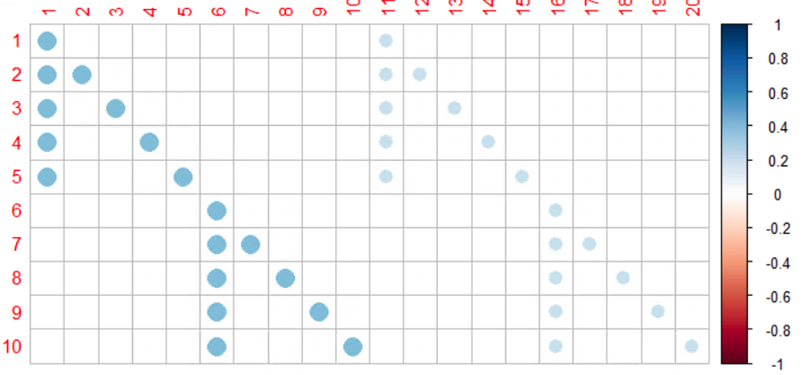
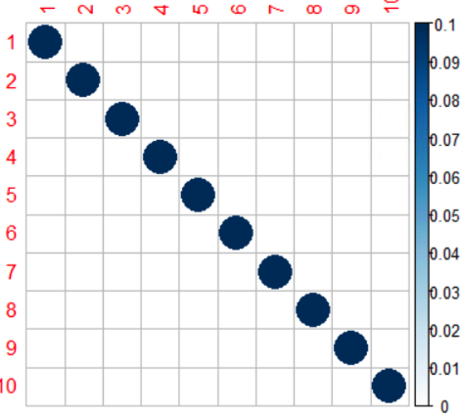

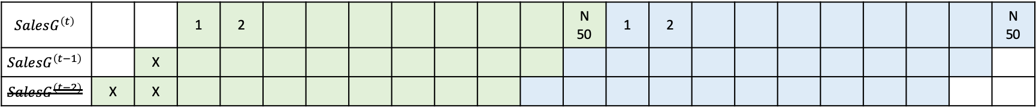
Simulation I: Wilms
$$K=5, p=2, Q_{row}=10, Q_{col}=10∗2$$
$$SalesG^{\left(t\right)}$$ |  |  | 1 | 2 |  |  |  |  |  |  |  | N 50 | 1 | 2 |  |  |  |  |  |  |  | N 50
$$Sale{sG}^{\left(t−1\right)}$$ |  | X
$$Sale{sG}^{\left(t−2\right)}$$ | X | X

Slide 3
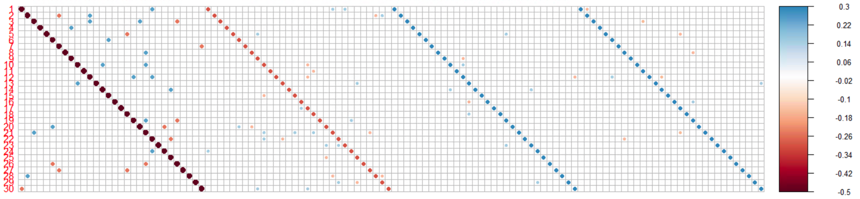
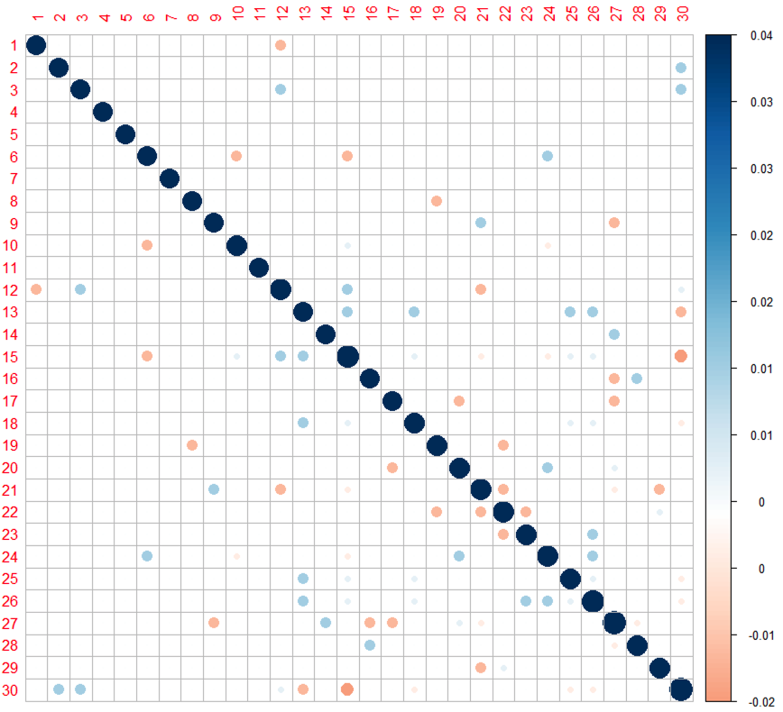
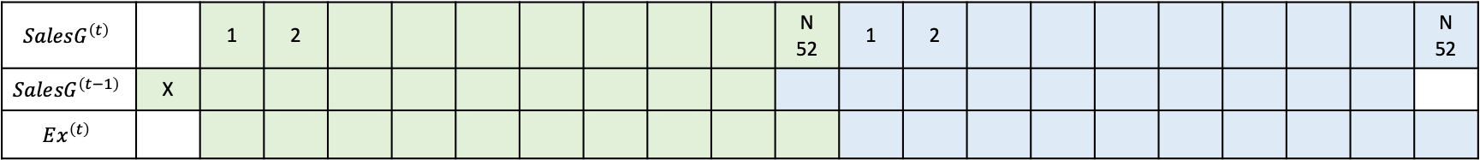
Simulation II: Retail
$$K=30, p=1, Q_{row}=30, Q_{col}=30∗1∗4$$
$$SalesG^{\left(t\right)}$$ |  | 1 | 2 |  |  |  |  |  |  |  | N 52 | 1 | 2 |  |  |  |  |  |  |  | N 52
$$Sale{sG}^{\left(t−1\right)}$$ | X
$$Ex^{\left(t\right)}$$
Simulation III: Retail (Ex-dependent)…”granger caused”

Slide 4
Simulation 1(wilms): 50 runs
Iterative GLS
Model Select | initial | TPR.en | TPR.ex | TNR.en | TNR.ex | MAEE | MAFE.train | MAFE.test
BIC1(scale) BIC1(scale) | X | 0.948 | X | 0.567 | X | 0.064 | 0.259 | 0.291
BIC2(scale) BIC1(scale) | X | 0.951 | X | 0.568 | X | 0.064 | 0.259 | 0.292
CE optimization
Objectives | initial | TPR.en | TPR.ex | TNR.en | TNR.ex | MAEE | MAFE.train | MAFE.test
MSE(C) | X | 0.983 | X | 0 | X | 0.134 | 0.242 | 0.315
MSE(C+Z) | X | 0.798 | X | 0.894 | X | 0.058 | 0.269 | 0.294
MSE(C+Z) | warm | 0.817 | X | 0.901 | X | 0.057 | 0.269 | 0.292
MSE(C+Z)+L0 50% | X | 0.789 | X | 0.900 | X | 0.058 | 0.270 | 0.293
MSE(C+Z)+L0 50% | warm | 0.806 | X | 0.903 | X | 0.057 | 0.269 | 0.291

Slide 5
Simulation 2(hard): 10 runs
Iterative GLS
Model Select | initial | TPR.en | TPR.ex | TNR.en | TNR.ex | MAEE | MAFE.train | MAFE.test
BIC1(scale) BIC1(scale) | X | 0.958 | 0.944 | 0.768 | 0.751 | 0.011 | 0.140 | 0.294
BIC2(scale) BIC1(scale) | X | 0.960 | 0.952 | 0.756 | 0.732 | 0.011 | 0.115 | 0.285
CE optimization
Objectives | initial | TPR.en | TPR.ex | TNR.en | TNR.ex | MAEE | MAFE.train | MAFE.test
MSE(C+Z) | X
MSE(C+Z) | warm

Slide 6
CE optim: Objectives
MSE
Loglikelihood
BIC

