Slide 1
Gradient Descent, Nearest Neighbors
AIML for Engineers
Levent Burak Kara, Kevin Ferguson, Dan Emerson

Slide 2
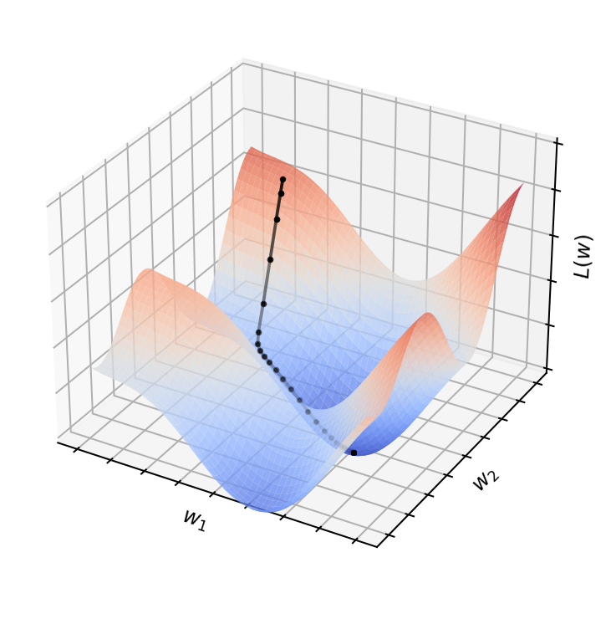
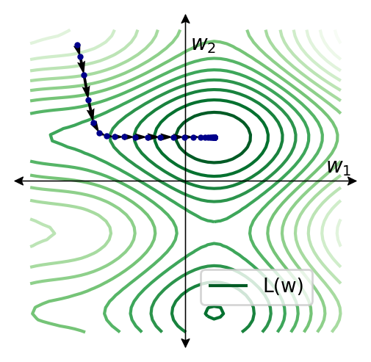

Gradient Descent
Training an ML model will frequently involve finding the minimum of a multi-variate function
GD is an iterative method commonly used for this purpose
This is a 2D function, not 3D
Notes:
In this slide, I want to plots like this. The left one should be a 2D functions, with a 3D render like this. Should be a function more complex than a quadratic function. Some several local minima would be useful
Give the analytical expression for the function you end up using. Like the one I showed as a placeholder.
The right plot should be a top view contour plot
Use L, w1, w2 (not x1, x2)
# Without fractions (don’t use this one)
L(\boldsymbol{w}) = w_1^2/3 + w_2^2/5 - \cos(4 w_1 - 1)/8 - \sin(5 w_2)/5
# With fractions:
L(\boldsymbol{w}) = \frac{w_1^2}{3} + \frac{w_2^2}{5} - \frac{\cos(4 w_1 - 1)}{8} - \frac{\sin(5 w_2)}{5}

Slide 3

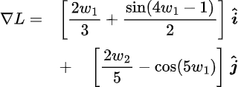

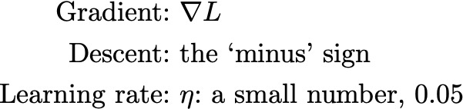
Gradient Descent
Pick a starting point
Find the direction (in the input space w) that results in the fastest decrease in the function value
Take a small step in that direction
Repeat until convergence
Update rule
Notes:
Here, in addition to the analystical expression of L, also provide an analytical expression of grad of L, like my example.
The latex code for the above symbiolic equations was:
\displaystyle \nabla{L} = \frac{\partial L}{\partial w_1} \hat{\textbf{i}} + \frac{\partial L}{\partial w_2} \hat{\textbf{j}} = \left[ { \frac{\partial L}{\partial w_1}, \frac{\partial L}{\partial w_2}} \right]
If you find that useful…
# Gradient:
\nabla{L} =& \left[ \frac{2w_1}{3} + \frac{\sin(4 w_1 - 1)}{2} \right]\;\boldsymbol{\hat{i}}\\
&+\quad\left[ \frac{2w_2}{5} - \cos(5 w_1) \right]\;\boldsymbol{\hat{j}}

Slide 4
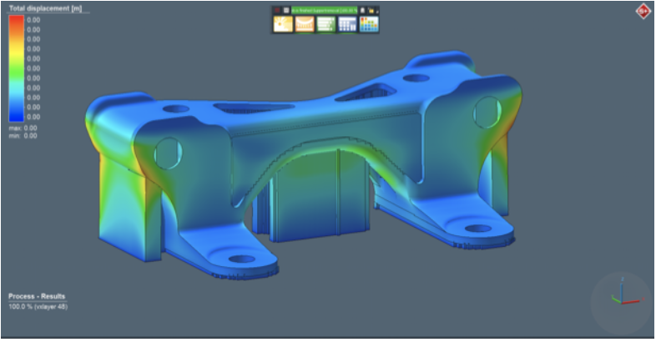
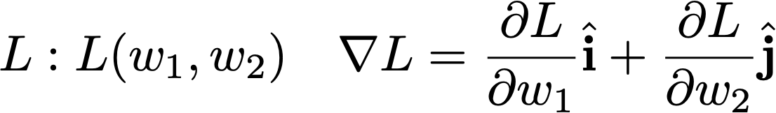
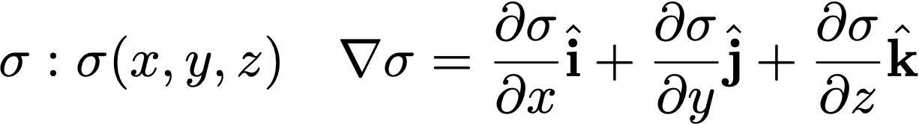
Function Dimensionality
Loss function of a 2-dof ML model
Residual stress on an additively printed part
Notes:
Here, in addition to the analystical expression of L, also provide an analytical expression of grad of L, like my example.
The latex code for the above symbiolic equations was:
\displaystyle \nabla{L} = \frac{\partial L}{\partial w_1} \hat{\textbf{i}} + \frac{\partial L}{\partial w_2} \hat{\textbf{j}} = \left[ { \frac{\partial L}{\partial w_1}, \frac{\partial L}{\partial w_2}} \right]
If you find that useful…
# Gradient:
\nabla{L} =& \left[ \frac{2w_1}{3} + \frac{\sin(4 w_1 - 1)}{2} \right]\;\boldsymbol{\hat{i}}\\
&+\quad\left[ \frac{2w_2}{5} - \cos(5 w_1) \right]\;\boldsymbol{\hat{j}}

Slide 5
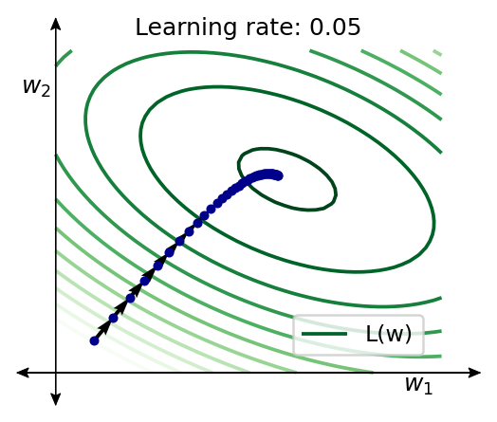
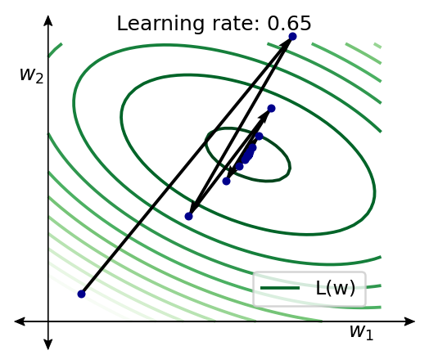
Gradient Descent
Uses only the first derivative information
May get stuck in a local minimum
Saddle points introduce challenges
η too small: May converge too slowly
η too big: May oscillate around minima
Can start with a large η , then gradually decrease it over the iterations.
There are more advanced versions of GD
Momentum methods, acceleration
Second order methods: Newton-Raphson
Notes:
In this example, can you show two examples of a GD (on a quadratic function is fine), top view contour plot.
For a small learning rate, we should see many small steps.
For a large lerning rate we should see large steps and osciallations/
Similar to the ones shown on a 1D example here: https://towardsdatascience.com/gradient-descent-algorithm-a-deep-dive-cf04e8115f21
And
https://www.cs.toronto.edu/~rgrosse/courses/csc2541_2021/slides/lec07.pdf

Slide 6
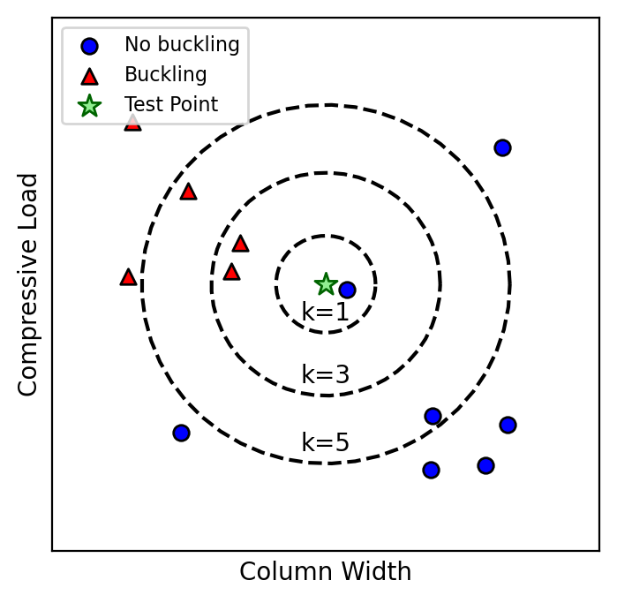
K - Nearest Neighbor Classification
Make class decisions based on the nearest training point(s).
k is the number of nearest training points considered.
The simplest ML model we will see
Choose a k value (usually problem dependent)
Given a test point, find the k nearest training points to the test point.
For distance calculations, L2 is common
Label test point with the majority vote of the NN training point labels
n-ties can be broken by an n sided coin-flip
Notes:
Re-draw this plot Use smaller dots, like your red and black. Data set can be made up or can be one of the context problems you have used already.

Slide 7
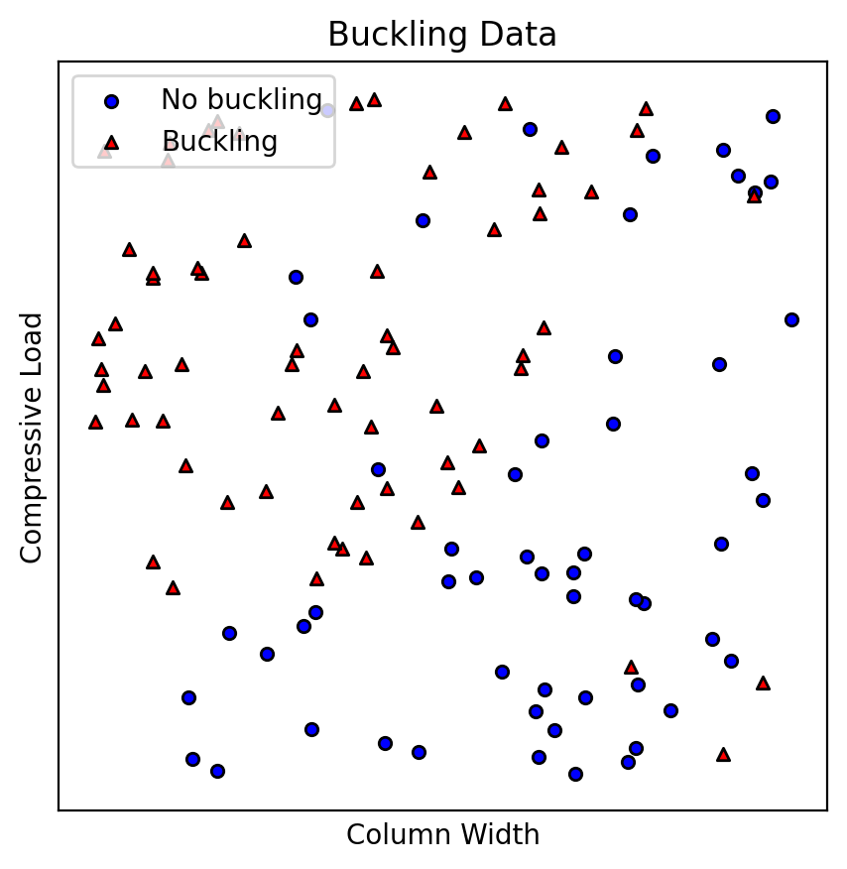
K - Nearest Neighbor Classification
Notes:
See the next slide. This slide should include an non classified original training data. I will show a green decision boundary that a human may come up with. If the data changes, we will change the curve obviously.

Slide 8
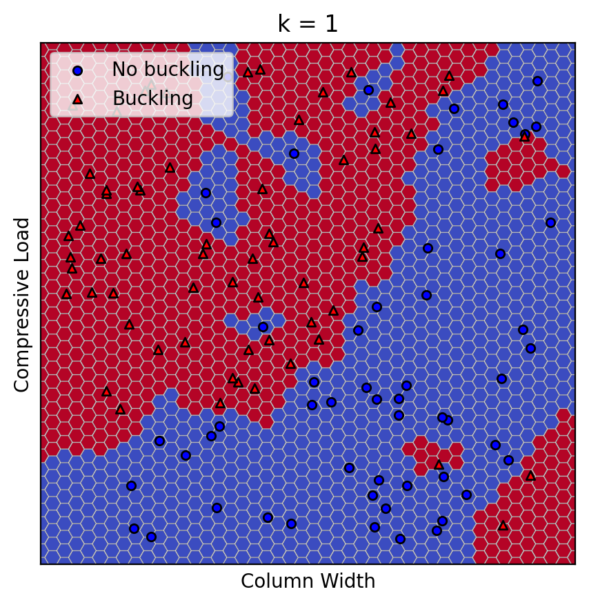
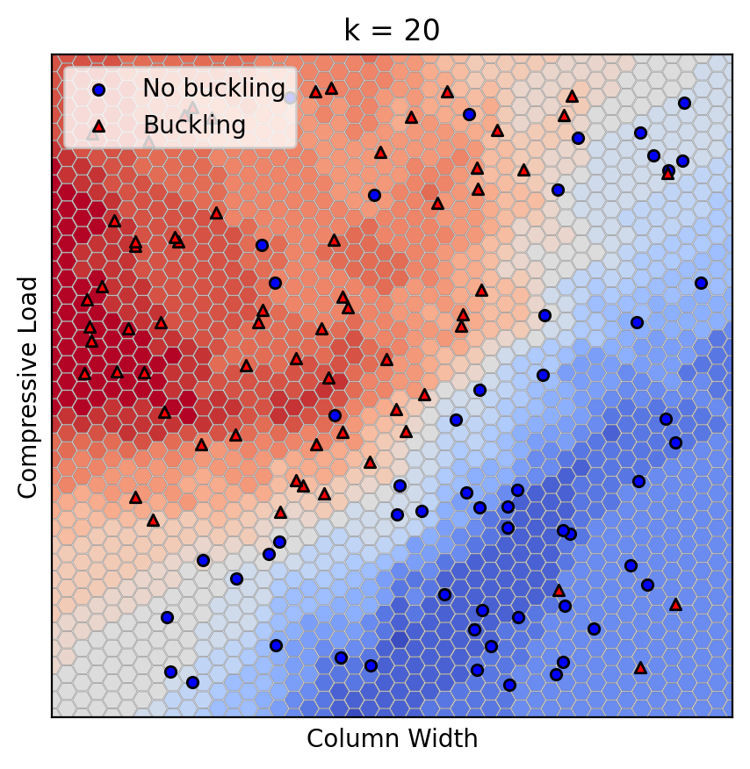
K - Nearest Neighbor Classification
Small k can make decisions too sensitive to noise
Large k may cause too much smoothing
Notes:
Show an example. Many points should be here. I want to show that with 1 NN, things can get noisy (see the example I mention here, but we should use a different context. See the document Understanding the Bias-Variance Tradeoff.pdf. This is from the website: https://scott.fortmann-roe.com/docs/BiasVariance.html see the interactive slider there.
I like the hex pattern here but If generating this type of hex pattern is too difficulty with Python, we can use this example directly.

Slide 9
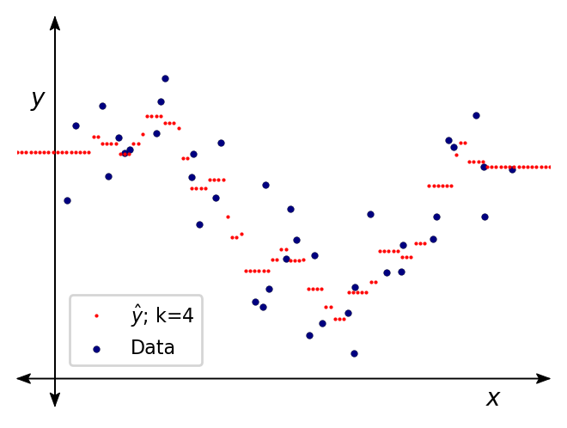
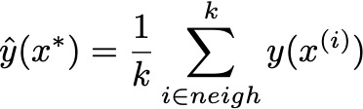
K - Nearest Neighbor Regressor
Conceptually very similar to k-NN classifier
The output value of a test point x* is determined by the values of the training points in the vicinity (k-neighborhood) of the test point
{x, y}: Training data with input values x and output values y
Also see LOESS (locally estimated scatterplot smoothing)
Unweighted regression
All neighborhood points have the same influence on the result
4-NN unweighted regression
Notes:
Use a plot similar to this one. In here, I would like the blue points to be labelled as y. I want the red curve to actually consists of - not a line - , but a bunch of small red dots. I would like to still label that as y _hat. This is to derive home the idea that in NN regression, there is no underlying function.
This function may look somewhat like several steps (unweighted NN)
Also,
Instead if X_1 use x for simplicity here. We will get into the super script vs subscript in the LLS module.

Slide 10
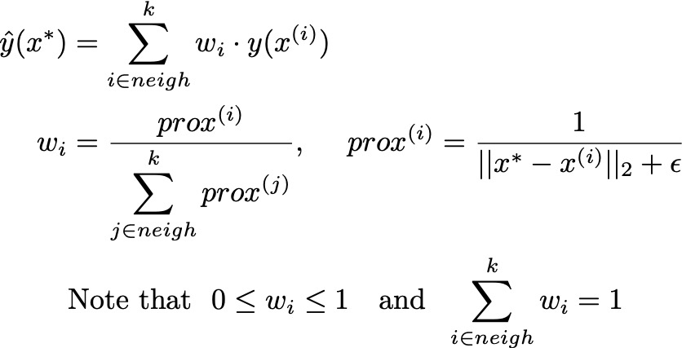
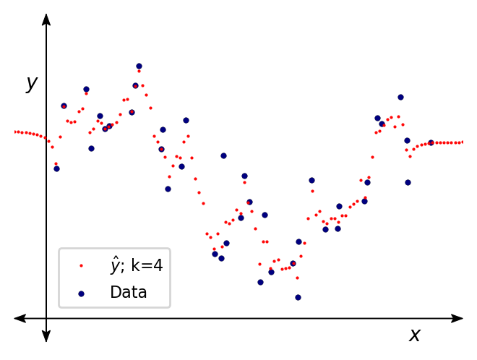
K - Nearest Neighbor Regressor
Weighted regression
Neighbors closer to x* (i.e. greater proximity prox) have a greater influence (w_{i})
𝟄: a small num, say 10⁻⁶ , to avoid division by zero
4-NN weighted regression
Notes:
Like the previous slide, but now if we used weighted kNN regression, the curve may look smoother.

Slide 11
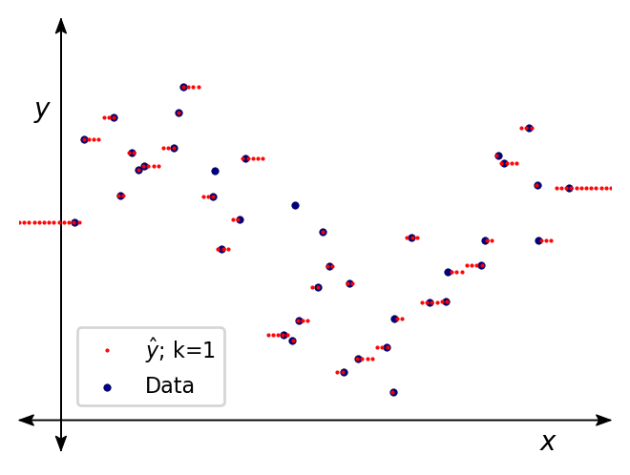
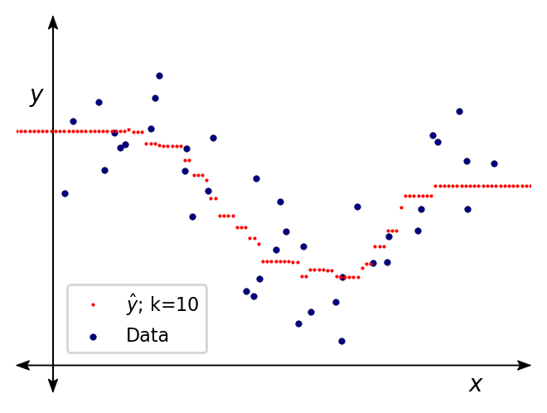
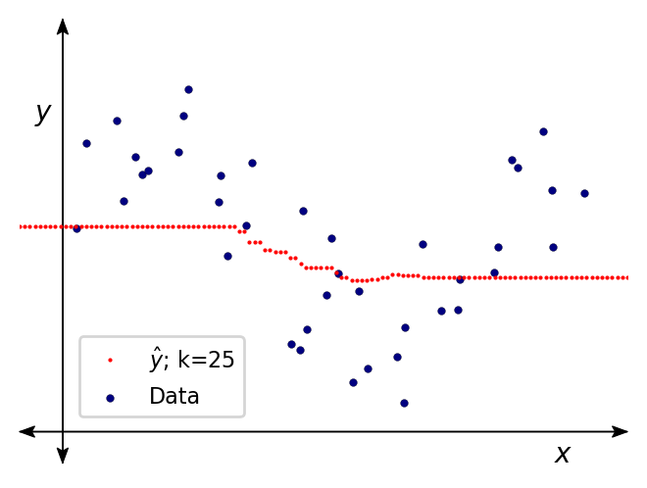
K - Nearest Neighbor Regressor
1-NN unweighted regression
10-NN unweighted regression
25-NN unweighted regression
Notes:
In this slide, I want to show three plots side by side. Same training data in both case. 1NN should create overfitted, step like responses. 3 NN should be the ‘best’ fit. 10NN should be too smooth.
The data here can be as noisy as the one shown here: https://en.wikipedia.org/wiki/Local_regression#/media/File:Loess_curve.svg
If 3 is not good, can try 2, 4, 5 etc. Can you sklearn in but functions/ .

Slide 12
K - Nearest Neighbor: Discussions
Non-parametric (no underlying functional model)
Simple to implement and interpret
Can be memory intensive and slow
For every new test points, the nearest neighbors in the training set have to be found
But space partitioning schemes such as KD-trees can accelerate this
Finding the ‘best’ k may require trial-and-error.
k too small. Overfits to noise.
k too large: Too much smoothing

